Slide 1
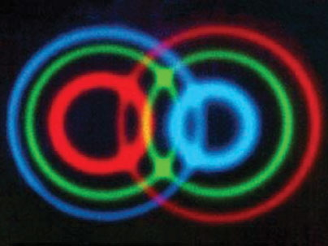
Bell’s inequalities and their uses
The Quantum Theory of Information and Computation
http://www.comlab.ox.ac.uk/activities/quantum/course/
Mark Williamson
mark.williamson@wofson.ox.ac.uk
10.06.10

Slide 2
Aims of lecture
Local hidden variable theories can be experimentally falsified.
Quantum mechanics permits states that cannot be described by local hidden variable theories – Nature is weird.
We can utilize this weirdness to guarantee perfectly secure communication.

Slide 3
Overview
Hidden variables – a short history
Bell’s inequalities as a bound on `reasonable’ physical theories
CHSH inequality
Application – quantum cryptography
GHZ paradox

Slide 4
Hidden variables – a short history
Story starts with a famous paper by Einstein, Podolsky and Rosen in 1935.
They claim quantum mechanics is incomplete as it predicts states that have bizarre properties contrary to any `reasonable’ complete physical theory.
Einstein in particular believed that quantum mechanics was an approximation to a local, deterministic theory.
Analogy: Classical statistical mechanics approximation of deterministic, local classical physics of large numbers of systems.

Slide 5
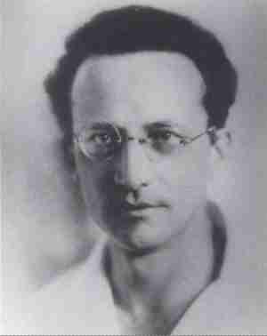
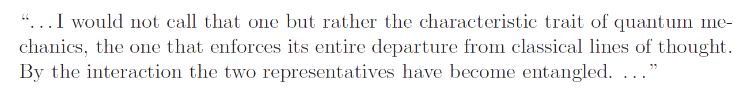
EPRs argument used the peculiar properties of states permitted in quantum mechanics known as entangled states.
Schroedinger says of entangled states:
E. Schroedinger, Discussion of probability relations between separated systems. P. Camb. Philos. Soc., 31 555 (1935).

Slide 6
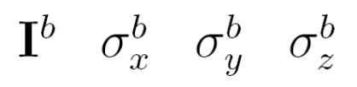
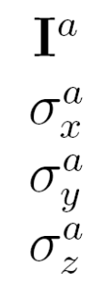
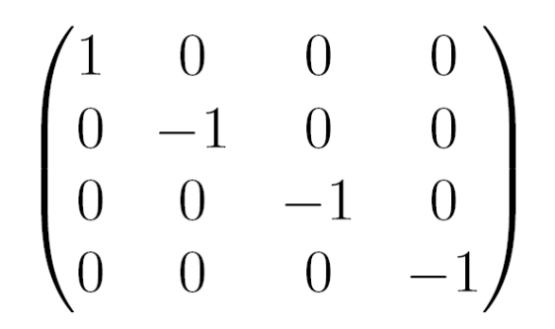
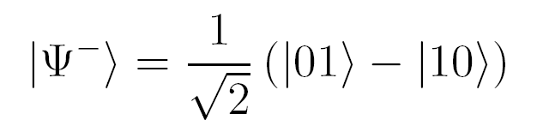
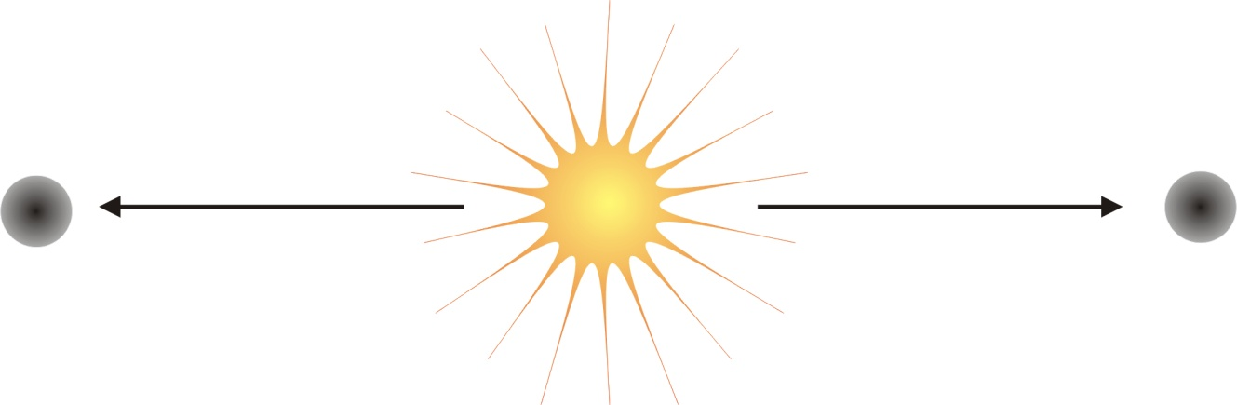






Entangled states
Observation: QM has states where the spin directions of each particle are always perfectly anti-correlated.

Slide 7
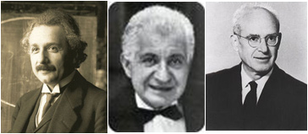
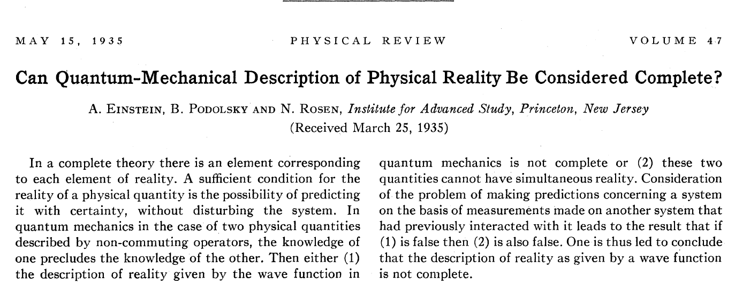
Einstein, Podolsky and Rosen (1935)
EPR use the properties of an entangled state of two particles a and b to engineer a paradox between local, realistic theories and quantum mechanics

Slide 8
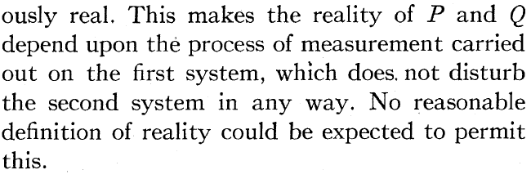
Einstein, Podolsky and Rosen
Roughly speaking: If a and b are two space-like separated particles (no causal connection between the particles), measurements on particle a should not affect particle b in a reasonable, complete physical theory.
Either
Quantum mechanics is incomplete (there is a deeper theory describing the behavior of the systems).
There is no reality: The systems do not possess actual values until they are measured (no elements of reality).

Slide 9
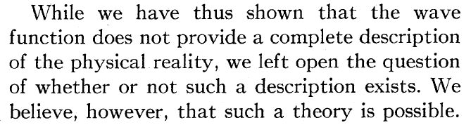
Assumptions in their argument:
locality – no influence between space-like separated events.
realism – properties of objects exist in some sense independent of measurement choice.
free will of experimenter – we can chose what we measure independently of the particular state we are measuring.
EPR favor (i):
In particular they favor a local, deterministic theory. Theories of this type belong to a class called local hidden variable theories.

Slide 10
Q: Is there a deeper theory reproducing quantum mechanics – any hidden variable* theories consistent with predictions of QM?
* A hidden variable theory is a larger set of theories (weaker) than a local hidden variable theory.

Slide 11
What are hidden variable theories?
Hidden variable theories:
The behavior of the states in the theory are not only governed by measurable degrees of freedom but have additional ‘hidden’ degrees of freedom that complete the description of their behavior.
‘Hidden’ because if states with prescribed values of these variables can be prepared or manipulated then predictions of the theory would be in contradiction with experiments.
As applied to quantum mechanics:
Wave function or state vector not a complete description of the physical state of a system.
Complete description would also include the specification of the hidden variables describing that state.
If one could prepare quantum states with prescribed values of that hidden variable or manipulate them at will, quantum mechanical predictions would disagree with experiments. Beyond quantum theory…

Slide 12
Q: Is there a deeper theory reproducing quantum mechanics – any hidden variable theories consistent with predictions of QM?
A: John Von Neumann says no.

Slide 13
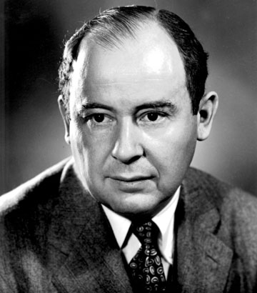
No hidden variables - Von Neumann (1932)
Gave a proof that no hidden variable theory could reproduce quantum mechanics (before EPR it seems).
His argument according to Bell:
‘Any real linear combination of any two Hermitian operators represents an observable, and the same linear combination of expectation values is the expectation value of the combination.’
Refs: J. Von Neumann, Mathematical Foundations of Quantum Mechanics, Princeton University Press (1932)
J. S. Bell, On the problem of hidden variables in quantum theory, Rev. Mod. Phys. 38, 447 (1966)

Slide 14
Q: Von Neumann’s assumption is true for quantum mechanics but is it necessary for any theory reproducing quantum mechanics?
A: Not according to Bohm!

Slide 15
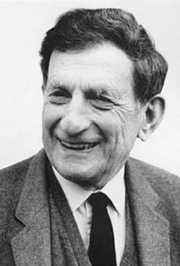
An explicit hidden variable theory – Bohm (1952)
In 1952 Bohm constructs a hidden variable theory that reproduces quantum mechanics – de Broglie-Bohm mechanics.
Von Neumann is wrong…
Price to pay – the hidden variable theory he constructs is nonlocal.
Bohm’s model is not of the desire of EPR who want a local, hidden variable theory.
Ref: D. Bohm, A suggested interpretation of the quantum theory in terms of hidden variables. Phys. Rev. 85, 166 (1952)

Slide 16
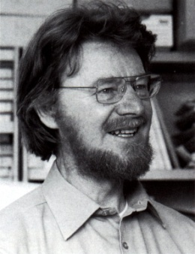
Enter Bell (1964)
Up until this point all discussion was metaphysics. No testable consequences for any particular picture of Nature.
Bell’s work changed this.
He showed any realistic, local hidden variable theory predicts different results to quantum mechanics.
Our pictures of Nature could be experimentally falsified.
Ref: J. S. Bell, On the Einstein-Podolsky-Rosen paradox. Physics 1, 195, (1964)

Slide 17
Bell inequalities
Bell takes EPRs argument as a working hypothesis, that a local hidden variable theory exists, reproducing the results of QM and tries to derive experimental consequences.
That is, he assumes
locality – no influence between space-like separated events.
realism – properties of objects exist in some sense independent of measurement choice.
free will of experimenter – we can choose what we measure independently of the particular state we are measuring.

Slide 18
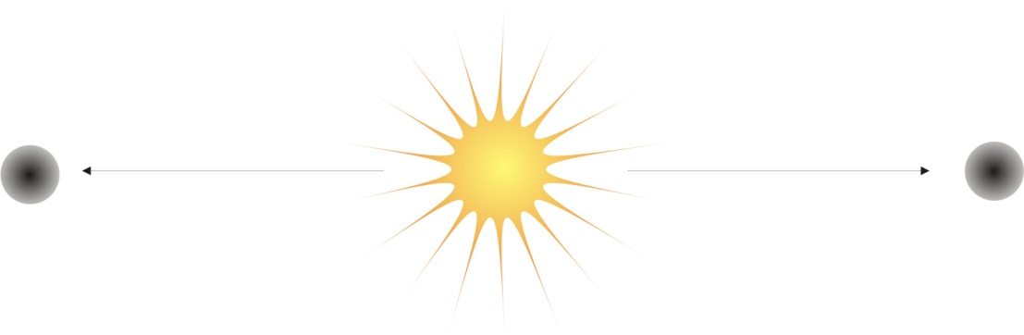
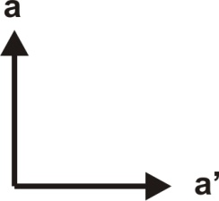
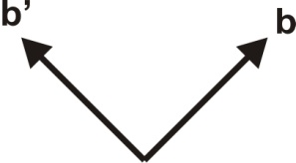
Bell’s inequalities – The CHSH* inequality
Perform experiment N times, each trial labelled by n.
Two measurement settings on each particle represented by vectors a, a’ and b, b’
Measurement outcomes labelled a_{n}, a_{n}’ and b_{n}, b_{n}’.
There can be two measurement outcomes with value 1 or -1
Assume each measurement reveals a pre-existing property (realism)
Assume measurement outcome on one of particles not influenced by measurement setting on the other particle (locality)
Assume measurement setting chosen independent of state of particles (free will)
* J. F. Clauser, M. A. Horne, A. Shimony and R. A. Holt. Proposed experiment to test local hidden-variable theories. Phys. Rev. Lett. 23, 880 (1969)

Slide 19
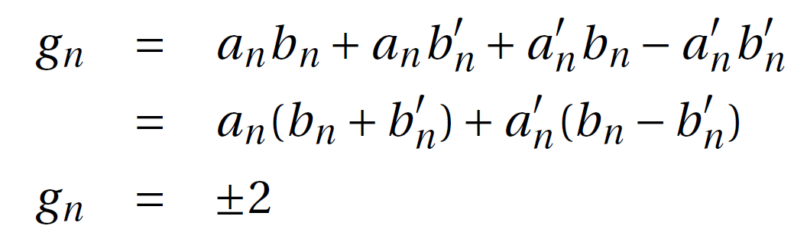
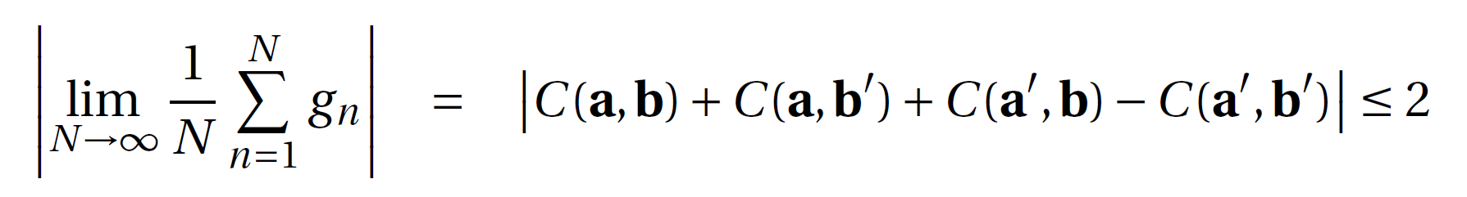
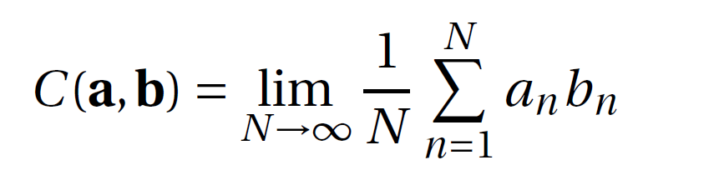
Bell’s inequalities – The CHSH* inequality
Consider the quantity g_{n}, a combination of the measurement outcomes on the nth trial:
The expectation value is therefore
* J. F. Clauser, M. A. Horne, A. Shimony and R. A. Holt. Proposed experiment to test local hidden-variable theories. Phys. Rev. Lett. 23, 880 (1969)

Slide 20
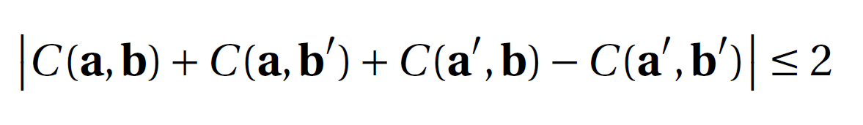
Bell’s inequalities – The CHSH* inequality
Note that in deriving the CHSH inequality we have not assumed any particular theory, only that it has to be a local, realistic theory. This is the power, generality and simplicity of the result. It provides a bound on any theory of this type.
Q: What does QM predict for the expectation values?
* J. F. Clauser, M. A. Horne, A. Shimony and R. A. Holt. Proposed experiment to test local hidden-variable theories. Phys. Rev. Lett. 23, 880 (1969)

Slide 21
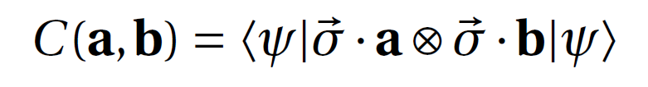
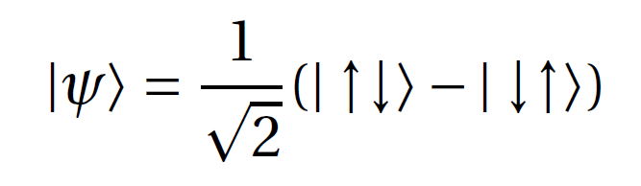
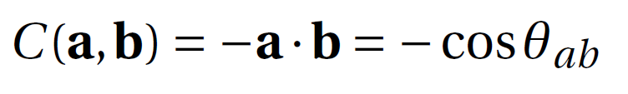
Consider measuring the spin of each particle, when each particle has spin ½.
Choose two different measurements of spin in different spatial directions on the first particle, these are given by vectors a and a’
Do likewise for the second particle, b and b’
In QM expectation value for a measurement of spin in direction a on first particle and direction b on second given by
Now assume the source produces the singlet (maximally entangled) state in every trial

Slide 22
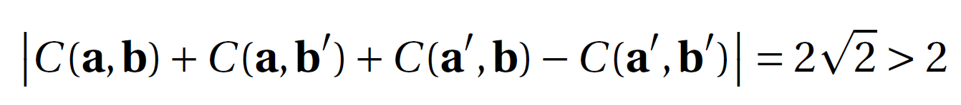
Choose to arrange the measurement directions such that
In that case
Conclusion: QM (or more precisely the singlet state) cannot be described by a local realistic model.
Q: Do singlet states exist in the real world and do they violate the Bell inequality?
A: Experiments have confirmed that QM can violate the Bell inequality (but always with loop holes).

Slide 23
The key property of QM allowing this violation is entanglement.
Key point: A measurement on one particle of singlet state affects the state of the other, even if they are space-like separated.

Slide 24
Implications
Which assumption is incorrect?
Locality?
Realism?
Free will?
Some or all of them?
Some people like to say quantum mechanics is realistic but nonlocal.
Others like to say measurements bring reality into being.
At the moment it is a matter of personal preference until we can derive experimentally falsifiable predictions. Either way Nature is weird!
Q: If Nature really behaves in this way, why don’t we experience it in everyday life? Trying to answer this leads to the Pandora’s box of quantum mechanical interpretations…

Slide 25
Caveats
Entanglement is necessary for violation of a Bell inequality but it is not known whether all entangled states violate some sort of Bell inequality
entanglement = nonlocality?
No loophole free Bell inequality experiment has been performed:
Sampling
Space-like separation
Free will!

Slide 26
Quantum Cryptography
Using the weirdness for something useful

Slide 27
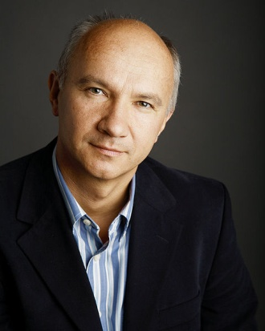
Quantum cryptography based on Bell’s theorem
Ekert 91
Better called quantum key distribution
A way of distributing a key to encode a message without an eavesdropper gaining any information on the key.
The security is guaranteed by quantum theory, violation of a Bell inequality is the insurance that no third party has the key.
Ref: A. K. Ekert, Quantum Cryptography based on Bell’s theorem, Phys. Rev. Lett. 67, 661 (1991)

Slide 28

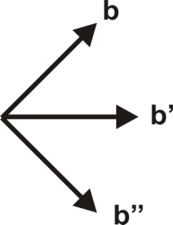
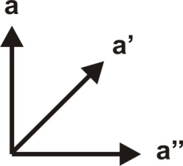


Eve
Alice
Bob
Protocol:
One half of each singlet state is sent to Alice and Bob.
Alice and Bob agree to measure each of their spins in one of 3 different directions chosen randomly by both of them (these directions are agreed before hand).
They repeat this process N times and record which measurement setting they used and the result.

Slide 29
Eve
Alice
Bob
Protocol (contd.):
After this they tell each other publicly which measurement settings they used on each trial but not their measurement results. Eve can listen to this information.
When Alice and Bob find they have used the same measurement settings they know that their results are completely anti-correlated. This happens on average in 2/9 of the trials. They now share a random key between them that they can use to encrypt a message.

Slide 30
Eve
Alice
Bob
Protocol (contd.):
Alice and Bob can check for an eavesdropper by checking whether a Bell inequality is violated in the trials they did not use the same measurement settings.
If there is a violation they know Eve cannot have any information on their key. This is because if Eve has made a projective measurement, she will have brought definite values into existence. The state will no longer be entangled and it can be described by a local, hidden variable model.

Slide 31
More specifically…

Slide 32
GHZ paradox
A Bell inequality without probabilities for 3 or more qubits.
See N. D. Mermin, Quantum mysteries revisted, Am. J. Phys. 58, 731 (1990) for a beautiful non-technical account.
See N. D. Mermin, Extreme quantum entanglement in a superposition of macroscopically distinct states, Phys. Rev. Lett. 65, 1838 (1990) for the technical version.

Slide 33
Summary
Bell inequalities provide bounds on local, realistic models
Quantum mechanics violates this bound so it is not a realistic, local theory
Can use this fact to guarantee perfect communication security – quantum cryptography
GHZ argument provides a direct contradiction without use of probabilities

Slide 34
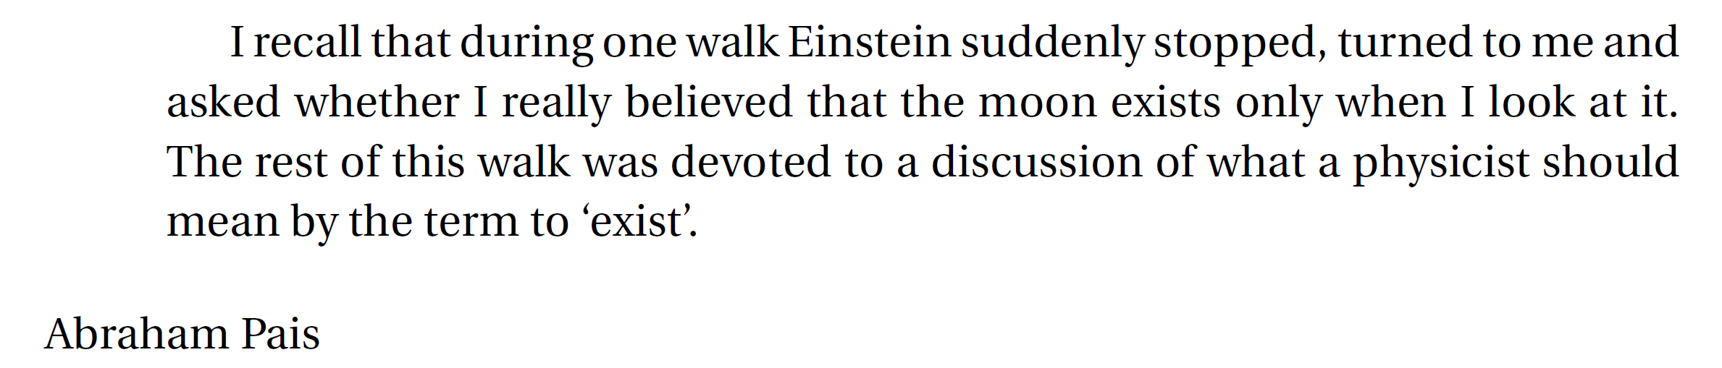
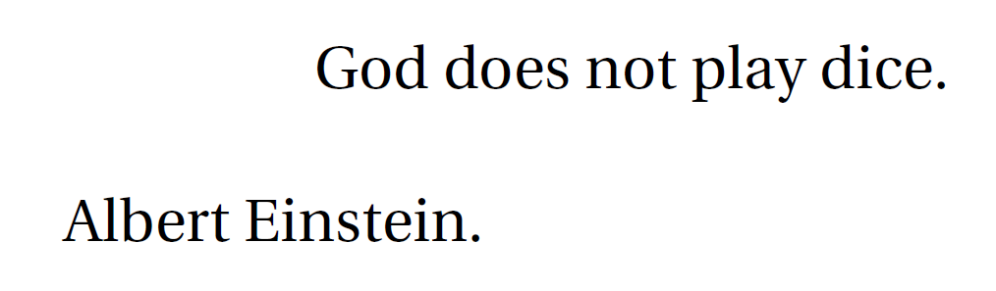
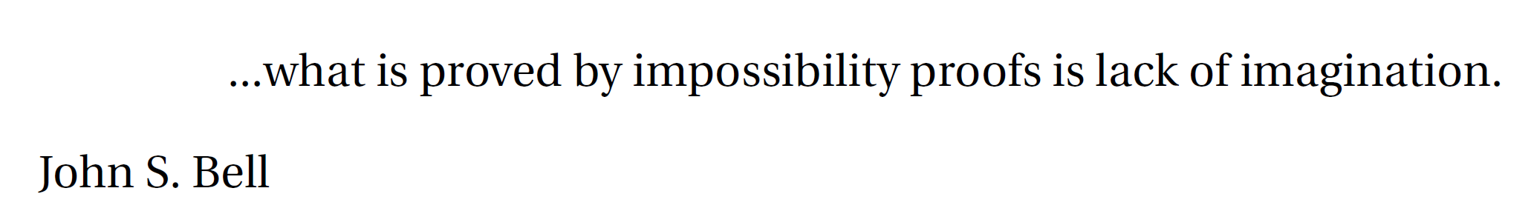

Slide 35
References
E. Schroedinger, Discussion of probability relations between separated systems. P. Camb. Philos. Soc., 31 555 (1935).
A. Einstein, B. Podolsky and N. Rosen. Can quantum-mechanical description of reality be considered complete? Phys. Rev. 47, 777 (1935).
J. Von Neumann, Mathematical Foundations of Quantum Mechanics, Princeton University Press (1932)
J. S. Bell, On the problem of hidden variables in quantum theory, Rev. Mod. Phys. 38, 447 (1966)
D. Bohm, A suggested interpretation of the quantum theory in terms of hidden variables. Phys. Rev. 85, 166 (1952)
J. S. Bell, On the Einstein-Podolsky-Rosen paradox. Physics 1, 195, (1964)
J. F. Clauser, M. A. Horne, A. Shimony and R. A. Holt. Proposed experiment to test local hidden-variable theories. Phys. Rev. Lett. 23, 880 (1969)
A. K. Ekert, Quantum Cryptography based on Bell’s theorem, Phys. Rev. Lett. 67, 661 (1991)
N. D. Mermin, Quantum mysteries revisted, Am. J. Phys. 58, 731 (1990)
N. D. Mermin, Extreme quantum entanglement in a superposition of macroscopically distinct states, Phys. Rev. Lett. 65, 1838 (1990)
J. S. Bell, Speakable and Unspeakable in Quantum Mechanics, Cambridge University Press (1987).
M. Redhead, Incompleteness, Nonlocality and Realism: A Prolegomenon to the Philosophy of Quantum Mechanics, Clarendon Press, Oxford (1987).

