Slide 1
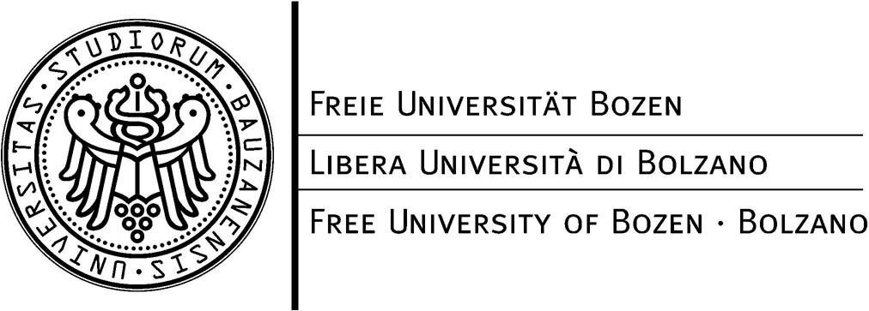

Evolution of DL-Lite
Knowledge Bases
D. Calvanese, E. Kharlamov,
W. Nutt, and D. Zheleznyakov
Free University of Bozen-Bolzano
ISWC, Shanghai
November, 2010

Slide 2
Description Logics (DLs)
DL Knowledge Base:
  Concepts are
  classes of objects
  Roles are
  relations between objects
  TBox is
  for structure of the knowledge
  ABox is
  for instances of concepts and roles
TBox:
Cleric
Husband
Priest
ABox:
Carl
Bob
John
Adam
This is a formalism underlying ontologies
2/31
Notes:
picture

Slide 3
Knowledge Base
Concepts:
Roles:
TBox:
ABox:
Wife, Husband, Single, Woman, Priest
HasHb
Wife ⊑ Woman
Wife ≡ ∃HasHb
Husband ≡ ∃HasHb–
Husband ⊑ ¬ Single
Priest ⊑ Single
Husband ⊑ ¬ Priest
Wife(Mary),
hasHb(Mary,John)
Priest(Adam), Priest(Bob)
Single
Husband
John
1..n
(Mary, John)
hasHb
Priest
Adam Bob
1..n
Woman
Wife
Mary
3/31
Notes:
explain notation, connect with UML diagrams
running example → KB or smth
relation – no arrows
diamond – smaller or delete(!)
instances – another step

Slide 4
What if There Is New Information?
New Inormation N:
Single(John)
How should the KB evolve?
Single
Husband
John
John
1..n
(Mary, John)
hasHb
Priest
Adam Bob
1..n
Woman
Wife
Mary
4/31
Notes:
explain notation, connect with UML diagrams
running example → KB or smth
relation – no arrows
diamond – smaller or delete(!)
instances – another step

Slide 5
DLs and Semantic Web
Ontology Web Language (OWL) is W3C recommendation for SW
  DLs provide foundation for OWL
DL-Lite: tractable fragment of DL
  PTime reasoning
  essentially Horn Logic
  tractable profile of OWL 2 QL
5/31
Notes:
first – story about John, Mary, et al, then the rest

Slide 6
Why Is Evolution Interesting?
Application domains are modeled using
Ontologies/OWL
  The state of the domain change
  New facts about domain appear
Web Services change information
represented through Ontologies
  How does the Ontology change?
6/31
Notes:
first – story about John, Mary, et al, then the rest

Slide 7
Outline
Requirements for an evolution operator
Attempt to apply classical approaches
  Model-Based approaches
  Formula-Based approaches
Our proposal
  Bold Semantics
  Careful Semantics
Conclusion

Slide 8
Conceptual Requirements
Old Knowledge:
New Knowledge:
Evolved Knowledge:
Single
Husband
John
Cleric
Single
Husband
John
RentSub
hasHb
RentSub
hasHb
Minister
Carl
Priest
Adam Bob
Cleric
1..n
1..n
Wife
Mary
Minister
Carl
Priest
Adam Bob
Wife
Mary
DL-Lite KB
Evolution Operator
DL-Lite KB
Evolved knowledge should
be consistent – no logical contradictions
be coherent – no empty concepts
entail New Knowledge
minimally different from the old KB – principle of minimal change
Priest(Bob)∧¬Priest(Bob) ☒
Priest ⊑ Single
Priest ⊑ ¬Single
☒
8/31
Notes:
useless components? empty concepts? explain coherency
protected data?

Slide 9
Technical Requirements
Closure under evolution:
Evolution result should be expressible in DL-Lite
Efficiency:
Evolution result should be computable in PTime
9/31

Slide 10
Can Previous Work Help?
Knowledge evolution
was studied by the AI community
Primarily for Propositional Logic (PL)
Two main types of approaches to evolution in PL:
  Model-Based Approaches (MBAs)
  operate with set of models
  Formula-Based Approaches (FBAs)
  operate with set of formulas
Which of them are applicable to DL-Lite evolution?
10/31

Slide 11
Outline
Requirements for an evolution operator
Attempt to apply classical approaches
  Model-Based approaches
  Formula-Based approaches
Our proposal
  Bold Semantics
  Careful Semantics
Conclusion

Slide 12
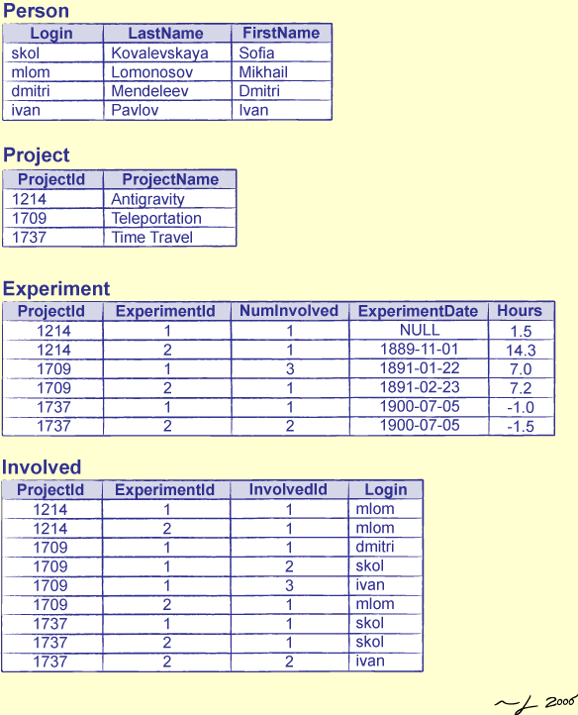
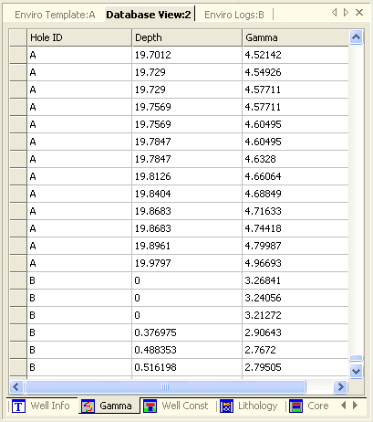
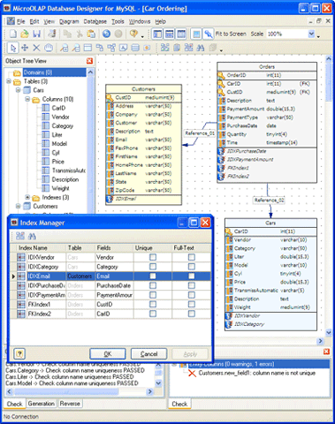

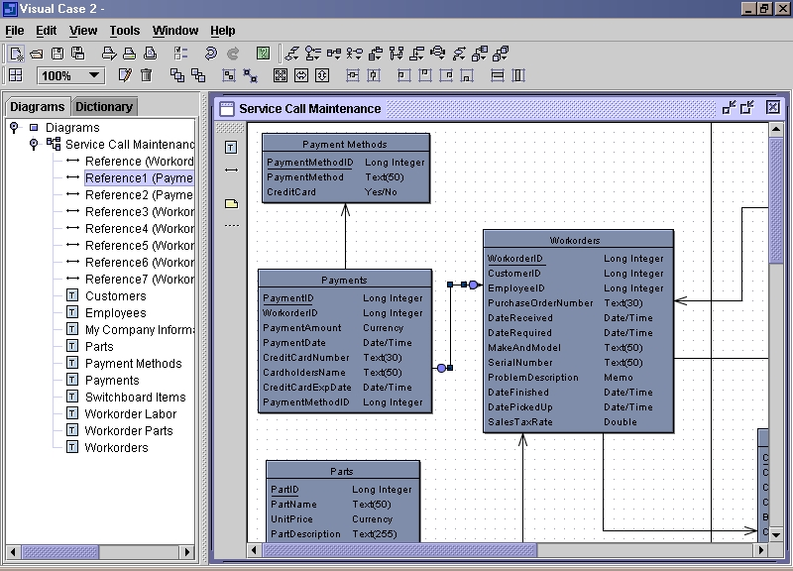
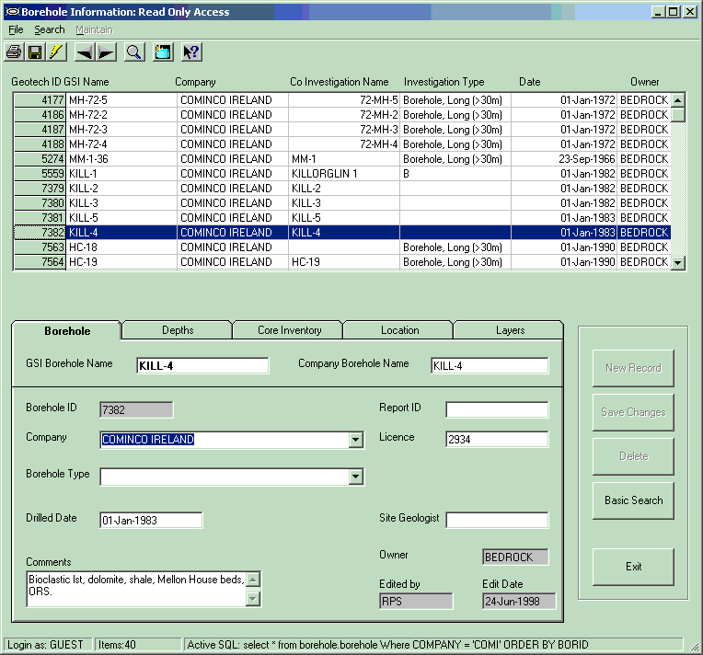
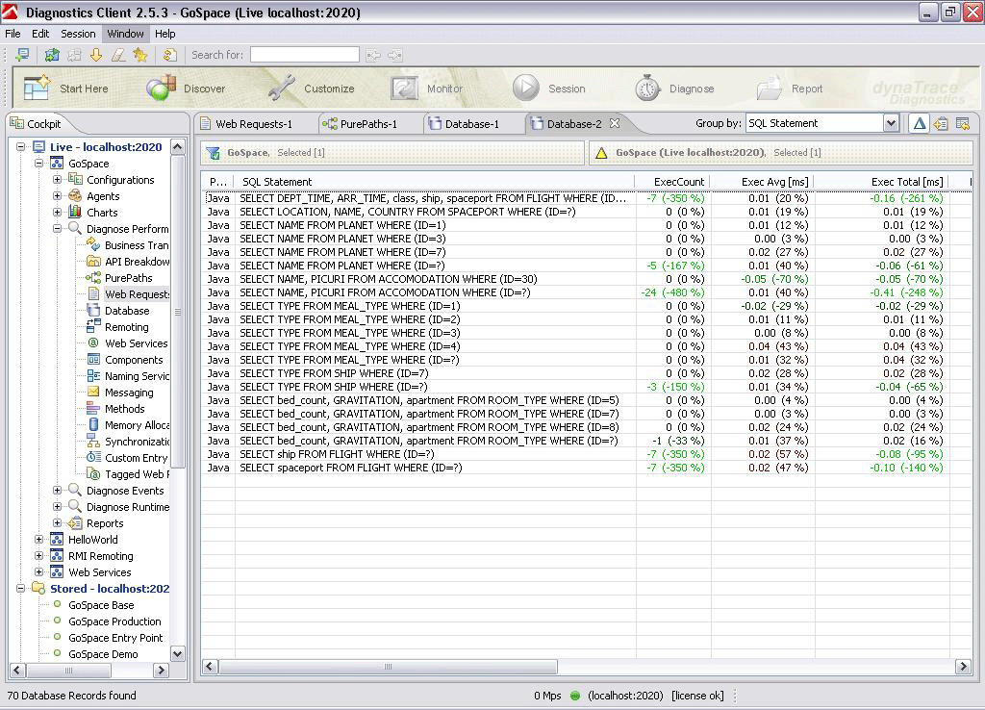
Model-Based Approaches
Old Knowledge K:
Single
Husband
John
Mod(K)
RentSub
hasHb
Mod(N) are too many models
Keep those that are “closest” to Mod(K)
Two flavours of Model-Based Approaches:
  Local
  Global
1..n
Wife
Mary
New Knowledge N:
Cleric
Mod(N)
Minister
Carl
Priest
Adam Bob
12/31

Slide 13
Local Model-Based Approaches
Old Knowledge K:
Single
Husband
John
Mod(K)
RentSub
hasHb
1..n
Wife
Mary
Minimal
distance
Minimal
distance
Minimal
distance
Minimal
distance
New Knowledge N:
The result of evolution:
Cleric
Mod(N)
Minister
Carl
Priest
Adam Bob
☑
☑
☑
☒
13/31

Slide 14
Local Model-Based Approaches
Old Knowledge K:
Single
Husband
John
Mod(K)
RentSub
hasHb
1..n
Wife
Mary
Is there a representation?
Evolved KB K’:
The result of evolution:
Single
Husband
John
Mod(K’)
Cleric
RentSub
hasHb
1..n
MinisterCarl
Priest
Adam Bob
WifeMary
☑
☑
☑
13/31

Slide 15
Global Model-Based Approaches
Old Knowledge K:
Single
Husband
John
Mod(K)
RentSub
hasHb
1..n
Wife
Mary
New Knowledge N:
The result of evolution:
Cleric
Mod(N)
Minister
Carl
Priest
Adam Bob
☑
☑
☒
☒
14/31

Slide 16
Global Model-Based Approaches
Old Knowledge K:
Single
Husband
John
Mod(K)
RentSub
hasHb
1..n
Wife
Mary
Is there a representation?
Evolved KB K’:
The result of evolution:
Single
Husband
John
Mod(K’)
Cleric
RentSub
hasHb
1..n
MinisterCarl
Priest
Adam Bob
WifeMary
☑
☑
14/31

Slide 17
How to Measure Distance btw Models?
All MBAs are based on
  distances between interpretations
Distance in Propositional Logic:
  as a set
  as a number
Example:
I = {p, q, r}
J = {p, s}
dist⊖(I,J) = I ⊖ J
dist|⊖| (I,J) = |I ⊖ J|
dist⊖(I,J) = {q, r, s}
dist|⊖| (I,J) = 3
15/31

Slide 18
Dimensions of MBAs
Approach
global: G
local: L
set: ⊖ number: |⊖|
What is distance
symbols: S
atoms: A
Distance is built upon
Propositional Logic: two dimensions.
Description Logics: one more dimension!
Distance is built upon
  symbols
  atoms
16/31

Slide 19
Dimensions of MBAs
Approach
global: G
local: L
set: ⊖ number: |⊖|
What is distance
symbols: S
atoms: A
Distance is built upon
Example:
I = {Priest(Bob), Wife(Mary)}, J = {Priest(Adam), Wife(Mary)}
  Atoms: dist⊖(I,J) = {Priest(Bob), Priest(Adam)}
  Symbols: dist⊖(I,J) = {Priest}
16/31

Slide 20
Dimensions of MBAs
Approach
global: G
local: L
set: ⊖ number: |⊖|
What is distance
symbols: S
atoms: A
Distance is built upon
  Two possibilities for each of three dimensions
  → eight possible semantics
  Inexpressibility Theorem:
    For all of eight semantics the result of the evolution
    cannot be expressed in DL-Lite
16/31

Slide 21
What May Go Wrong?
Single
Husband
New Knowledge: Single(John)
What happened with Mary?
Our intuition: 2 cases
Mary is single
Mary is married to another guy
John
a guy
1..n
hasHb
Priest
(Mary, John )
?
Adam
Bob
1..n
Woman
Wife
Mary
  MBAs give more cases:
Mary is married to either Adam or Bob (but not to both)
Drawback I: Mary married to one of the priest is counterintuitive
Drawback II: Inexpressible in DL-Lite
K’ ⊭ Priest(Bob)
K’ ⊭ Priest(Adam)
K’ ⊨ Priest(Adam) ∨ Priest(Bob)
17/31
Notes:
2 and 3 are together?
DL-Lite is essentionally Horn logic
DL-Lite: 1) tractable 2) nice computational properties => 3) Horn-Logic (special slide)

Slide 22
MBAs Do Not Work
… because
  they ignore structure of the KB
  the allow too many cases
  result of evolution cannot be expressed in DL-Lite
  ➔ MBAs cannot be adopted for KB evolution in DL-Lite
18/31

Slide 23
Outline
Requirements for an evolution operator
Attempt to apply classical approaches
  Model-Based approaches
  Formula-Based approaches
Our proposal
  Bold Semantics
  Careful Semantics
Conclusion

Slide 24
Formula-Based Approaches
Old Knowledge K:
Idea:
To take union K ∪ N
What if K ∪ N is unsatisfiable?
Single
Husband
John
RentSub
hasHb
Cleric
1..n
Unsatisfiable
Wife
Mary
New Knowledge N:
Cleric
Cleric
Minister
Carl
Priest
Adam Bob
Minister
Carl
Priest
Adam Bob
21/31

Slide 25
Formula-Based Approaches
Old Knowledge K:
Satisfiable
☑
Single
Husband
John
Single
Husband
John
☑
RentSub
RentSub
RentSub
hasHb
Cleric
hasHb
Cleric
Cleric
1..n
1..n
Approach:
Choose a subset K_{max} ⊆ K
  Consistent with N
  Coherent with N
  Maximal wrt set inclusion
Result:
K_{max} ∪ N
Problem:
In general K_{max} is not unique
Wife
Mary
Wife
Mary
Satisfiable
☑
New Knowledge N:
Unsatisfiable
Cleric
☒
Cleric
Minister
Carl
Priest
Adam Bob
Minister
Carl
Priest
Adam Bob
21/31

Slide 26
What To Do?
What to do with several K_{max}?
Classical approaches:
  When In Doubt Throw It Out:
  take intersection of K_{max}
  Cross-Product: take disjunction of K_{max}
  Loses too much data
coNP-complete
Not expressible
in DL-Lite
K_{max1}∪ N
K_{max2}∪ N
(K_{max2} ∩ K_{max1})∪ N
K ∪ N
OR
TempStaff
Teaching
TempStaff
Teaching
TempStaf
Teaching
TempStaf
Teaching
∨
PhD
PhD
PhD
PhD
22/31

Slide 27
Outline
Requirements for an evolution operator
Attempt to apply classical approaches
  Model-Based approaches
  Formula-Based approaches
Our proposal
  Bold Semantics
  Careful Semantics
Conclusion

Slide 28
Our Proposal – Bold Semantics
Take an arbitrary K_{max}
Update(K, N) = K_{max}∪ N
The result is non-deterministic
K ∪ N
K_{max} ∪ N
TempStaff
Teaching
TempStaff
Teaching
PhD
PhD
Can be computed in PTime
23/31
Notes:
no algorithm
non-determinism
PTime

Slide 29
How To Avoid Non-Determinism?
Preferences “reduce” non-determinism:
  Order over assertions
  Minimality wrt cardinality
  etc.
Evolution in specific cases may be deterministic:
  ABox evolution
24/31
Notes:
no algorithm
non-determinism
PTime

Slide 30
ABox Evolution Is Deterministic
Assumptions:
  N is a set of ABox assertions
  Evolution does not change TBox
Theorem:
For a DL-Lite KB the result of ABox evolution is unique and computable in PTime.
Single
Husband
John
a guy
John
1..n
Recall:
Our intuition: 2 cases
Mary is single
Mary is married to another guy
hasHb
Priest
(Mary, John )
?
Adam
Bob
1..n
Woman
Wife
☒
Mary
☑
New knowledge N: Single(John)
Add assertions from N
Find conflicting assertions
Resolve conflicts
Drawback: Mary cannot get divorced
26/31
Notes:
unexpectedness
algorithm: step by step appears
example, then theorem

Slide 31
Outline
Requirements for an evolution operator
Attempt to apply classical approaches
  Model-Based approaches
  Formula-Based approaches
Our proposal
  Bold Semantics
  Careful Semantics
Conclusion

Slide 32
Careful Semantics for ABox Evolution
Formula φ is unexpected for K_{max} and N
if K_{max}∪ N ⊨ φ and K_{max} ⊭ φ nor N ⊭ φ
In our example an unexpected formula is:
φ = ∃a guy.hasHb(Mary, a guy)∧(a guy≠John)
Role-constraining formula (RCF):
φ = ∃x.R(a,x)∧(x≠c₁)∧...∧(x≠c_{n})
Preference: We want K_{max} to be careful:
no unexpected RCF are allowed
K_{max} ∪ N ⊨ φ then K_{max}⊨ φ or N ⊨ φ
Theorem: For every DL-Lite KB K and new data N, careful K_{max} exists, is unique, and is computable in PTime
28/31

Slide 33
Careful Semantics for ABox Evolution
Single
Husband
New knowledge N: Single(John)
Run bold semantics algorithm for ABox evolution
Find unexpected formulas φ
Delete assertions entailing φ
John
a guy
John
1..n
Recall:
Our intuition: 2 cases
Mary is single
Mary is married to another guy
hasHb
Priest
(Mary, John )
?
Adam
Bob
1..n
Woman
Wife
☑
Mary
Mary
☑
Unexpected formulas:
φ = ∃a guy.hasHb(Mary, a guy)∧(a guy≠John)
29/31
Notes:
add Woman

Slide 34
Outline
Requirements for an evolution operator
Attempt to apply classical approaches
  Model-Based approaches
  Formula-Based approaches
Our proposal
  Bold Semantics
  Careful Semantics
Conclusion

Slide 35
Conclusion
We reviewed Model-Based Approaches to evolution
  Found MBAs are inapplicable for DL-Lite evolution
We reviewed classical Formula-Based Approaches
  Showed hardness or inapplicability of them
We proposed two novel Formula-Based Approaches
  Bold Semantics
  Careful Semantics
We developed polynomial time algorithms for new semantics
31/31

Slide 36
Thank you!

Slide 37


ACSI Project
Artifact-Centric Service Interoperation
FP 7 grant, agreement n. 257593
http://www.acsi-project.eu/
ONTORULE Project
ONTOlogies Meets Business RULes
FP 7 grant, ICT-231875
http://ontorule-project.eu/
Webdam Project
Foundations of Web Data Management
ERC FP7 grant, agreement n. 226513
http://webdam.inria.fr/

