Slide 1

Secure Authentication
in the Grid
ESORICS, September 2017
Cas Cremers, Martin Dehnel-Wild, and Kevin Milner

Slide 2
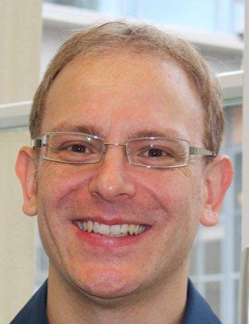
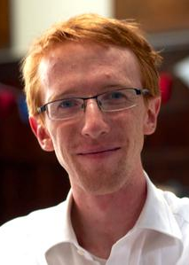
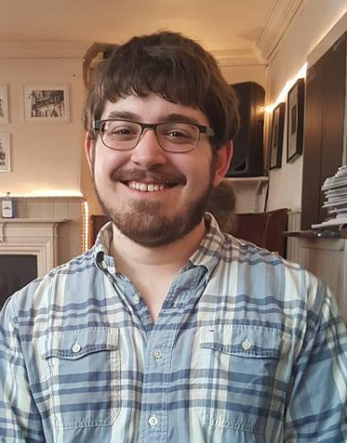
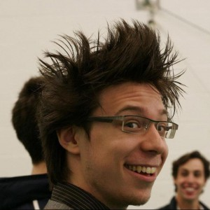
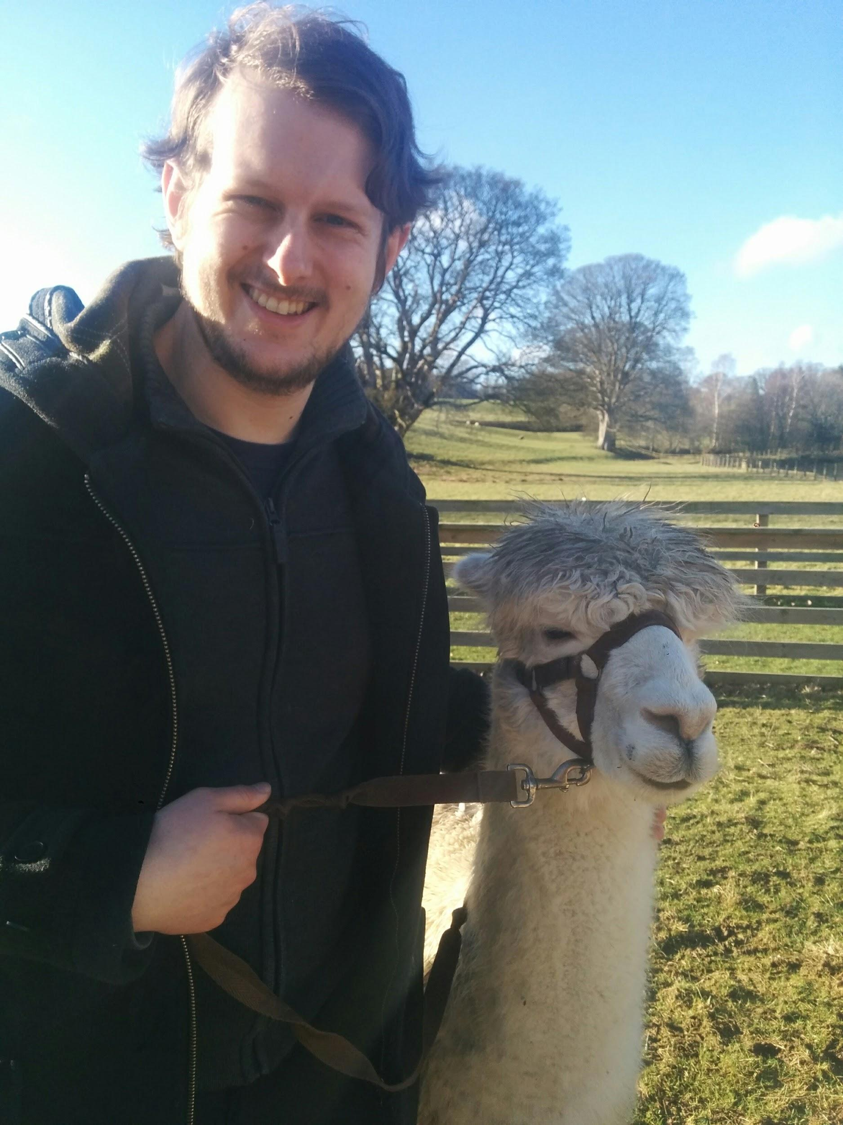
Oxford CS: Information Security Group
High Assurance Security Research
Prof. Cas Cremers
Martin Dehnel-Wild
Kevin Milner
Katriel Cohn-Gordon Luke Garratt Dennis Jackson Nicholas Moore

Slide 3

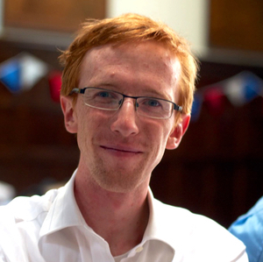


The Problem

Slide 4
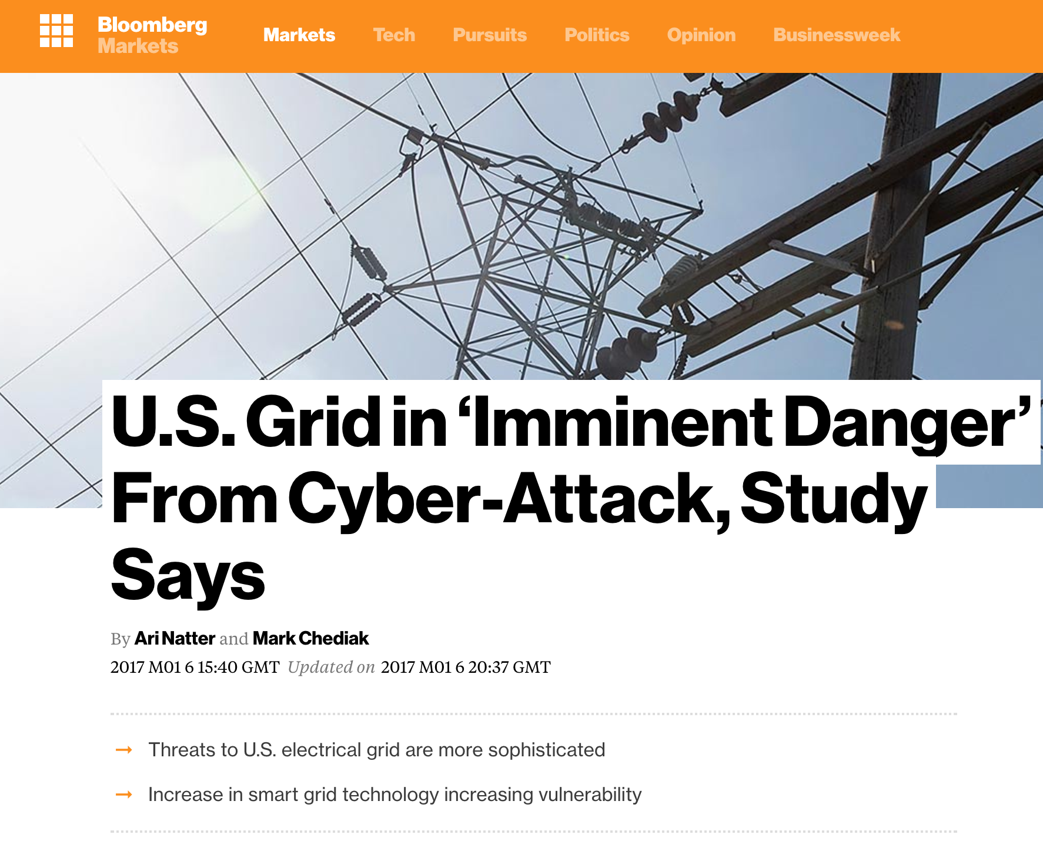
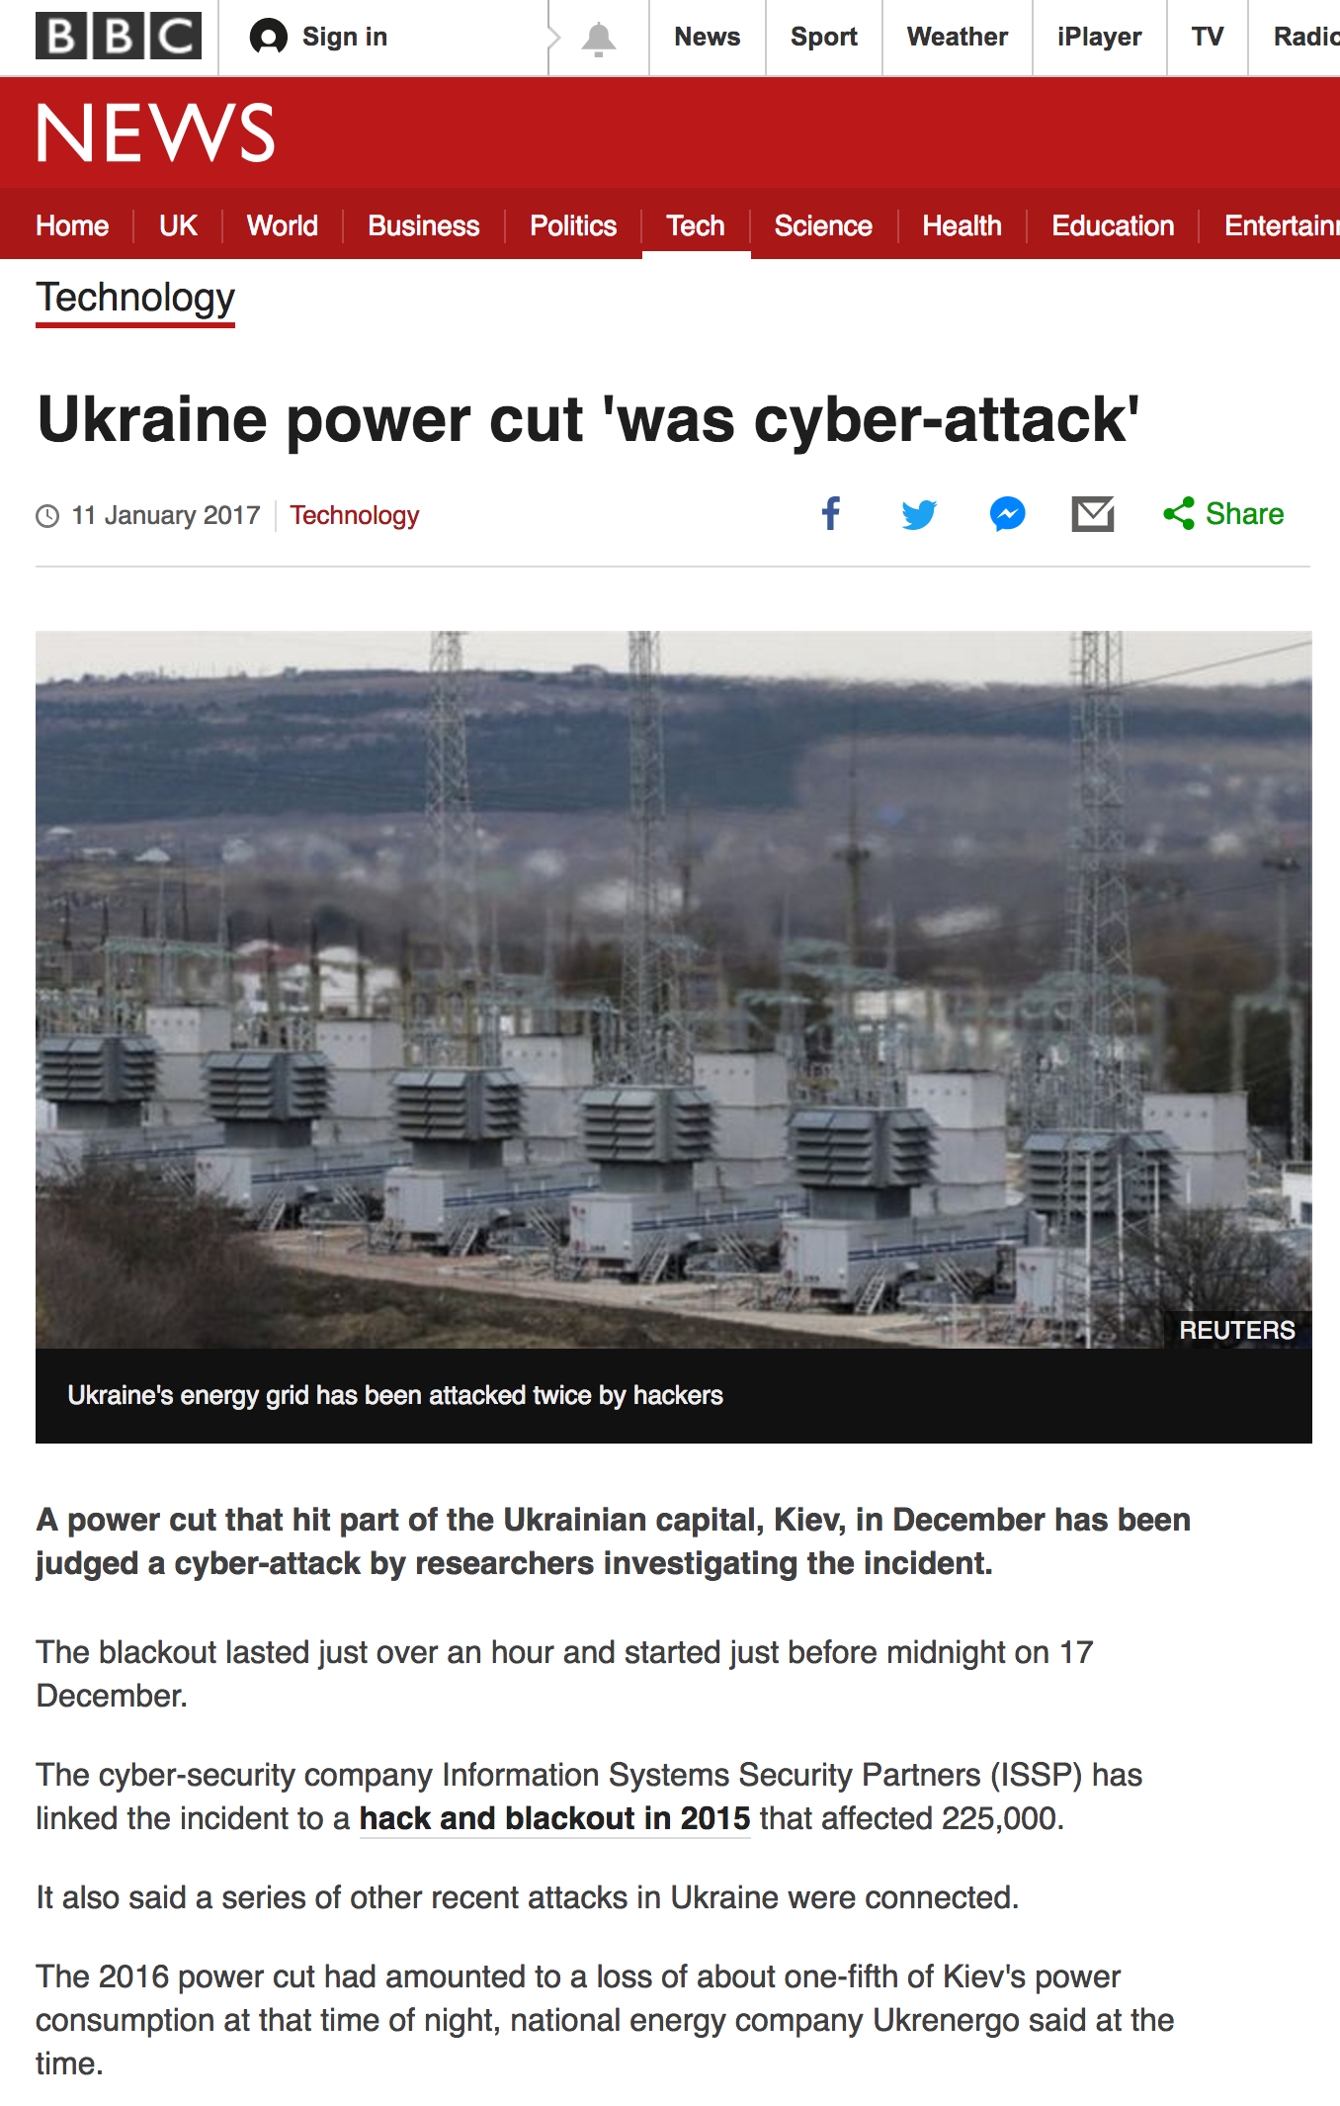
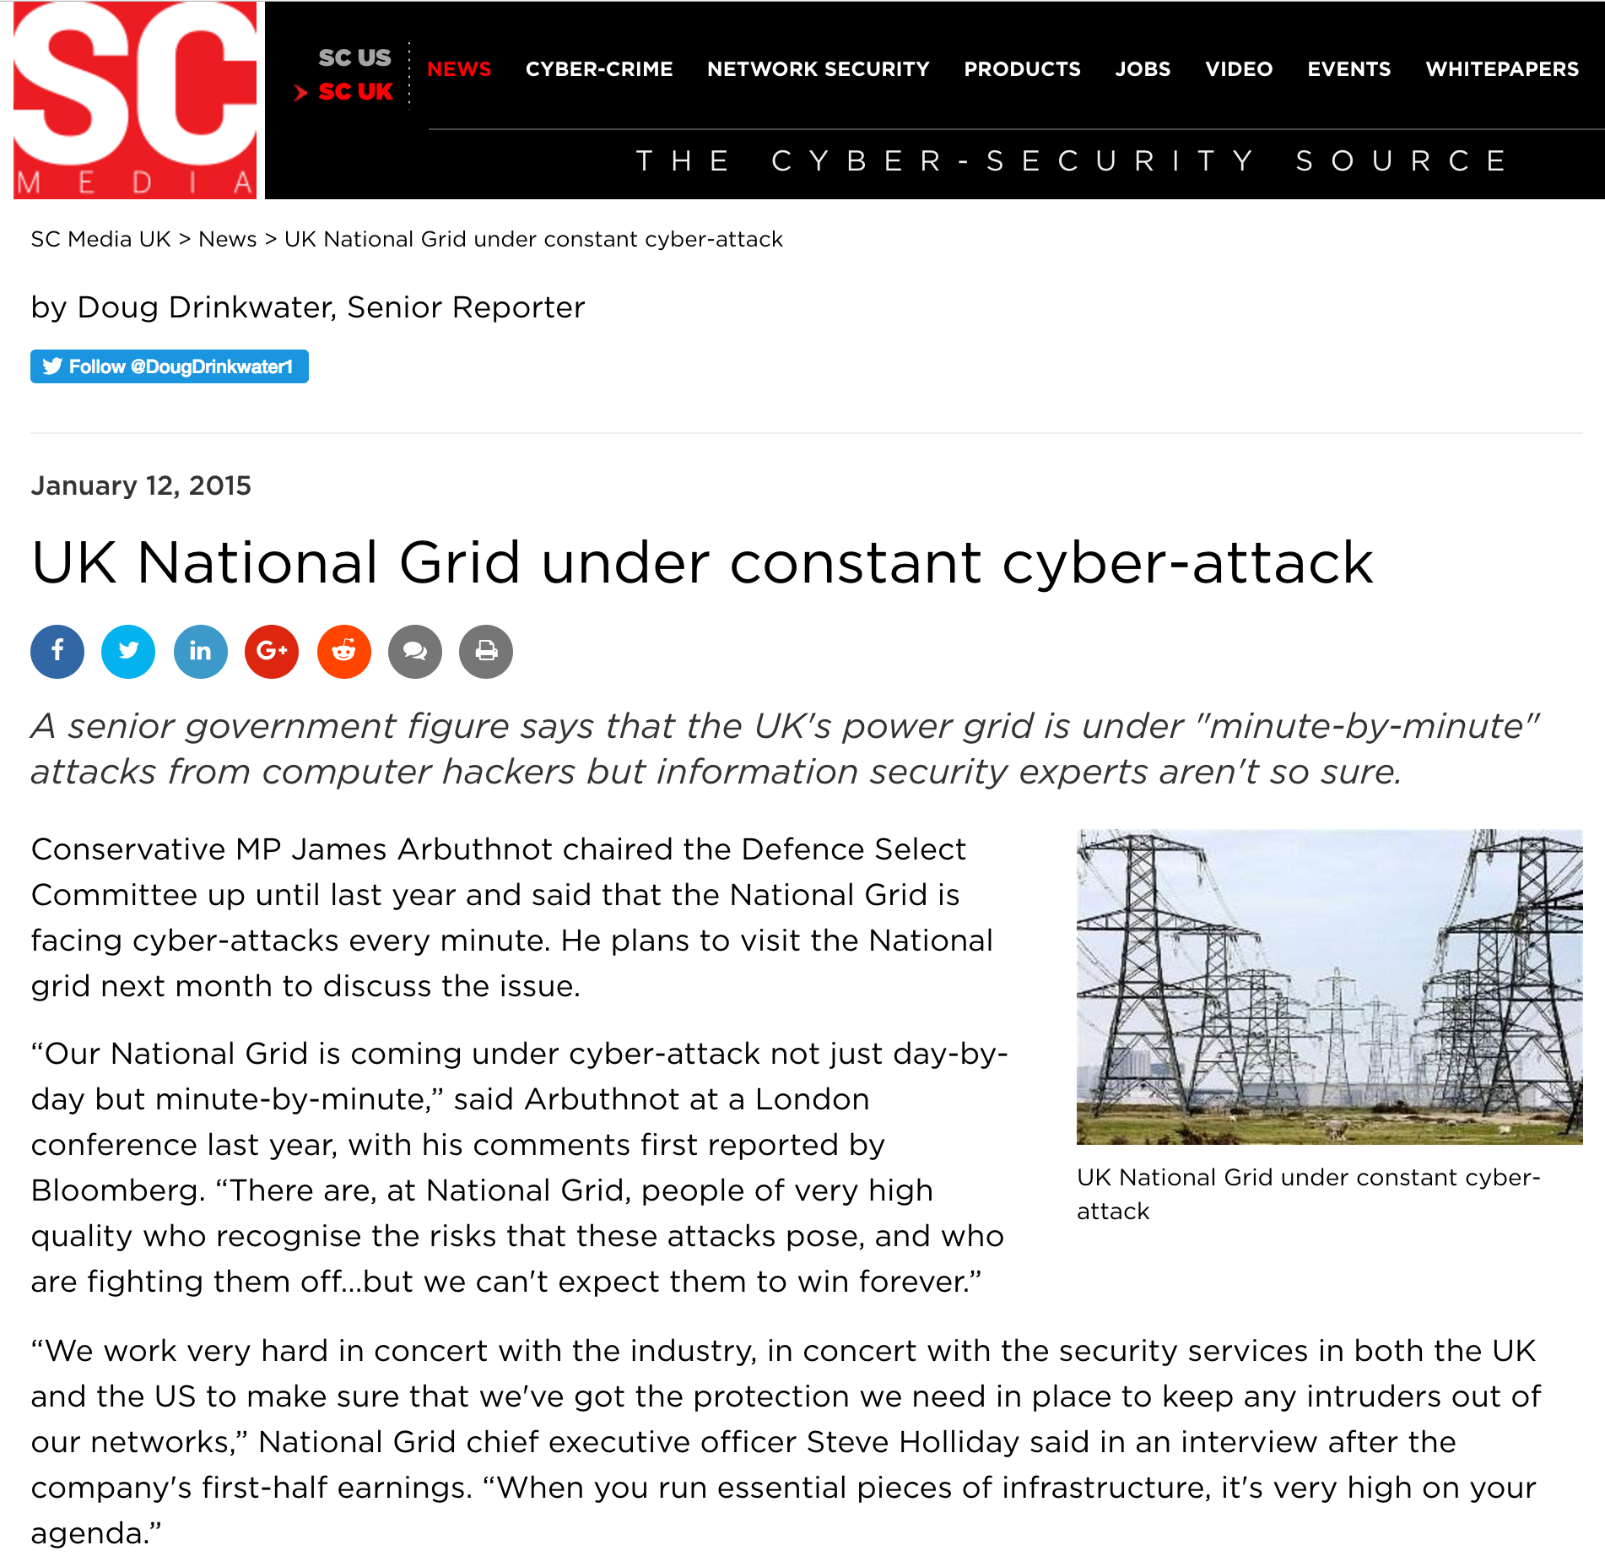
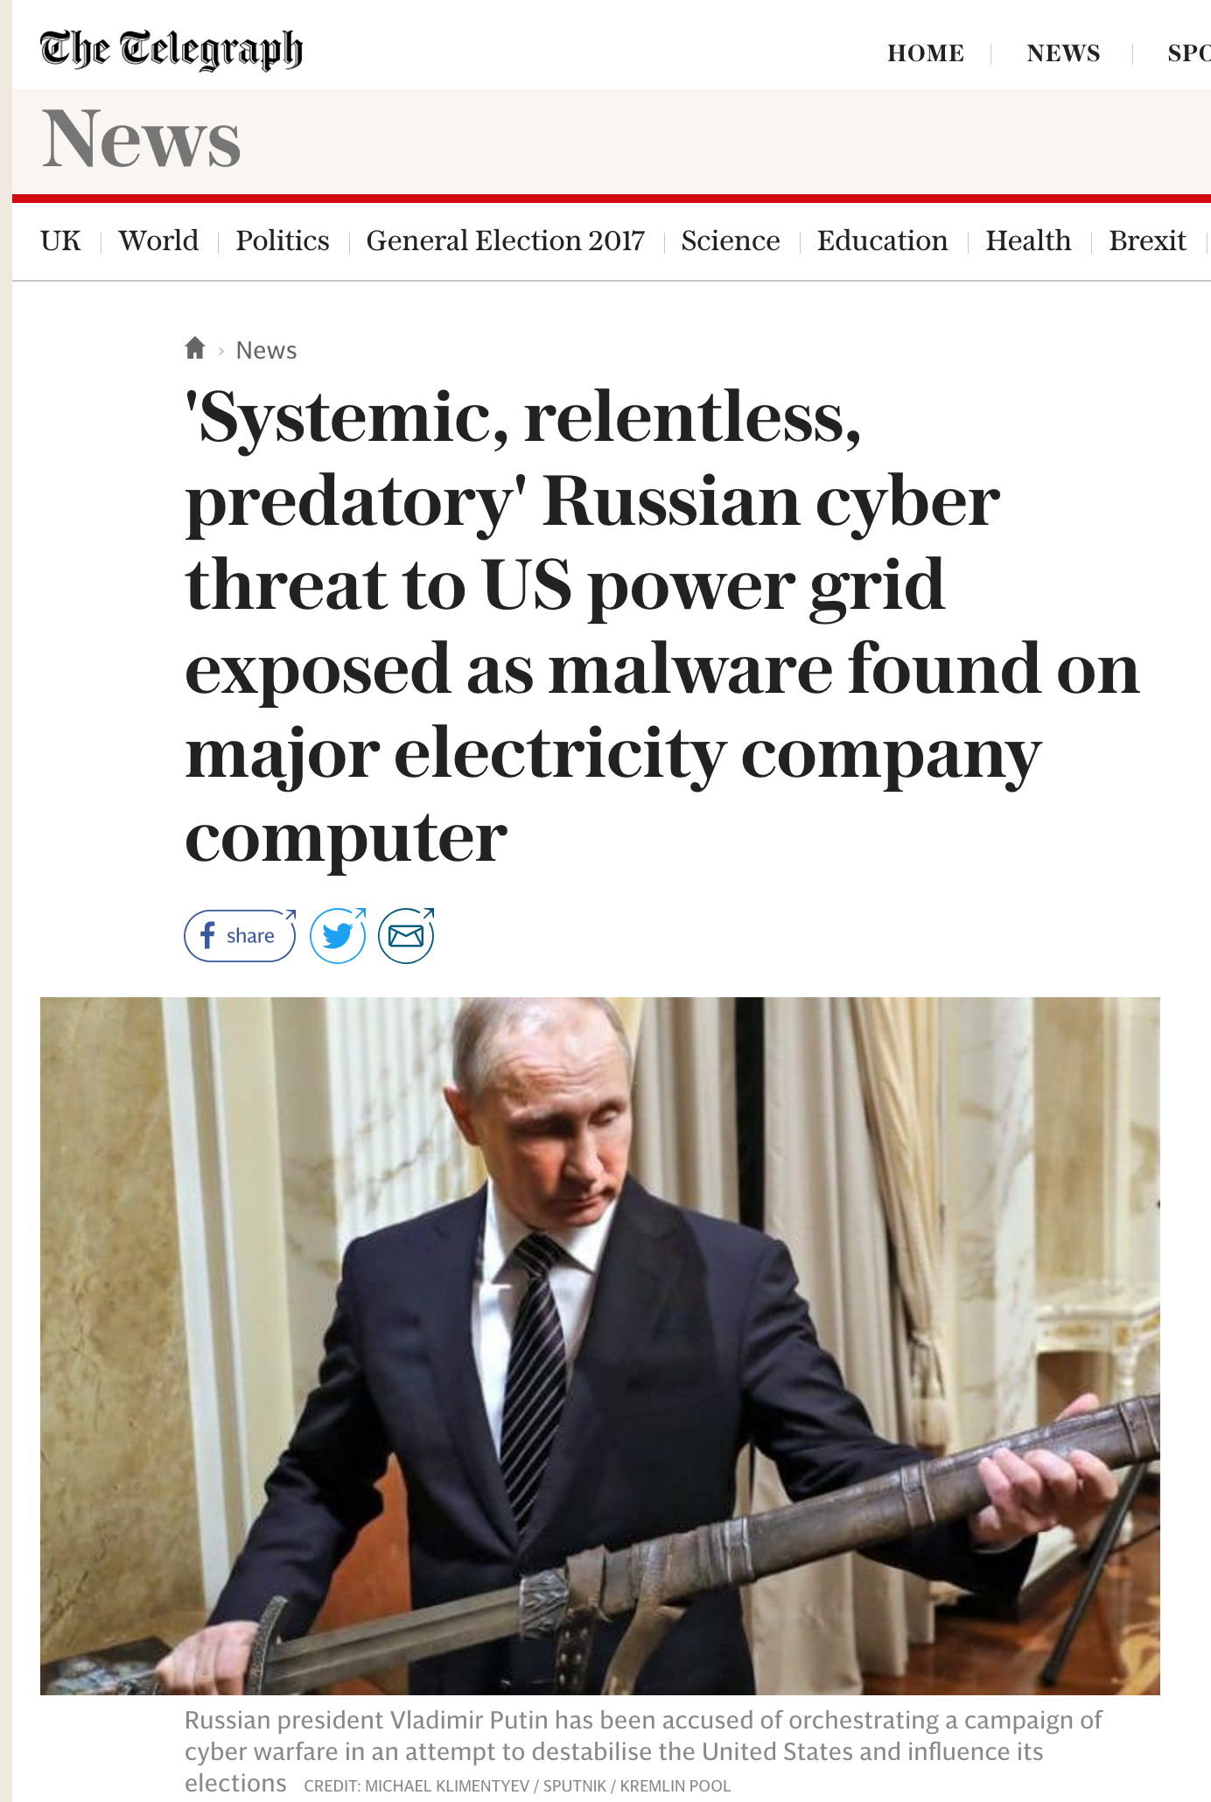
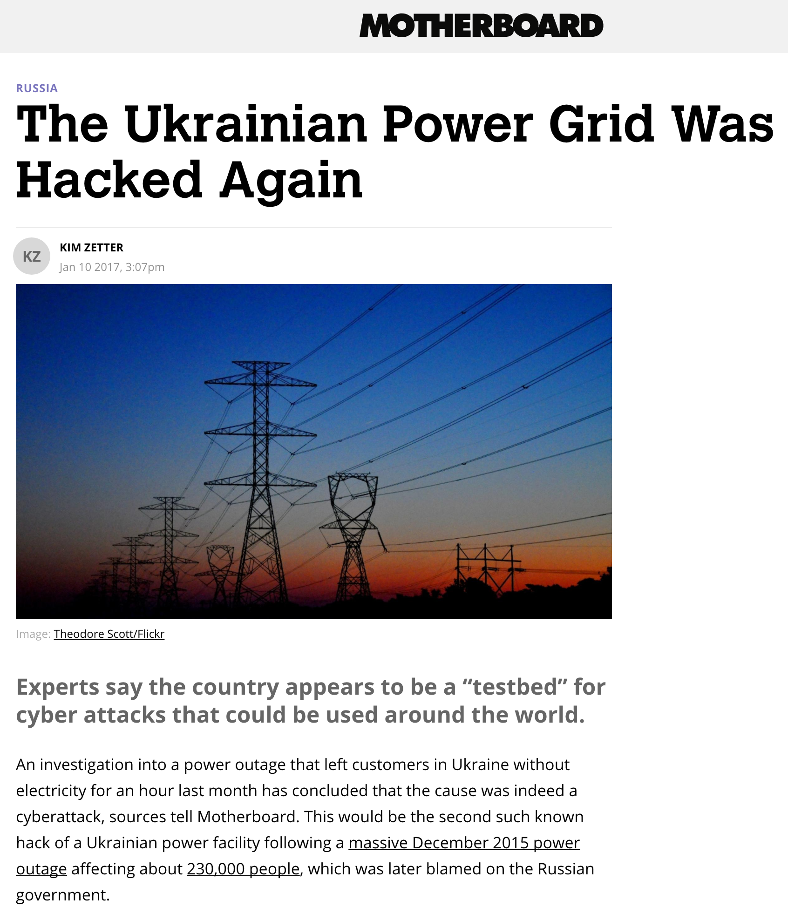
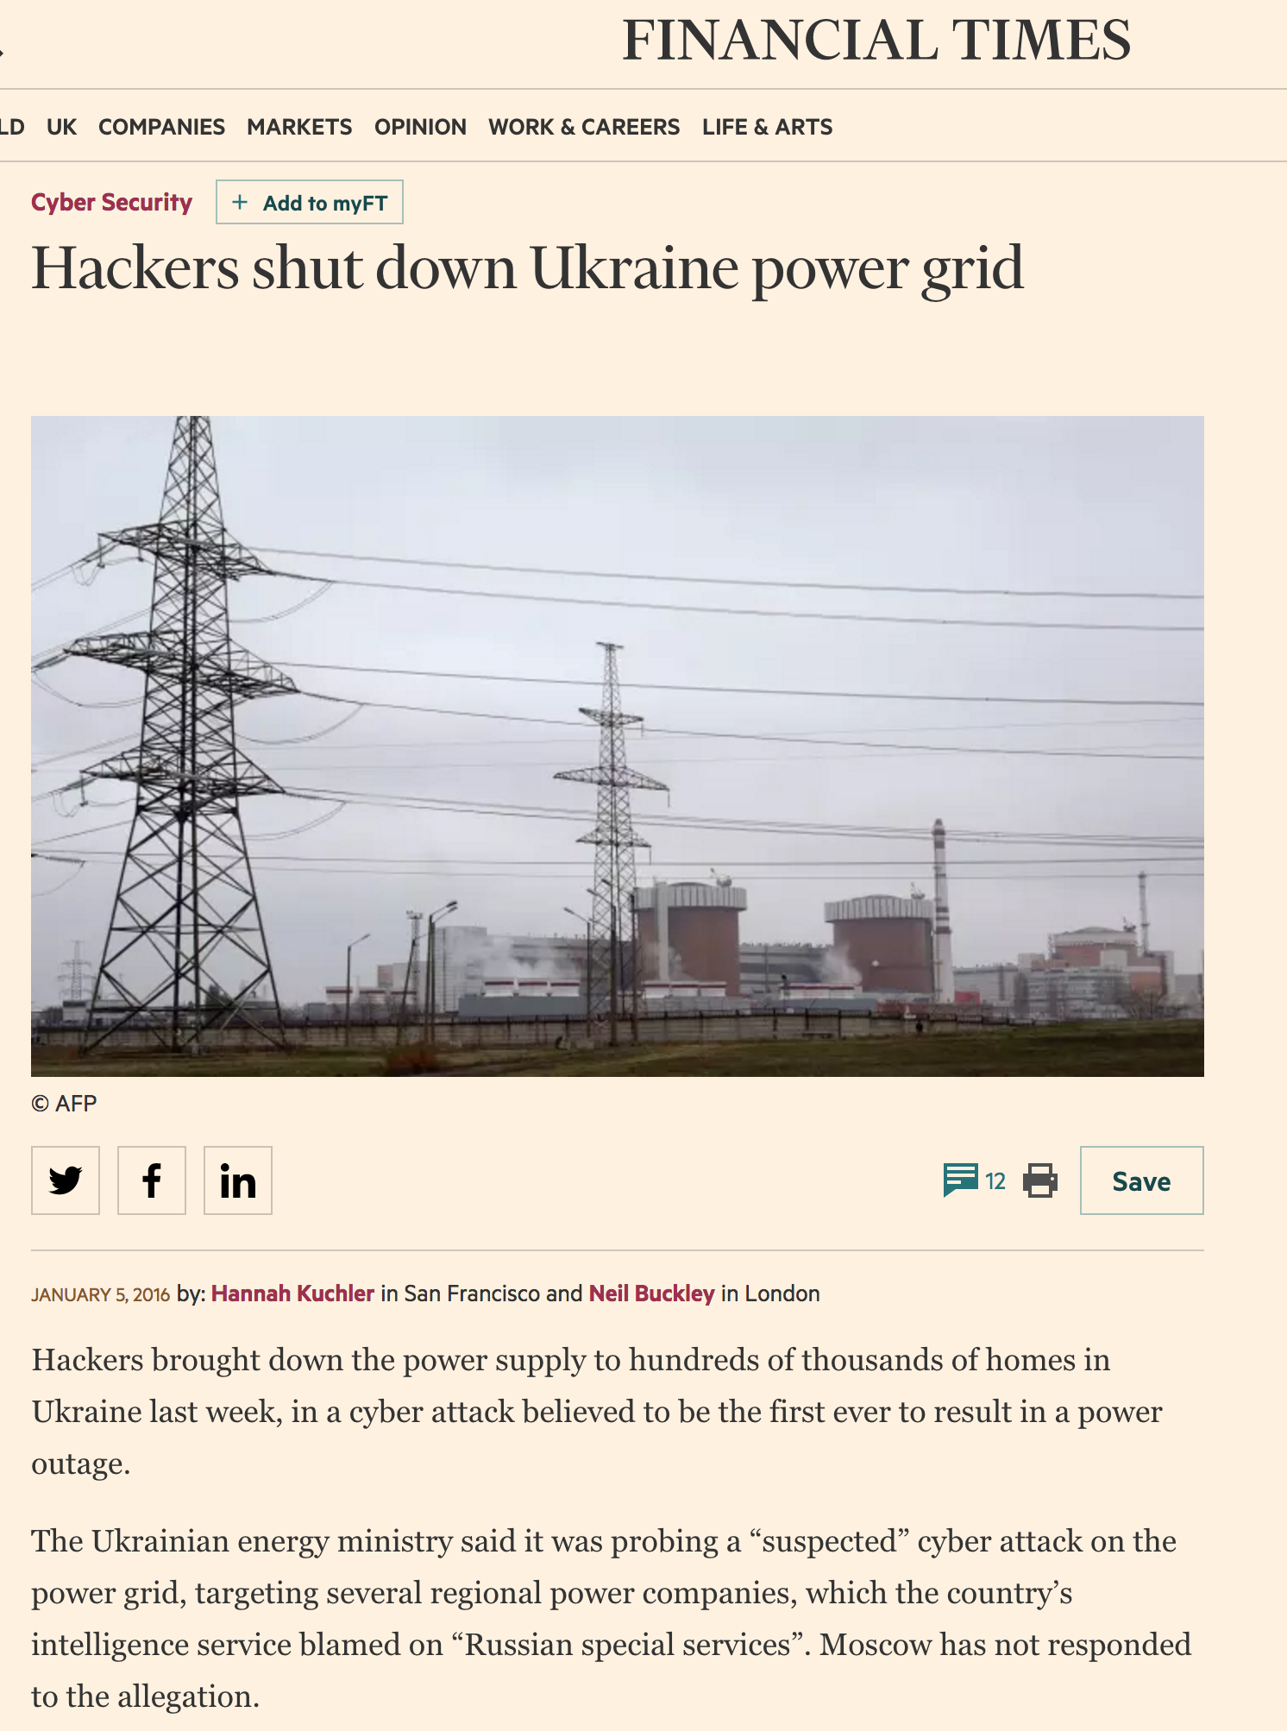

Slide 5
Outline of Talk
DNP3: Secure Authentication v5 Protocol Suite
DNP3’s required security properties
Our Modelling and Analysis Process
The Challenges we faced
Our Contributions
The Alleged Replay Attack
Wrap up

Slide 6

DNP3: Secure Authentication v5

Slide 7
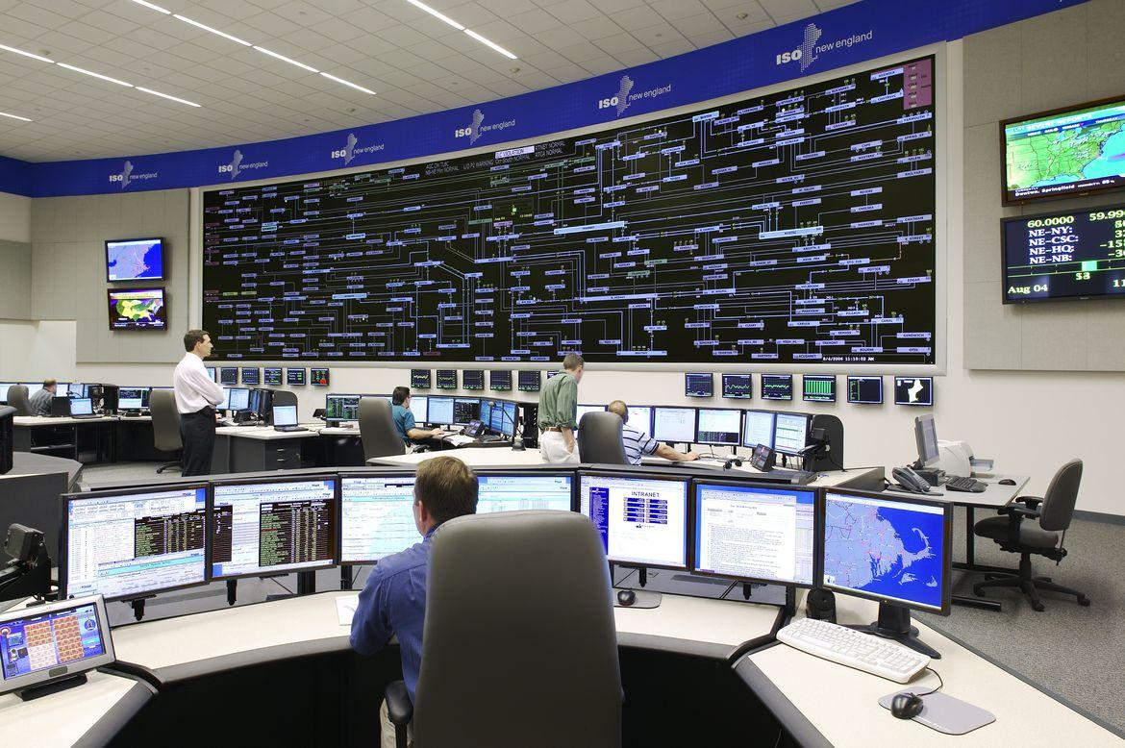
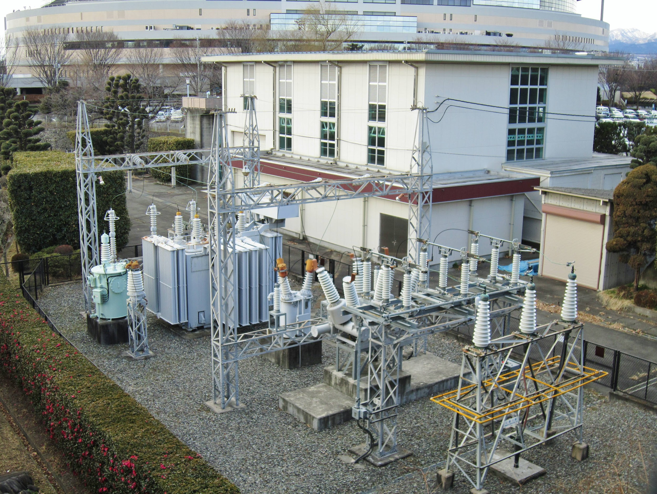
DNP3: “Distributed Network Protocol”
Utility grid protocol (e.g. electricity, water): ICS
IEEE 1815-2012
Used to send commands and monitoring packets between central control stations and outstations
(Photos: ISO New England, Wikimedia)

Slide 8

Secure Authentication v5: 2012
Sub-section of DNP3, used to authenticate control and monitoring packets
Based on IEC/TS 62351-5:2013

Slide 9
SAv5: Three sub-protocols
Update Key Change
Session Key Update
ASDU Authentication
*ASDU ≈ Critical Packet

Slide 10
SAv5: Three sub-protocols
Authority Key
(Pre-distributed)
Update Key Change
New Update Key
Update Key
(Pre-distributed)
Session Key Update
Session Keys
ASDU Authentication
Critical ASDU
Success / Failure

Slide 11
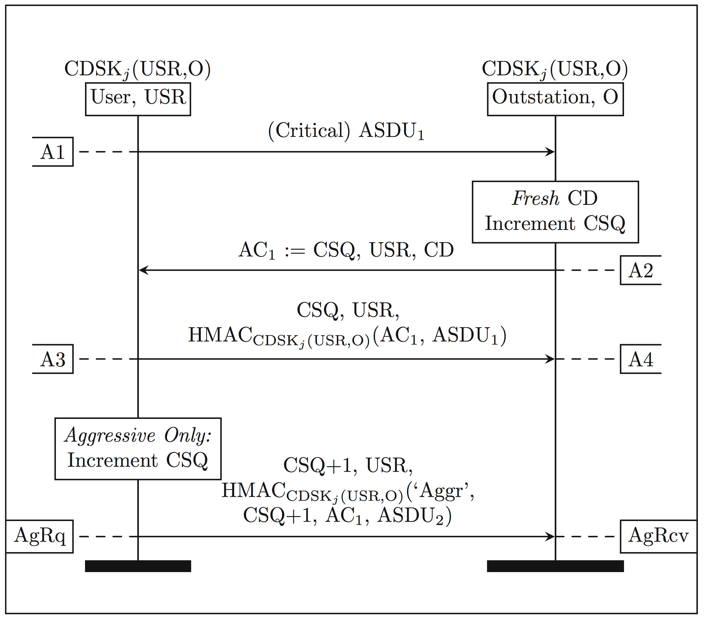
ASDU Authentication

Slide 12
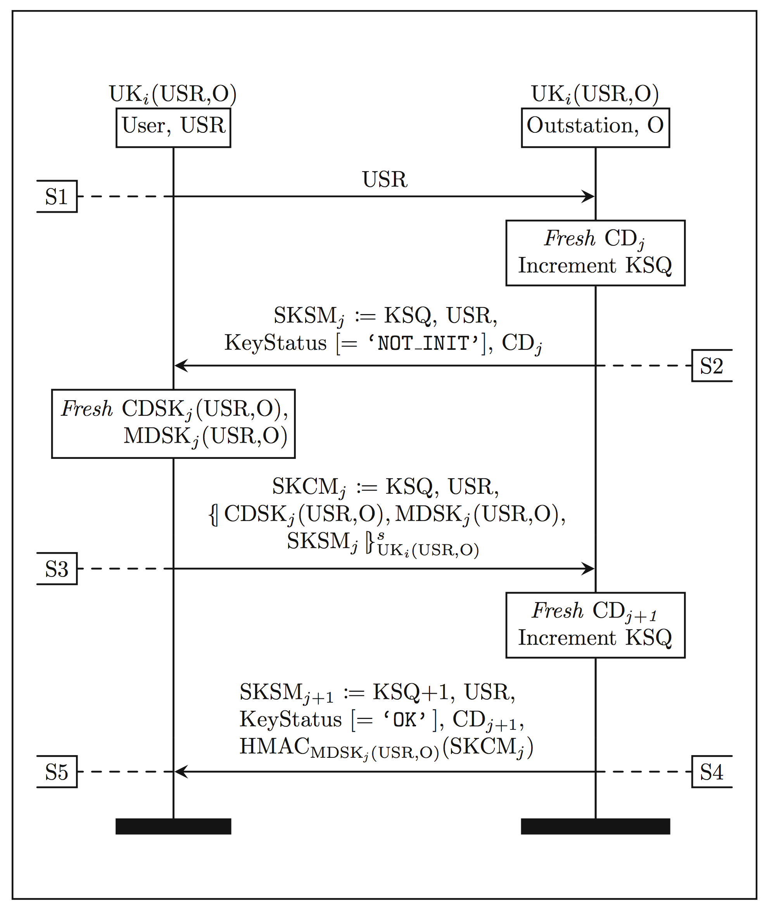
Session Key Update

Slide 13
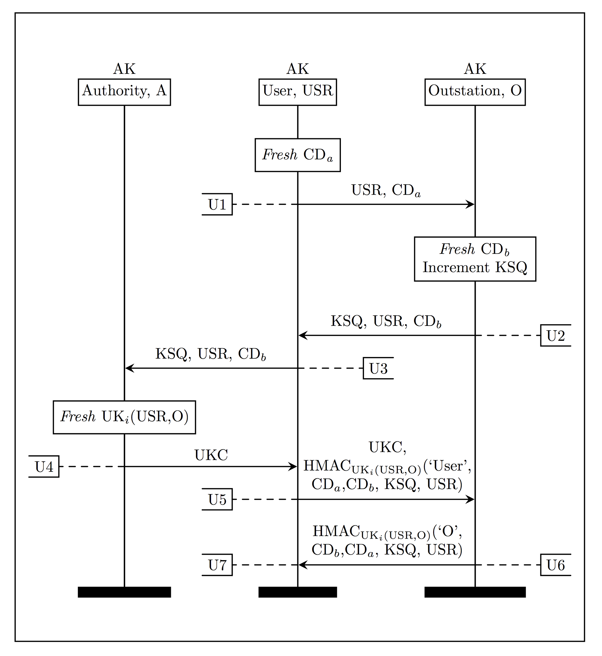
Update Key Change

Slide 14
SAv5: Three sub-protocols
Authority Key
(Pre-distributed)
Update Key Change
New Update Key
Update Key
(Pre-distributed)
Session Key Update
Session Keys
ASDU Authentication
Critical ASDU
Success / Failure

Slide 15
Update Key Change
Session Key Update
ASDU Authentication

Slide 16
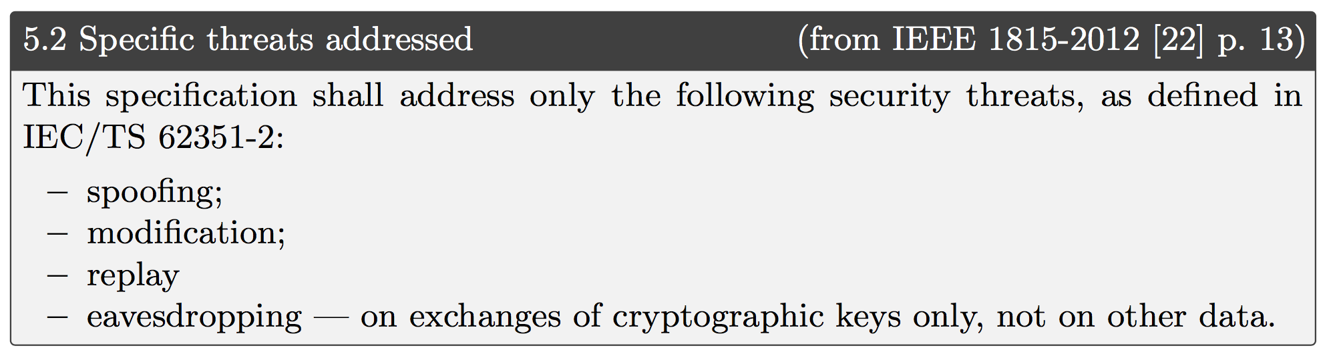
Desired Security Properties

Slide 17
Modelling and Analysis
Modelled all three sub-protocols using Tamarin-Prover.
Modelled the required security properties in relation to the protocol model (again, in Tamarin).
Analysed the protocols’ behaviour, and whether it meets its required security properties or not.

Slide 18
Challenges for High Assurance
821-page IEEE Specification: IEEE 1815-2012
Complex and stateful protocol suite
New modelling techniques developed to deal with DNP3’s large amount of state (invariant facts)
Very limited previous work
  Only analysed 1 of 3 sub protocols
  Reported replay attack
    Hard to confirm due to complicated spec
Challenging even for state of the art verification technology

Slide 19
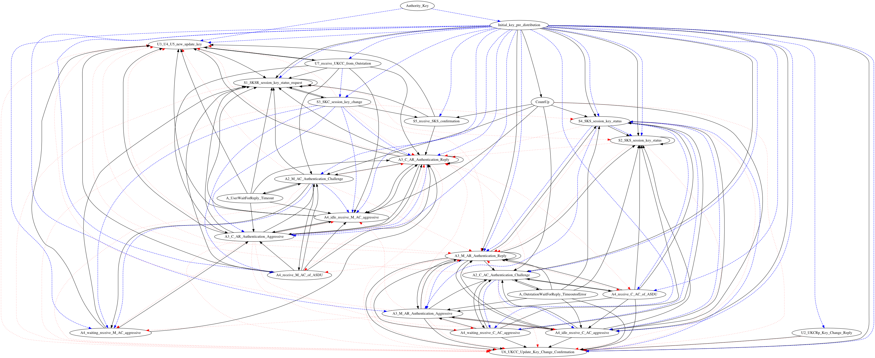

Slide 20
Our contributions
We proved (in the symbolic model) that the protocol meets its desired security properties
  First formal model of all three sub-protocols and their desired security properties
  First formal analysis of all three sub-protocols in combination
  We created the proof using the Tamarin Prover
Our results show previously claimed attack impossible
Various recommendations to improve protocol

Slide 21
Replay Attack
Amoah et al. 2016* claimed a replay attack in the ASDU Authentication sub-protocol
Allowed an attacker to block a non-aggressive mode packet, and then ‘replay’ it as an aggressive-mode packet (this packet is still only accepted once); this change of mode would have violated agreement.
Not possible in faithful implementations: the standard requires authentication mode to be included in the HMAC
Authors admit attack was an artefact of too simplistic modelling
*Amoah, R., Camtepe, S.A., Foo, E.: Formal modelling and analysis of DNP3 secure authentication. J. Network and Computer Applications 59, 345–360 (2016).

Slide 22

The Tamarin Prover
Unbounded security protocol verification tool
Multi-university project (Oxford, ETH Zurich, LORIA)
Our group actively develops Tamarin
Previously analysed TLS 1.3, ISO/IEC 9798, Yubikey, Wireguard
https://tamarin-prover.github.io

Slide 23
Results & wrap up
We proved that DNP3 SAv5 meets its claimed security properties
  Refreshingly (!) previously claimed attack not possible
  We provide high assurance for this Utility Grid protocol standard
Shows further real-world utility of the Tamarin Prover
  Effort: ~4 person months
Martin Dehnel-Wild
martin.dehnel-wild@cs.ox.ac.uk // @mpdehnel

