Slide 1
Snorocket 2.0: Concrete Domains and Concurrent Classication
Alejandro Metke-Jimenez | Postdoc, AEHRC
alejandro.metke@csiro.au
the Australian e-Health research centre | ict centre

Slide 2
Snorocket 2.0
Motivation
Architecture
Concrete domains
Test ontologies
Experimental results
Future work
Our ontology tools

Slide 3
Motivation
Snorocket was initially implemented to support SNOMED CT authoring
Some concepts cannot be correctly modelled without concrete domains
For example, “Hydrochlorothiazide 50mg tablet” cannot be modelled without a data literal to represent the quantity of the active ingredient
AMTv3 has recently introduced concrete domains

Slide 4
Architecture

Slide 5
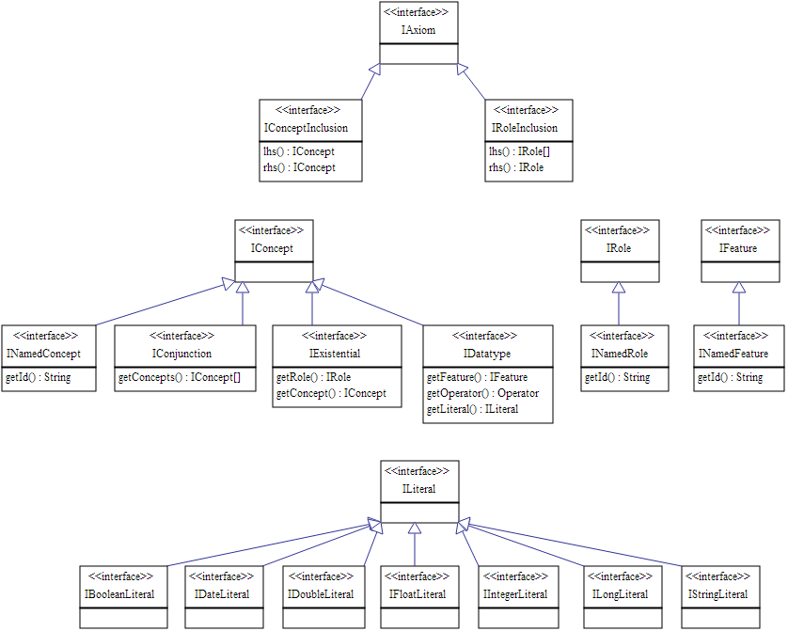
Architecture

Slide 6
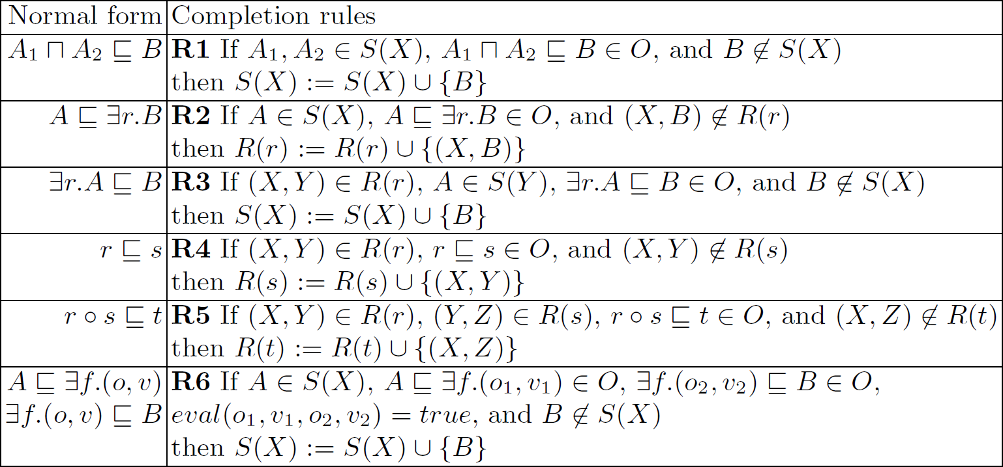
Concrete Domains
CEL normalisation algorithm works with minimal changes
Added an additional completion rule

Slide 7
Test Ontologies
SNOMED CT
Australian Medicines Terminology v3 (with concrete domains)
AMT axioms are more “complex” than the typical axioms found in SNOMED CT
High degree of nesting (e.g. to associate BOSS value and unit with actual ingredient)
Still simple to author since axioms follow same pattern
Ontology | # Classes | # Object Properties | # Data Properties | # Axioms
 |  |  |  | Original | Normalised
SNOMED CT | 296518 | 62 | 0 | 660610 | 1169613
AMTv3 | 61059 | 78 | 4 | 150750 | 561331

Slide 8
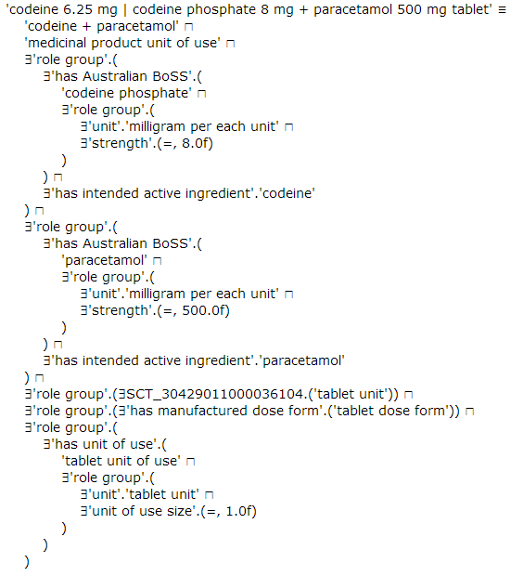
Test Ontologies

Slide 9
Experimental Results
Performance of tableaux-based reasoners was poor when classifying AMT
Elk is fastest
 | SNOMED CT | AMT
HermiT (1.3.7) | 1567.3 | mem
FACT++ (1.6.2) | 330 | 4220
jCel (0.15) | 761 | -
Snorocket (1.3.4) | 33.8 | -
Snorocket (2.0.1) | 26 | 26.2
ELK (0.32) | 9.1 | 10.5

Slide 10
Future work
Optimise multi-threaded implementation
Incorporate restrictions necessary to ensure tractability when dealing with concrete domains
Explore mechanisms to incorporate units natively in reasoning process

Slide 11
Our ontology tools
Snorocket – ontology reasoner
Open source – Apache 2.0
Available in GitHub: https://github.com/aehrc/snorocket
Ontoserver – ontology search
Provides search over ontologies
Available as a Java library and a REST API sandbox: http://ontoserver.csiro.au:8080
Based on Lucene and Solr
Snapper
Eclipse-based SNOMED CT mapping & refset tool
Free for use in Australia

Slide 12
Questions?
Australian eHealth Research Centre
Alejandro Metke
Postdoctoral Research Fellow
Phone: 07 3253 3645
Email: alejandro.metke@csiro.au
Web: www.aehrc.com

