Slide 1
TReasoner: System Description
Andrei Grigorev
Postgraduate student
Tyumen State University

Slide 2
TReasoner: Overview
TReasoner is OWL Reasoner made on Java (developed in NetBeans) with usage of OWL API;
Do classification and check consistency in SHOIQ logic with datatype expression support;
Source code and precompiled libraries are available at http://treasoner.googlecode.com

Slide 3
TReasoner: Implementation
It:
implements teableau algorithm for SHOIQ (developed by Ian Horrocks and Ulrike Sattler);
uses backJumping, caching, global caching;
Implements some novel optimization techniques (SS-branching, Bron-Kerbosch algo, isomorphic concepts searching);

Slide 4
TReasoner: Architecture
Ontology
OWL API
Knowledge base
KB
Wrapper
Checker
Question
Answer
Interpretation

Slide 5
About Optimizations: SS-branching
∀R.(∀R1.(A ⊓ B ⊓ C)) and ∃R.D ⊓ ∃R.(∃R1.(¬B ⊔ ¬C) ⊓ (T ⊓ F ⊔ G)) ⊔ ∃R.(∃R1.(¬A ⊔ ¬B))
For disjointness checking no tableau decision procedure needed;
Unsat are determined by simple procedure named SS-branching;

Slide 6
About Optimizations: SS-branching
If C and D are concepts, and C is conjunction of concepts C1, C2, …, Cn and D is conjunction of concepts D1, D2, …, Dm, then if some Ci and some Dj are disjoint then C and D are disjoint;
Such conditions where determined for disjunctions, disjunction and conjunctions, exist and for all quantifiers;
If Ci and Dj are complex concepts (not literals) for disjointness checking same procedure are used;
It helps to determine wide class of cases of disjoint concepts.

Slide 7
About Optimizations: Bron-Kerbosch algo using
For concept in DNF form:
(C11 ⊔ C12) ⊓ (C21 ⊔ C22) ⊓ (C31 ⊔ C32) ⊓ (¬C11 ⊔ ¬C21) ⊓ (¬C11 ⊔ ¬C31) ⊓ (¬C21 ⊔ ¬C31) ⊓ (¬C12 ⊔ ¬C22) ⊓ (¬C12 ⊔ ¬C32) ⊓ (¬C22 ⊔ ¬C32)
Where each concept C** may be complex concept without disjunctions;
Bron-Kerbosch algorithm may be used;

Slide 8
About Optimizations: Bron-Kerbosch algo using
Build a n-partite graph:
Every concept proposition connection (C**⊓C**) is part of the graph G, C** presented as vertex in the part;
Edge between vertexes is exist iff (¬C**⊓¬C**) are contained in concept expression;
If n-clique in graph is exist then such concept is satisfiable (unsatisfiable otherwise);
To date it works only for unsat concepts finding or for sat concepts without axioms in TBox;

Slide 9
About Optimizations: Bron-Kerbosch
(C11 ⊔ C12) ⊓ (C21 ⊔ C22) ⊓ (C31 ⊔ C32) ⊓ (¬C11 ⊔ ¬C21) ⊓ (¬C11 ⊔ ¬C31) ⊓ (¬C21 ⊔ ¬C31) ⊓ (¬C12 ⊔ ¬C22) ⊓ (¬C12 ⊔ ¬C32) ⊓ (¬C22 ⊔ ¬C32)
C11
C21
C31
C12
C22
C32

Slide 10
About Optimizations: Isomorphic concepts
New optimization technique is under development;
Hypothesis: If two concepts are isomorphic, then first concept is satisfiable if and only if second concept is satisfiable;
For isomorphic concepts finding algorithm Edmonds are used.

Slide 11
About Optimizations: Isomorphic concepts
C1 ⊑ ∃Role1.C2
C3 ⊑ ∃Role1.C2
C2 ⊑ D1
D2 ⊑ C3 ⊓ C1
…
C3 ⊑ ∃Role1.C2
C1 ⊑ ∃Role1.C2
C2 ⊑ D1
D2 ⊑ C1 ⊓ C3
…

Slide 12
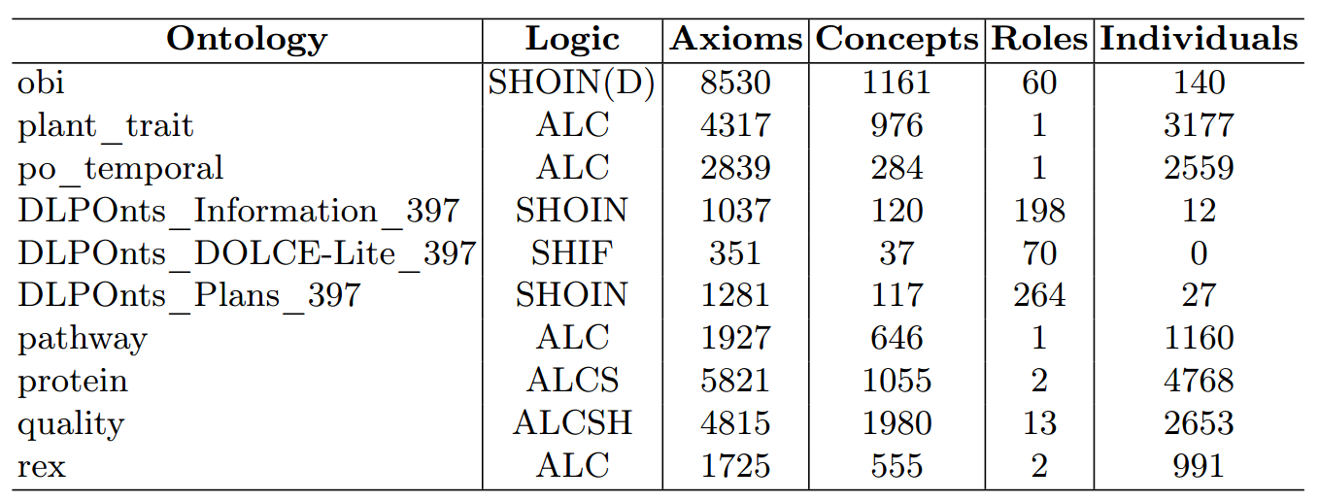
TReasoner: Evaluation

Slide 13
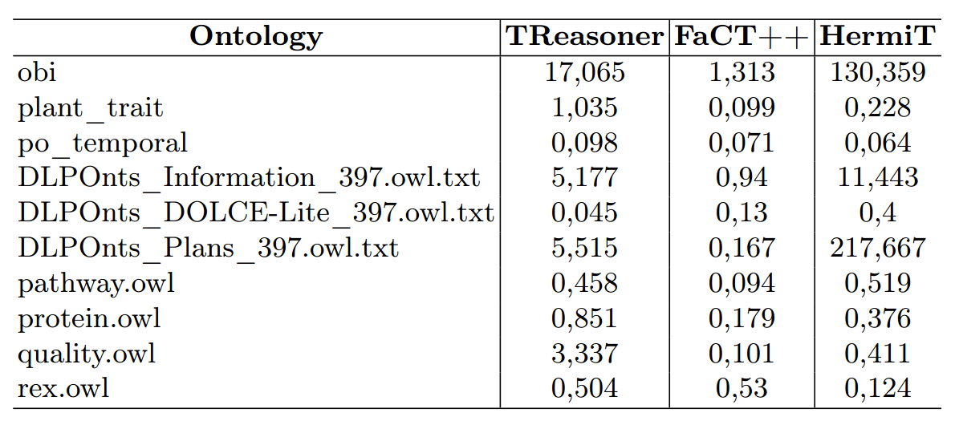
TReasoner: Evaluation

Slide 14
Thank you very much!

Slide 15
TReasoner: Evaluation
Evaluation shows that, TReasoner may not compete yet with such strong systems like HermiT and FaCT++, but in future works reducing of worktime expected (I hope)

