Slide 1
KB_Bio_101: A Challenge for OWL Reasoners
Vinay K. Chaudhri
Stijn Heymans
Michael Wessel
This work is owned by Vulcan Inc. and is licensed for use under the Creative Commons Attribution-NonCommerical-ShareAlike 3.0 license (http://creativecommons.org/licenses/by-nc-sa/3.0/). Vulcan Inc., July 2013

Slide 2
Acknowledgment
This work is funded by Vulcan Inc.
See http://www.vulcan.com and www.projecthalo.com
AURA/Inquire Development Team
Eva Banik, Peter Clark, Roger Corman, Nikhil Dinesh, Debbie Frazier, Stijn Heymans, Sue Hinojoza, David Margolies, Adam Overholtzer, Aaron Spaulding, Ethan Stone, William Webb, Michael Wessel and Neil Yorke-Smith
Ashutosh Pande, Naveen Sharma, Rahul Katragadda, Umangi Oza

Slide 3
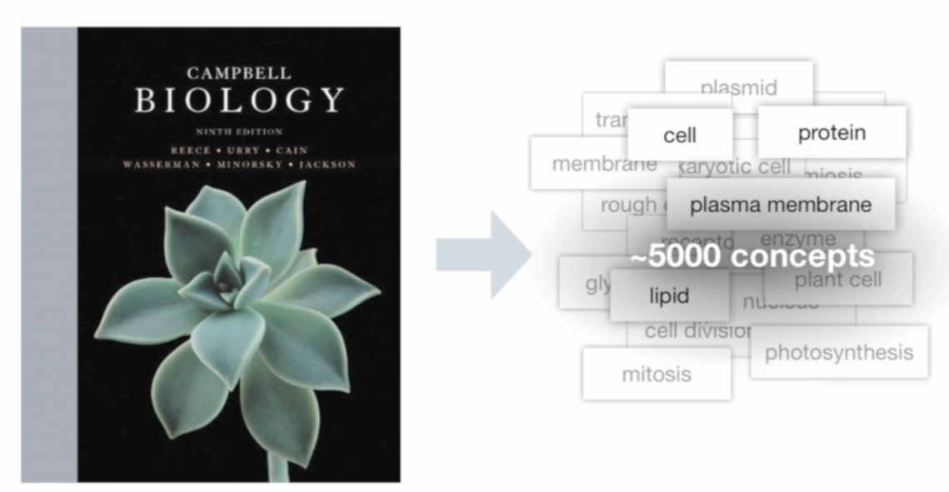
KB_Bio_101
Campbell Biology is a textbook used in introductory (ie, 101) biology courses in colleges
The KB is used in an intelligent textbook prototype
See http://www.aaaivideos.org/2012/inquire_intelligent_textbook/
The KB is a valuable asset: it was created by an estimated 12 person years of encoding effort by biologists, and an estimated 5 person years of work on the upper ontology
Vulcan has released this asset free of charge for research purposes http://www.ai.sri.com/~halo/public/exported-kb/biokb.html

Slide 4
Challenges for OWL Reasoning
Graph-structured descriptions
Terminological cycles
Size and complexity
Over 5000 classes
Requires at least SHOIQ(D_{n})

Slide 5
KR in KB_Bio_101
All the favorite features
Classes
Necessary and sufficient conditions
Disjoint-ness
Multiple Inheritance
Relations and Property Values
domain, range
inverse relations
transitivity
Relation hierarchy
Relation composition
qualified number restrictions
Nominals
Every Cell is a Living Entity and
has a Ribosome and a Chromosome part
$$∀ x :Cell\left(x\right)→∃ y_{1},y_{2}: LivingEntity\left(x\right)∧hasPart\left(x,y_{1}\right) ∧ hasPart\left(x,y_{2}\right) ∧ Ribosome\left(y_{1}\right) ∧ Chromosome(y_{2})$$

Slide 6
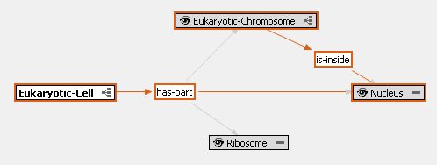
KR in KB_Bio_101
Unique Features
Graph structured descriptions
Every Eukaryotic Cell is a Cell and
has parts Eukaryotic Chromosome, Nucleus and a Ribosome such that
Eukaryotic Chromosome is inside the Nucleus
$$∀ x :EukaryoticCell\left(x\right)→$$
$$∃ y_{1},y_{2},y_{3}:Cell\left(x\right)∧$$
$hasPart\left(x,y_{1}\right) ∧ hasPart\left(x,y_{2}\right)∧ hasPart\left(x,y_{3}\right)∧$
$$isInside\left(y_{2},y_{3}\right)∧ Ribosome\left(y_{1}\right) ∧$$
$EukaryoticChromosome(y_{2})$ $∧$ $Nucleus(y_{3})$
The knowledge shown in red is not expressible in known decidable description logics such as OWL 2
This can be captured in Rule Languages

Slide 7
KR in KB_Bio_101
Unique Features
Inherit and Specialize
In the Eukaryotic Cell
Ribosome was inherited from Cell
Chromosome was inherited from Cell and specialized to Eukaryotic Chromosome

Slide 8
KR in KB_Bio_101
Unique Features
Inherit and Specialize
In the Eukaryotic Cell
Ribosome was inherited from Cell
Chromosome was inherited from Cell and specialized to Eukaryotic Chromosome
$$∀ x :Cell\left(x\right)→ \\ hasPart\left(x,f_{Cell}\#1\left(x\right)\right) ∧ hasPart\left(x,f_{Cell}\#2\left(x\right)\right) ∧ Ribosome\left(f_{Cell}\#1\left(x\right)\right) ∧ Chromosome(f_{Cell}\#2\left(x\right))$$
$$∀ x :ECell\left(x\right)→ \\ hasPart\left(x,f_{ECell}\#1\left(x\right)\right) ∧ hasPart\left(x,f_{ECell}\#2\left(x\right)\right)$$
$$hasPart\left(x,f_{ECell}\#3\left(x\right)\right) ∧isInside\left(f_{ECell}\#2\left(x\right),f_{ECell}\#3\left(x\right)\right) ∧ Ribosome\left(f_{ECell}\#1\left(x\right)\right) ∧ Chromosome(f_{ECell}\#2\left(x\right))∧Nucleus(f_{ECell}\#3\left(x\right))$$

Slide 9
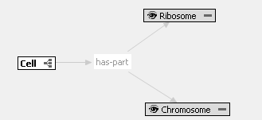
KR in KB_Bio_101
Unique Features
Inherit and Specialize
In the Eukaryotic Cell
Ribosome was inherited from Cell
Chromosome was inherited from Cell and specialized to Eukaryotic Chromosome
$$∀ x :Cell\left(x\right)→ \\ hasPart\left(x,f_{Cell}\#1\left(x\right)\right) ∧ hasPart\left(x,f_{Cell}\#2\left(x\right)\right) ∧ Ribosome\left(f_{Cell}\#1\left(x\right)\right) ∧ Chromosome(f_{Cell}\#2\left(x\right))$$
$$∀ x :ECell\left(x\right)→ \\ hasPart\left(x,f_{ECell}\#1\left(x\right)\right) ∧ hasPart\left(x,f_{ECell}\#2\left(x\right)\right)$$
$$hasPart\left(x,f_{ECell}\#3\left(x\right)\right) ∧isInside\left(f_{ECell}\#2\left(x\right),f_{ECell}\#3\left(x\right)\right) ∧ Ribosome\left(f_{ECell}\#1\left(x\right)\right) ∧ Chromosome(f_{ECell}\#2\left(x\right))∧Nucleus(f_{ECell}\#3\left(x\right))$$
$\left(f_{Cell}\#1\left(x\right)\right)$= $\left(f_{ECell}\#1\left(x\right)\right)$
$\left(f_{Cell}\#2\left(x\right)\right)$= $\left(f_{ECell}\#2\left(x\right)\right)$

Slide 10
KR in KB_Bio_101
Computational properties
Reasoning with KR in KB_Bio_101 is, in general, un-decidable
Object Oriented Knowledge Bases in Logic Programming (Chaudhri, et. al., Technical Communication of the International Conference on Logic Programming, 2013)
Available at: http://www.ai.sri.com/pub_list/1958
Let us consider the OWL export next

Slide 11
Necessary Properties of Classes
Tree-Structured descriptions
SubClassOf(:Cell
ObjectIntersectionOf(:Living-Entity
ObjectMinCardinality(1 :has-part :Chromosome)
ObjectSomeValuesFrom(:has-part
ObjectIntersectionOf(:Mixture :Cytoplasm))
ObjectSomeValuesFrom(:has-part
ObjectIntersectionOf(:Ribosome))
ObjectSomeValuesFrom(:has-part
ObjectIntersectionOf(:Chromosome))))

Slide 12
Necessary Properties of Classes
Graph-structured description
SubClassOf(:Eukaryotic-Cell
ObjectIntersectionOf(:Cell
ObjectSomeValuesFrom(:has-part
ObjectIntersectionOf(:Nucleus))
ObjectSomeValuesFrom(:has-part
ObjectIntersectionOf(:Eukaryotic-Chromosome
ObjectSomeValuesFrom (:is-inside
ObjectInterSectionOf( :Nucleus))))))
Problem: What to do about the is-inside edge between Eukaryotic-Chromosome and Nucleus?

Slide 13
Translating Graph Structures
Use of Node-ID Marker Concepts
SubClassOf(:Eukaryotic-Cell
ObjectIntersectionOf(:Cell
ObjectSomeValuesFrom(:has-part
ObjectIntersectionOf(:ID-4001 :Nucleus))
ObjectSomeValuesFrom(:has-part
ObjectIntersectionOf(:Eukaryotic-Chromosome
ObjectSomeValuesFrom (:is-inside
ObjectInterSectionOf(:ID-4001 :Nucleus))))))

Slide 14
Translating Graph Structures
Unravel to depth 2
SubClassOf(:Eukaryotic-Cell
ObjectIntersectionOf(:Cell
ObjectSomeValuesFrom(:has-part
ObjectIntersectionOf(:Nucleus
ObjectSomeValuesFrom (:is-inside-of
ObjectIntersectionOf(:Eukaryotic-Chromosome))))
ObjectSomeValuesFrom(:has-part
ObjectIntersectionOf(:Eukaryotic-Chromosome
ObjectSomeValuesFrom (:is-inside
ObjectInterSectionOf(:Nucleus))))))

Slide 15
Inherit and Specialize
In the Eukaryotic Cell
Ribosome was inherited from Cell
Chromosome was inherited from Cell and specialized to Eukaryotic Chromosome
SubClassOf(:Eukaryotic-Cell
ObjectIntersectionOf(:Cell
ObjectSomeValuesFrom(:has-part
ObjectIntersectionOf(:ID-4001 :Nucleus))
ObjectSomeValuesFrom(:has-part
ObjectIntersectionOf(:Eukaryotic-Chromosome
ObjectSomeValuesFrom (:is-inside
ObjectInterSectionOf(:ID-4001 :Nucleus))))))
SubClassOf(:Cell
ObjectIntersectionOf(:Living-Entity
ObjectSomeValuesFrom(:has-part
ObjectIntersectionOf(:Chromosome))))
There is no way to explicitly model inherit and specialize relationship in OWL.
Leads to an under-specification in class hierarchy

Slide 16
Nominals
KB_Bio_101 uses nominals, but some DL systems are unable to handle them (e.g., Eukaryotic Cell is big in relation to prokaryote)
First variant of export maps nominals to classes:
SubClassOf(:big :Size-Constant)
SubClassOf(:Eukaryotic-Cell
ObjectIntersectionOf(:Cell
ObjectIntersectionOf(
ObjectSomeValuesFrom(:size
ObjectIntersectionOf(:Size-Value ObjectIntersectionOf(
ObjectSomeValuesFrom(:the-scalar-value :big)
ObjectSomeValuesFrom(:scalar-unit-class :Prokaryote))))
The second variant includes nominals as intended
ClassAssertion(:Size-Constant :big)
SubClassOf(:Eukaryotic-Cell
ObjectIntersectionOf(:Cell
ObjectIntersectionOf(
ObjectSomeValuesFrom(:size
ObjectIntersectionOf(:Size-Value
ObjectIntersectionOf(
ObjectHasValue(:the-scalar-value :big)
ObjectSomeValuesFrom(:scalar-unit-class Prokaryote))))

Slide 17
Different Versions of KB_Bio_101
From an FOL representation of the KB, we generate a total of 432 versions
72 versions use node id markers
Dimensions of expressiveness
Cardinality constraint (exclude, include only functional, include all)
disjoint-ness (include, exclude)
sufficient properties (include, exclude)
relation axioms (include, exclude)
constant classes (include, exclude)
If constant classes: value classes (include, exclude)
360 versions use un-raveling
Organized by unraveling depth (0 to 4)
72 versions corresponding to each level of unraveling

Slide 18
KB_Bio_101 Statistics
Regarding Class Axioms:
# Classes | # Relations | # Constants | Avg. # Skolems / Class | Avg. # Atoms / Necessary Condition | Avg. # Atoms / Sufficient Condition
6430 | 455 | 634 | 24 | 64 | 4
# Constant Typings | # Taxonomical Axioms | # Disjointness Axioms | # Equality Assertions | # Qualified Number Restrictions
714 | 6993 | 18616 | 108755 | 936
Regarding Relation Axioms:
# DRAs | # RRAs | # RHAs | # QRHAs | # IRAs | # 12NAs / # N21As | # TRANS + # GTRANS
449 | 447 | 13 | 39 | 212 | 10 / 132 | 431
Regarding Other Aspects:
# Cyclical Classes | # Cycles | Avg. Cycle Length | # Skolem Functions
1008 | 8604 | 41 | 73815

Slide 19
Reasoning Challenges
Loading the KB
Classifying the taxonomy
Checking if it is consistent
ABOX Reasoning
Instantiate each concept by creating an individual
For that individual compute the value of all relations

Slide 20
Ontology Management Challenges
Ontology evaluation
Which parts of KB_Bio_101 are high quality? Which can be improved?
Ontology modularization
Can we extract meaningful modules from KB_Bio_101?
Ontology design patterns
What are repeating patterns of axioms in KB_Bio_101?
Ontology testing and debugging
Is KB_Bio_101 consistent? What are maximally consistent subsets?

Slide 21
Summary
KB_Bio_101
is a core component of an intelligent biology textbook
a valuable resource for AI research on reasoner evaluation
Graph structured concepts
Terminological cycles
Size and complexity
We welcome feedback from the community on this data set and suggestions for improving it

Slide 22
Thank You!
This work is owned by Vulcan Inc. and is licensed for use under the Creative Commons Attribution-NonCommerical-ShareAlike 3.0 license (http://creativecommons.org/licenses/by-nc-sa/3.0/). Vulcan Inc., June 2013

