Slide 1

A Survey of Current, Stand-alone
OWL Reasoners
Nicolas Matentzoglu, Jared Leo, Valentino Hudhra, Bijan Parsia, Uli Sattler

Slide 2
Motivation
Quo vadis, OWL reasoner development?
  Trends
  Extensions
Target some relevant folks to invite them to ORE
  Competition
  Workshop
Terminological reconciliation
  What do we mean by “OWL reasoner”?
  OWL vs DL, optimisations, calculi, many more
Pointing reasoning related researchers to
  Potential collaborations
  Relevant related work
  Relevant experts
Establish a sense of community
  Better tools for the users
  Hopefully one day focus some of the fragmented efforts
  After all we are a research area, not a market (yet, so much)

Slide 3
Abburu 2012
owl.cs@manchester
?
Mishra 2011
Past
Expert knowledge
Incomplete reasoner listings
Present
Reasonable surveys
More centralised benchmarking
Future
Centralised information on reasoning
Readily available updates on latest optimisations
Fragmented literature and benchmarking
“Complete” listings
Truly independent extensive benchmarks
Dentler et al 2011
ORE 2.0
w3c
Protege
ORE!

Slide 4

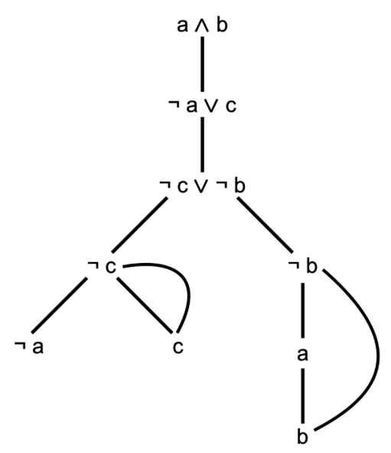

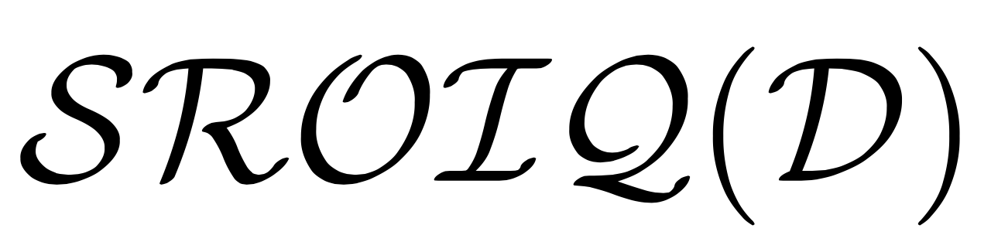

Reasoner Surveys
Reasoner Benchmark
  Performance
  Systematic approach
  Optimisations
  Practical considerations
  Competitions (ORE)
Reasoner Meta Survey
  Surveying existing systems
  Supported features
  Categorisation & Landscape
  Methodology

Slide 5
Goals
Identify all stand-alone (current) reasoners
… that will be able to process at least a subset of OWL
Problem:
  Exact scope (OWLIM, Jess, etc)
  Distinguish proof of concept
Extract interesting characteristics
Group reasoners by reasonable criteria
Get a sense of the direction reasoner developing is heading
Provide foundation for future KB of OWL Reasoning
  OWL Reasoner Ontology

Slide 6
Materials and Methodology
We survey current, stand-alone, OWL reasoners
  current... updated/introduced since Jan 2012
  stand-alone... intended to be used by itself
  OWL... dealing with a defined fragment of OWL.
Reasoner selection
  In: public lists + systematic review + previous surveys
  Systematic review by-product
  68 initial reasoners added to the pool
  Check the most up-to-date usage. Meets the criteria?
  35 final reasoners selected
Online questionnaire
  Designed by reasoner developers, logicians and empirical researchers
  Sent to known developers of selected reasoners
Final categorisation
  Mainly developer response, sometimes expert review (calculus)

Slide 7
Reasoner Characteristics
Utility
  User perspective
  What can it be used for?
Calculus
  Developer perspective
  How is functionality realised?

Slide 8
Reasoner Characteristics - Utility
Supported reasoning services :
  Classification
  Query Answering
  Data Access
  Consistency
  Explanations
  etc.
Expressivity levels :
  OWL Profile (OWL 2 EL ... OWL 2 DL)
  DL Fragment (EL ... EL+ ... EL++ ... ALC ... SROIQ(D))
Soundness and completeness
  With respect to what?

Slide 9
Reasoner Characteristics - Calculus
Model Construction:
  Building models to test knowledge base consistency
  Normally used in highly expressive fragments of OWL 2 DL
  Mainly used for automata-based and tableaux techniques
Consequence-Based Reasoning:
  Relies on adding logical consequences to the knowledge base
  Most commonly used for light weight fragments (EL+(+))
  Rule based, saturation, resolution etc.
Rewriting:
  Expands knowledge base by rewriting facts for a specific task
  Query answering, structural transformations

Slide 10
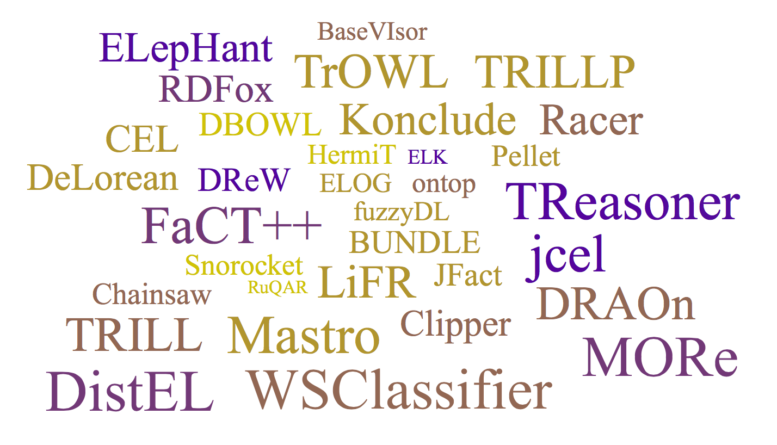
Results
Living Semantic Platform
KARMA
HydrOWL
PAGOdA
35 Reasoners

Slide 11
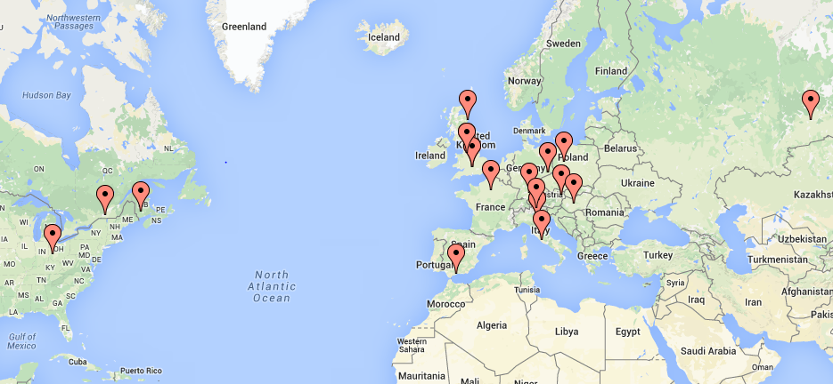
Results: Institutions

Slide 12
Results
All calculi were grouped into 4 categories
True Hybrid vs. Pseudo Hybrid
Model construction
Racer
FaCT++
Pellet
fuzzyDL
HermiT
LiFR
DRAOn
JFact
BUNDLE
Konclude
TReasoner
TRILL
TRILLP
Consequence-based
Rewriting
BaseVISor
CEL
Snorocket
jcel
TrOWL
ELK
DBOWL
DistEL
ELepHant
WSClassifier
DeLorean
DReW
Mastro
ontop
Clipper
ELOG
RDFox
RuQAR
Modular
Chainsaw
MORe

Slide 13
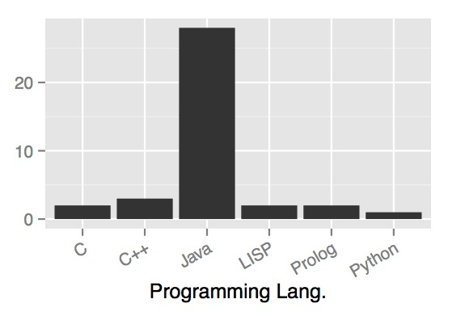


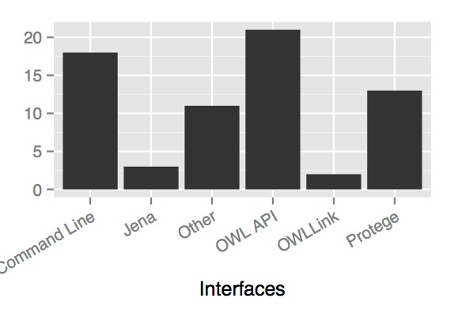


Results
One language to rule them all
OWL API rules

Slide 14
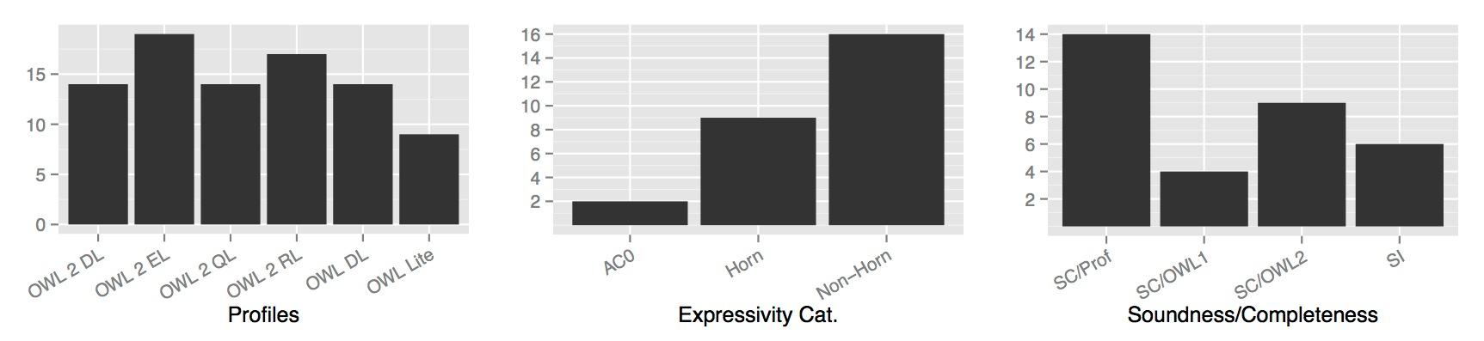
Results: Expressivity and services
Services
  Satisfiability checking (22)
  KB consistency (24)
  Entailments checking (19)
  Classification (21)
  Realisation (15)
  Conjunctive query answering (11)

Slide 15
Other features
Little use of modularity (4)
  Incremental (3)
  Classification (4)
Some use of parallelisation
  Classification (6)
  Prep-pro (4)
Some reasoners tuned to particular ontologies
  SNOMED
  FMA
Some experiments involving mobile technologies
  Run on Android (5)
  Never (24)

Slide 16
Results: Recent Activity

Slide 17
Foundations of the OWL Reasoning KB

Slide 18
Future Directions
Parallelism and Concurrency (6)
Incremental reasoning (4)
Other topics of interest:
  Reasoning with large scale datasets
  Meta-modelling and mete-reasoning
  Proof-based explanations
  Interfaces that support access to tableaux structure

Slide 19
Conclusions
There is still a lot going on in the world of OWL reasoning
While the survey was “exhaustive”, some reasoners where surely missed out
The data and knowledge generated as part of the service will be made accessible in for of a knowledge base…
… but whoever wants to see the data now: email us!

Slide 20
Thank You!

