Slide 1

Ontology-based Query Answering with PAGOdA
BERNARDO CUENCA GRAU
Joint work with Yujiao Zhou, Yavor Nenov, Ian Horrocks, Mark Kaminski

Slide 2
What does PAGOdA do?
Compute certain answers to a conjunctive query w.r.t. an OWL 2 TBox and ABox
Queries are written in a SPARQL-like syntax and compiled as CQs
PAGOdA is sound and complete if:
  The query does not contain cycles of length at least two involving only existentially quantified variables OR
  The TBox is Datalog or ELHO
Otherwise it works on a best-effort basis
Returns sound answer + upper bound on incompleteness

Slide 3
The idea behind PAGOdA
Redistribute the reasoning workload between
A scalable Datalog reasoner (RDFox)
A fully-fledged OWL 2 Reasoner (HermiT)]
Provide pay-as-you-go behaviour
  Uses Datalog reasoner “out of the box”
  Efficiently computes sound partial answers
  In “easy” cases, efficiently computes complete answers
  In “harder” cases, applies increasingly powerful but less scalable reasoning techniques as needed to completely answer query
  The use of the OWL 2 reasoner is rarely needed in practice
Pagoda works on rules with existential quantifiers and disjunctions in the head
DL ontologies are first normalised in rule form.

Slide 4
Step 1: Lower Bound
Consider the Datalog subset of the ontology
Extend it to capture some implications of disjunctive rules. Compute materialisation M.
We can (deterministically) derive that a_hare is not a meat eater and hence a Herbivore.
Compute answers to Q w.r.t. The ELHO subset of the ontology and M
  Feasible within Datalog using combined approach with filtration

Slide 5
Step 2: Upper Bound
Strengthen the ontology into a Datalog program
  Turn disjunctions into conjunctions
  Skolemise existential quantifiers
Replace with a fresh nullary predicate
We can obtain a first, naïve, upper bound materialisation

Slide 6
Step 2: Upper Bound
Naïve upper bound improved by chase procedures on top of RDFox.
  Turn disjunctions into conjunctions and replace
But do not Skolemise straightaway!
Add facts
only if Q does not hold in the current materialisation
Procedure terminates and computes a more refined upper bound

Slide 7
Step 2: Upper Bound
PAGOdA implements another chase procedure
  Existential and disjunctive rules applied only when needed
  When a disjunctive rule is applied, a single disjunct chosen
  When an existential rule applied, head is Skolemised to constant
This upper bound can be very precise, but it is useless if is derived

Slide 8

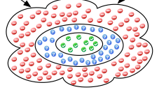
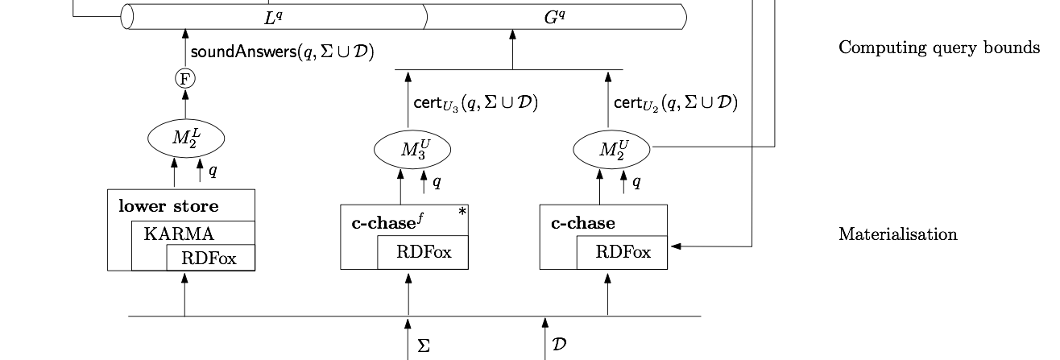
Obtaining the Gap
The Gap answers are computed from
  a lower bound (as described)
  the intersection of an upper bound where existentials are treated “lazily” and another one where disjunctions are also treated “lazily”

Slide 9
Step 2: Subset Extraction
Checking possible answers in the gap is expensive
Compute fragment sufficient to check the gap.
Achieved also via Datalog materialisation.
Size of the problem substantially reduced.

Slide 10
Subset Extraction
Construct a Datalog KB consisting of
All facts in
A fact for each gap answer a
Rules resulting from “inverting” rules in
Simulate hyperresolution proofs in “backwards”
Subset is then defined as follows:

Slide 11
Step 3: Summarisation
Further reduce problem size by summarising the KB subset
  Technique introduced by the SHER team at IBM
  “Merge” constants that are instances of same concepts
  Check answers against summary using OWL 2 reasoner
  The summary of the fragment is typically very small
This is an orthogonal over-approximation to previous ones
  We further reduce the size of the gap
  Sometimes we even make it empty !

Slide 12
Step 4: Dependency analysis
Group remaining candidate answers
  If a and b in the same group then a is an answer iff b is
  We can also establish dependencies between groups
Check group representatives against KB subset using the fully-fledged reasoner.

Slide 13
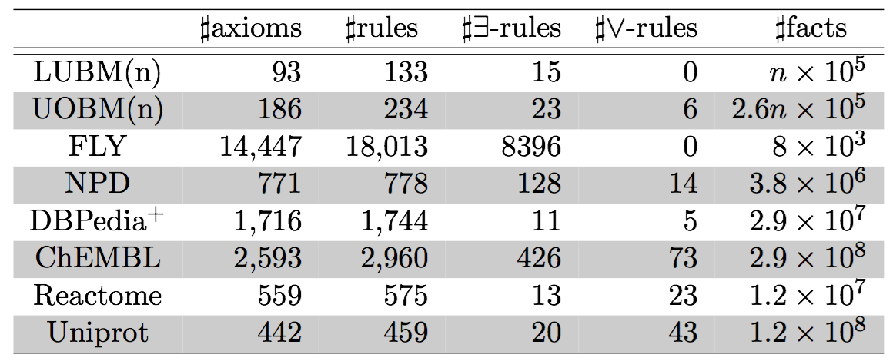
Evaluation: Test data
Queries:
  LUBM / UOBM: Standard queries + manually crafter “hard” queries.
  FLY: queries provided by ontology developers.
  NPD and DBPedia+: all atomic queries.
  ChEMBL/Reactome/Uniprot: realistic queries + atomic queries.
Experiments performed on a 5,000£ server with 32 cores and 250GB RAM

Slide 14
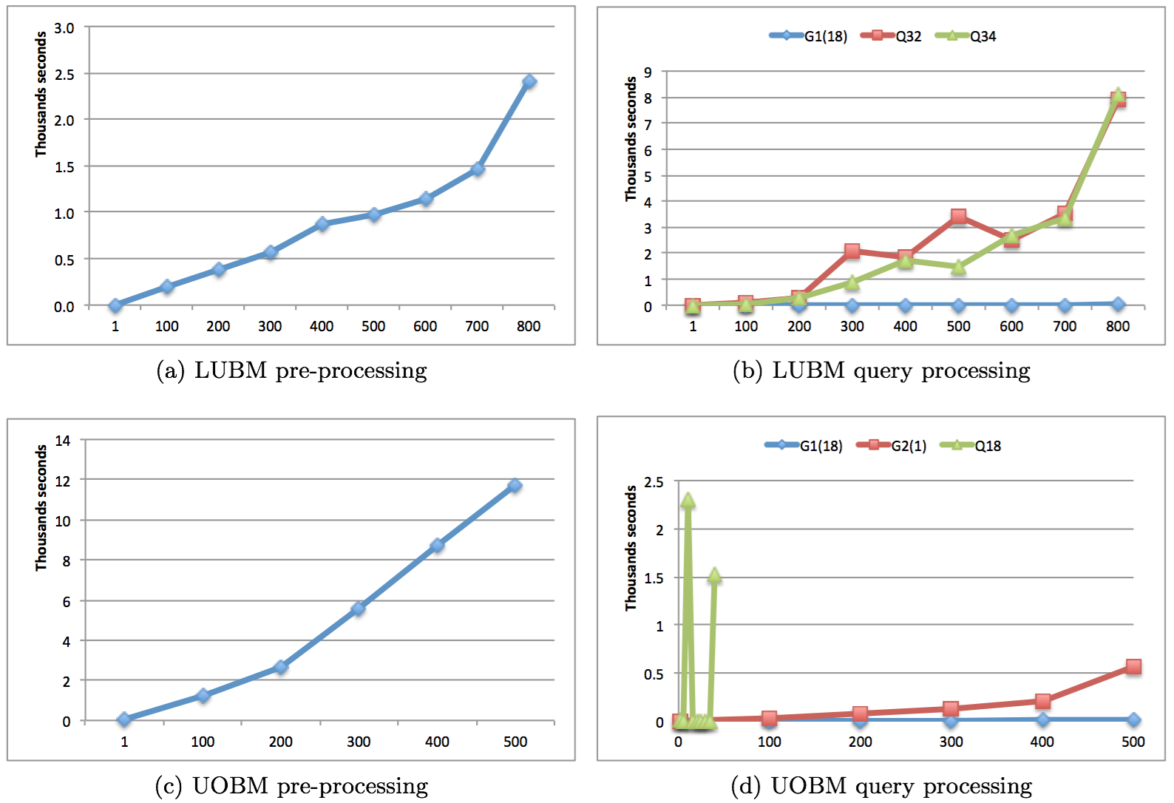
Evaluation: Scalability

Slide 15
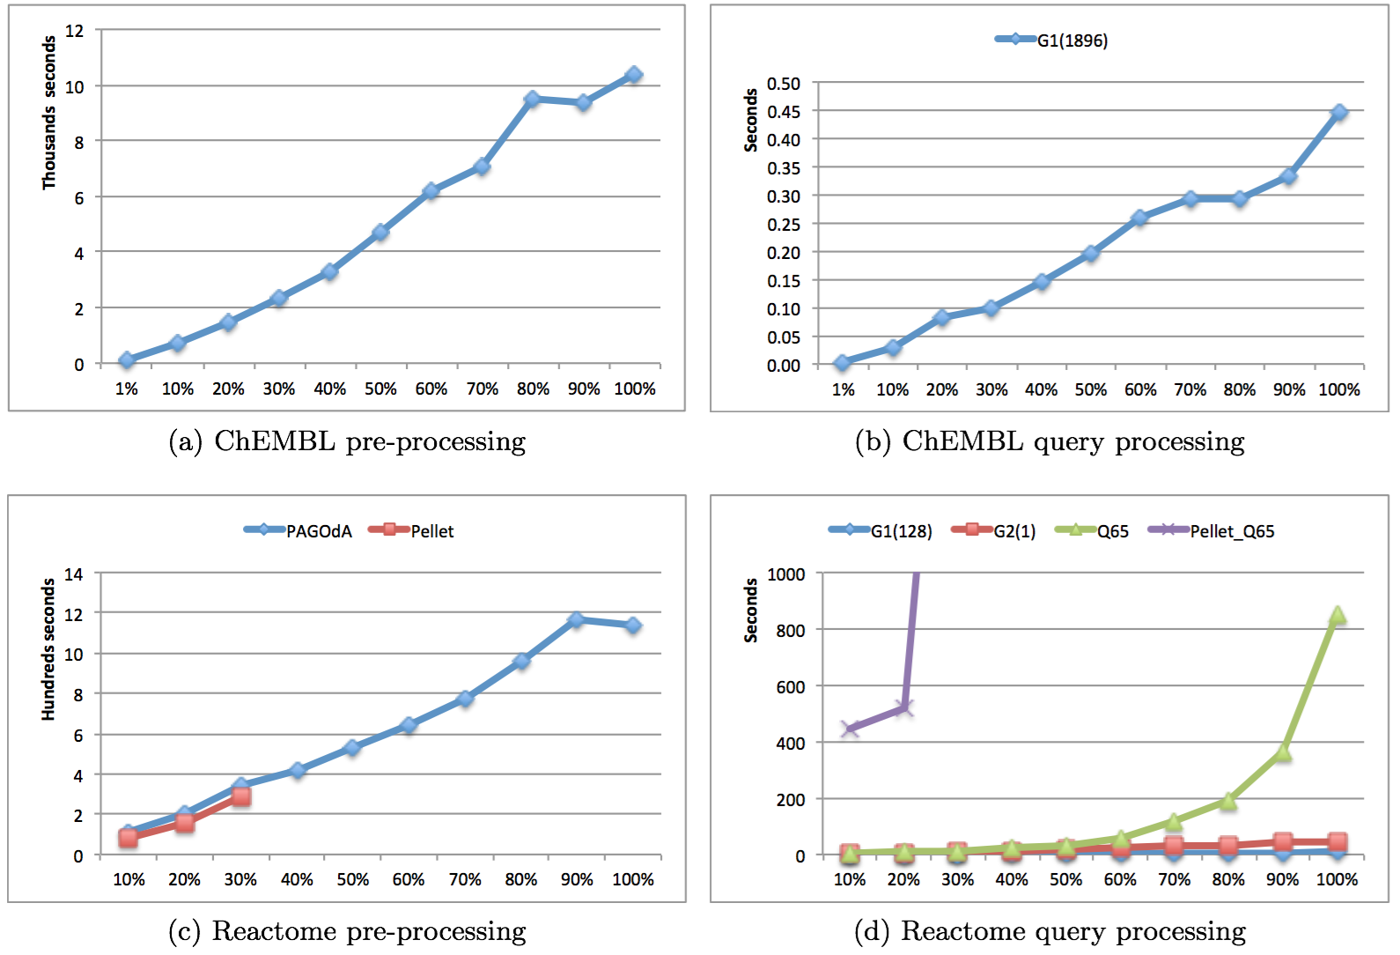
Evaluation: Scalability

Slide 16
Queries answered by each technique
 | LUBM (100) | UOBM(1) | FLY | DBPedia | NPD | ChEMBL (1%) | Reactome (10%) | Uniprot (1%)
Total | 35 | 20 | 6 | 1247 | 478 | 1896 | 130 | 240
Bounds | 33 | 16 | 5 | 1246 | 473 | 1896 | 128 | 236
Sum | 33 | 17 | 5 | 1247 | 478 |  | 129 | 240
Full | 35 | 20 | 6 |  |  |  | 130
Size of the largest subsets extracted
 | LUBM (100) | UOBM(1) | FLY | DBPedia | NPD | Reactome (10%) | Uniprot (1%)
Facts | 0.5% | 10.4% | 7.3% | 9 x 10⁻⁵% | 16% | 5.2% | 4 x 10⁻⁴%
Rules | 3.5% | 10.9% | 0.9% | 2.4% | 18% | 5.3% | 1.1%

Slide 17
Outlook
PAGOdA is a fully-fledged query answering system
  PAYG behaviour on unrestricted ontologies and queries
  Able to reason with expressive ontologies and large-scale datasets
  Available for you to download and try out!
The techniques in PAGOdA are generic
  Applicable even to undecidable languages !
The techniques in PAGOdA are interesting in their own right
  Subset computation techniques have motivated new research on module extraction.

