Slide 1
Ian Horrocks
Information Systems Group
Department of Computer Science
University of Oxford

Slide 2

History of the Semantic Web
“A new form of Web content that is meaningful to computers will unleash a revolution of new possibilities”
Notes:
Early days, emphasis was on the Web, and the use of semantics the enable new kinds of application, and in particular automation of functions that have up to now required human intervention, i.e., semantic WEB.

Slide 3
Standards
RIF
Feb, 2013
SAWSDL
Aug 2007
POWDER
Sep, 2009
PROV
Apr, 2013
GRDDL
Sep, 2007
SKOS
Aug, 2009
JSON-LD 1.0
Jan, 2014
RDFa
Oct, 2008
RDB2RDF
Sep, 2012
RDFa 1.1
Mar, 2015
Notes:
Underpinning the whole effort are the standards.
The “backbone” consists of RDF(S), OWL and SPARQL.
Many others also playing a role.
“Be fruitful and increase in number; fill the earth and subdue it.”

Slide 4
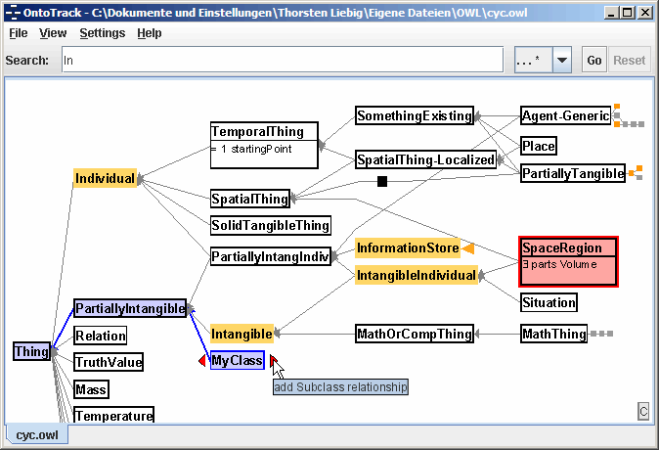
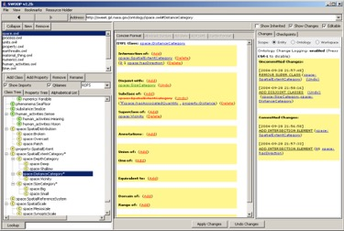

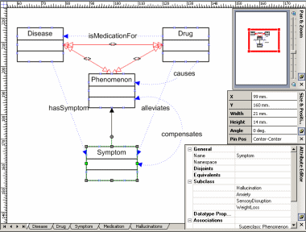

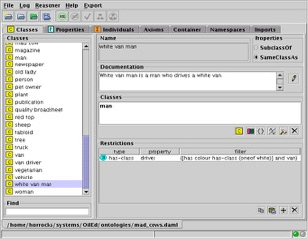
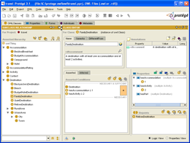


Tools
Hermit
Initial focus on ontology engineering
Main reasoning tasks are (class) consistency and subsumption/classification

Slide 5

Applications: Travel planning and booking
Notes:
If we take our own hype seriously, then failure is inevitable
To be fair, some hype was needed to get attention/funding;
Better viewed as a Grand Challenge than as a 10 year research project (compare with, e.g., robot football)

Slide 6
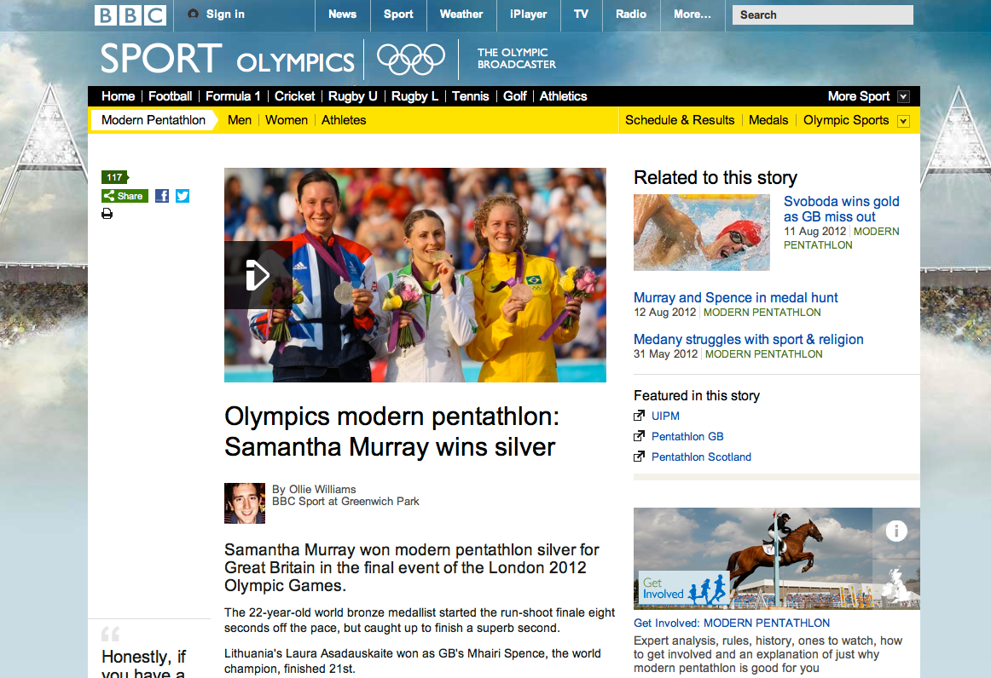
Applications: Content Management

Slide 7

Applications: Search
Notes:
If we take our own hype seriously, then failure is inevitable
To be fair, some hype was needed to get attention/funding;
Better viewed as a Grand Challenge than as a 10 year research project (compare with, e.g., robot football)

Slide 8
Applications: Search
Explicit KR sometimes needed, e.g., Knowledge Graph
Less rigorous treatment of semantics
Not using Semantic Web standards
Notes:
If we take our own hype seriously, then failure is inevitable
To be fair, some hype was needed to get attention/funding;
Better viewed as a Grand Challenge than as a 10 year research project (compare with, e.g., robot football)

Slide 9
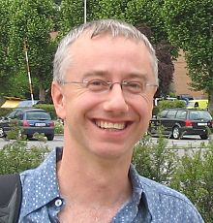
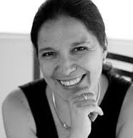
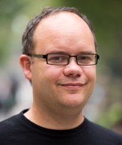
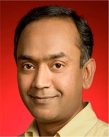
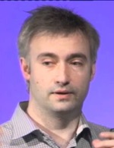
Applications: Search
Explicit KR sometimes needed, e.g., Knowledge Graph
Less rigorous treatment of semantics
Not using Semantic Web standards
Hiring Semantic Web people
Notes:
If we take our own hype seriously, then failure is inevitable
To be fair, some hype was needed to get attention/funding;
Better viewed as a Grand Challenge than as a 10 year research project (compare with, e.g., robot football)

Slide 10

Application Domains
Agriculture

Slide 11
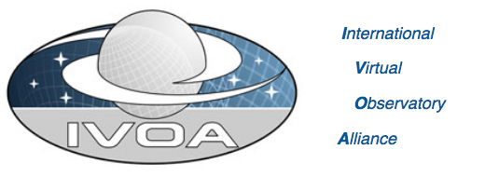
Application Domains
Agriculture
Astronomy

Slide 12
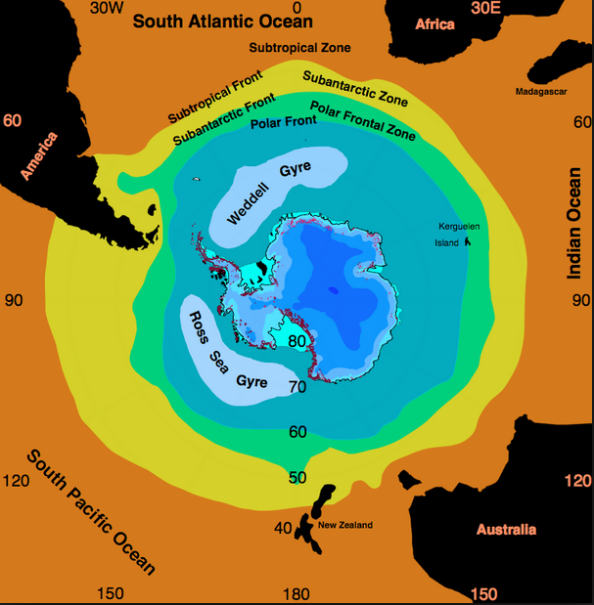
Application Domains
Agriculture
Astronomy
Oceanography

Slide 13
Application Domains
Agriculture
Astronomy
Oceanography
Defence
Education
Energy management
Geography
Gioscience
Life sciences
…

Slide 14
Application Domains
OBO foundry includes more than 100 biological and biomedical ontologies
Siemens “actively building OWL based clinical solutions”
SNOMED-CT (Clinical Terms) ontology
used in healthcare systems of more than 15 countries, including Australia, Canada, Denmark, Spain, Sweden and the UK
also used by major US providers, e.g., Kaiser Permanente
ontology provides common vocabulary for recording clinical data

Slide 15
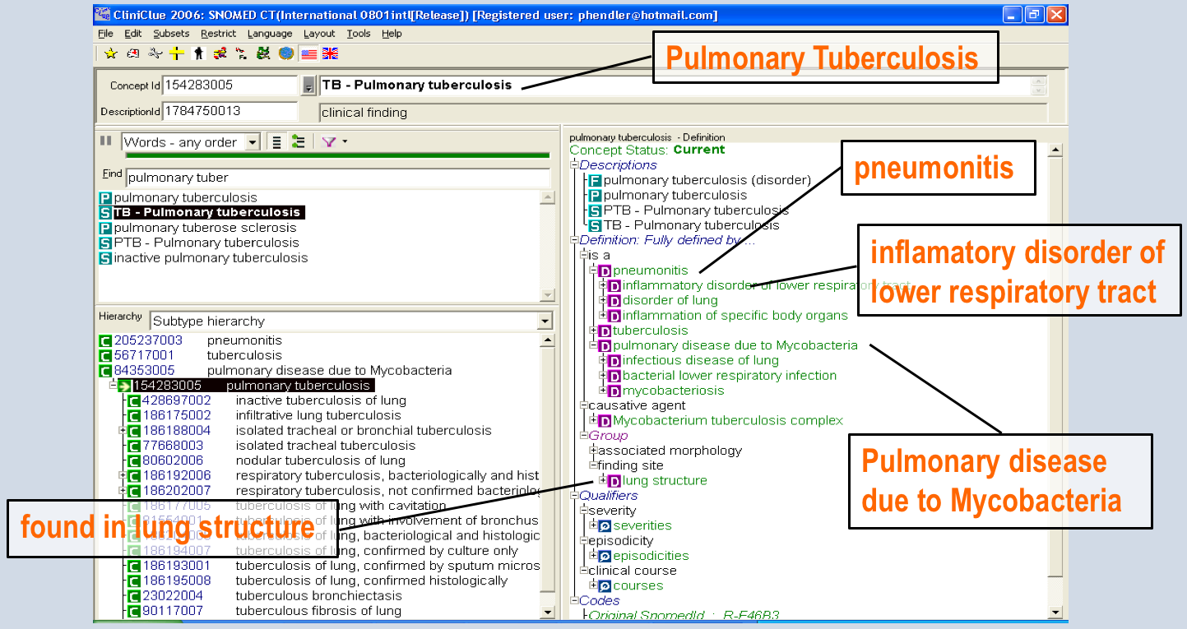
Ontologies as structured vocabularies
Ontologies used as structured vocabularies
SNOMED, e.g., distributed as simple taxonomy

Slide 16
Ontologies as structured vocabularies
Ontologies used as structured vocabularies
SNOMED, e.g., distributed as simple taxonomy
Ontology terms used as annotations/tags
Benefits of using logic-based ontology language include
Reasoning support (critical) for development & maintenance, in particular derivation of taxonomy from descriptions (classification)
Easier location of relevant terms within large structured vocab.
Query answers enhanced by exploiting class hierarchy
But limited query answering w.r.t. Ontology + Data

Slide 17
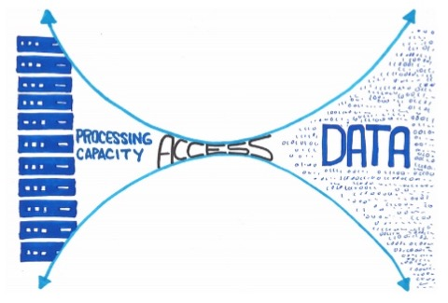
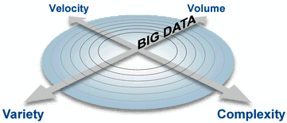
Data Access Applications: “Big Data”
Huge quantity of data increasing at an exponential rate
Identifying & accessing relevant data is of critical importance
Handling data variety & complexity often turns out to be main challenge
Ontologies can provide integrated and user-centric view of heterogeneous data sources

Slide 18

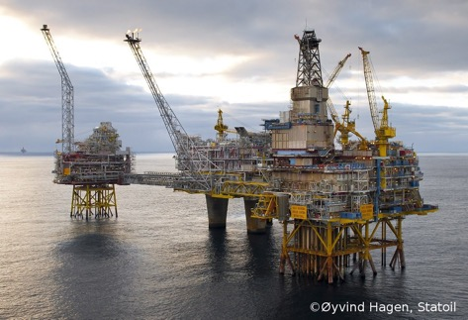
Data Access: Statoil Exploration
Geologists & geophysicists use data from previous operations in nearby locations to develop stratigraphic models of unexplored areas
TBs of relational data
using diverse schemata
spread over 1,000s of tables
and multiple data bases

Slide 19
Data Access: Statoil Exploration
Geologists & geophysicists use data from previous operations in nearby locations to develop stratigraphic models of unexplored areas
TBs of relational data
using diverse schemata
spread over 1,000s of tables
and multiple data bases
Data Access
900 geologists & geophysicists
30-70% of time on data gathering
4 day turnaround for new queries

Slide 20
Data Access: Statoil Exploration
Geologists & geophysicists use data from previous operations in nearby locations to develop stratigraphic models of unexplored areas
TBs of relational data
using diverse schemata
spread over 1,000s of tables
and multiple data bases
Data Access
900 geologists & geophysicists
30-70% of time on data gathering
4 day turnaround for new queries
Data Exploitation
Better use of experts time
Data analysis “most important factor” for drilling success

Slide 21
Data Access: Statoil Exploration
Complex models
Interdisciplinary: geology, physics, chemistry, …
Combine (in ad hoc ways) data from:
Multiple specialised sources
Direct and indirect observations
Different vendors
Incompatible models
Overlapping content

Slide 22
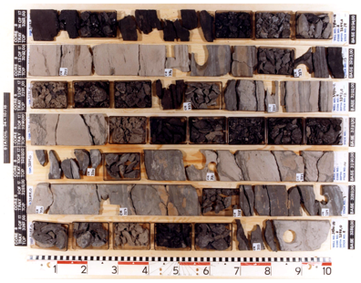
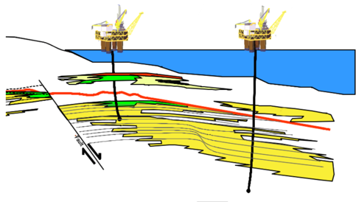
Data Access: Statoil Exploration

Slide 23
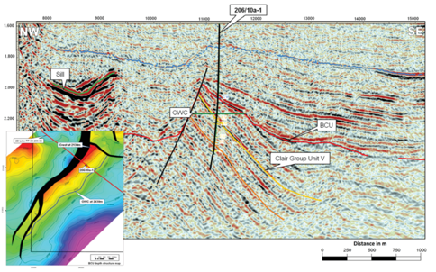
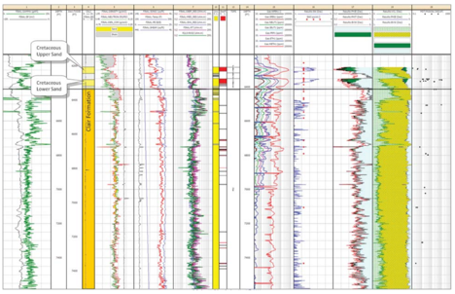
Data Access: Statoil Exploration

Slide 24
Data Access: Statoil Exploration
Query: Wellbores with cores that overlap log curves
Notes:
"Wellbores with cores that overlap log curves" is shorthand for something like "Wellbores where there is a core extracted and log curve measurements taken at the same depth (interval).” A log curve is "just" a measurement of some kind done along the wellbore path. They can do this while drilling or by sending a wire with instruments down the wellbore afterwards. A core is a piece of rock (or whatever the contents are) taken along the path of the wellbore. However, a "core sample" is a sample of the core, sent to the lab for analysis. The core is shown in the top right image. You can clearly see a hole after a core sample above the 9 digit in the ruler.

Slide 25
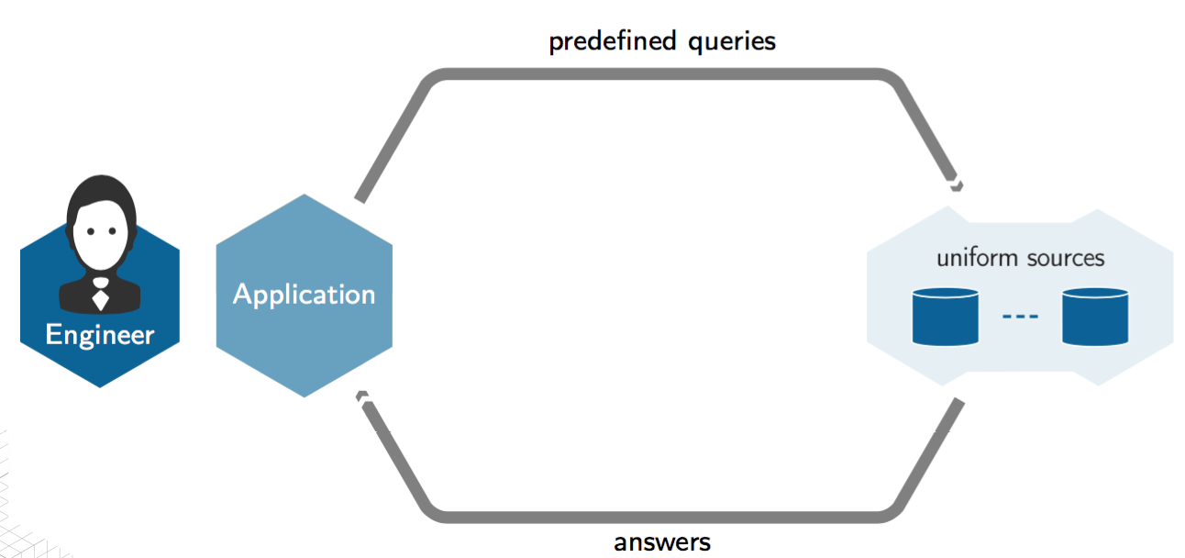
Data Access: Statoil Exploration

Slide 26
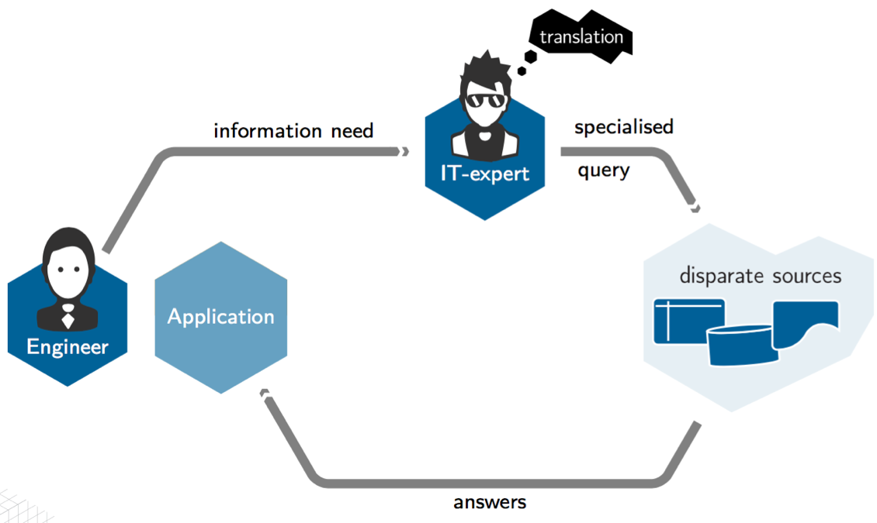
Data Access: Statoil Exploration

Slide 27
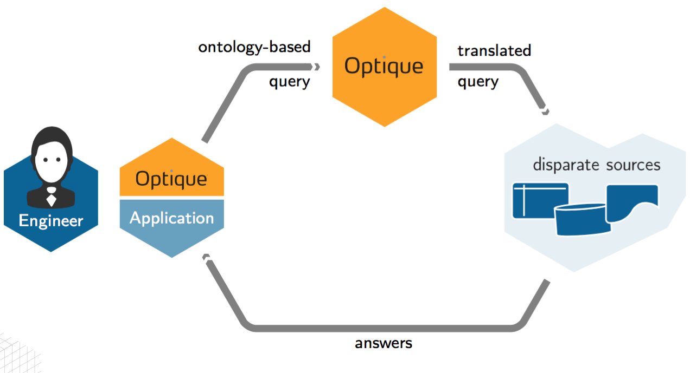
Data Access: Optique Approach

Slide 28
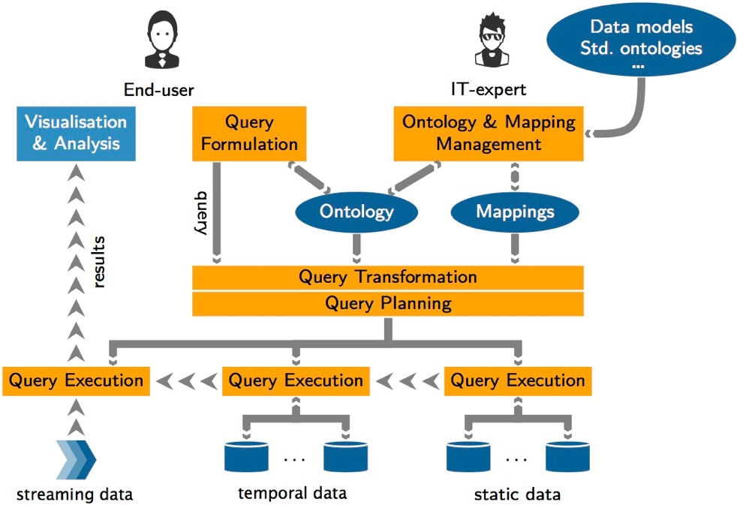
Data Access: Optique Approach

Slide 29
Data Access: Optique Approach

Slide 30
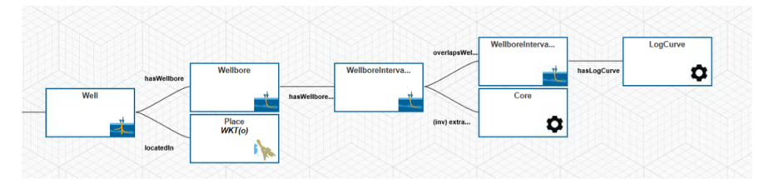
Data Access: Optique Approach

Slide 31
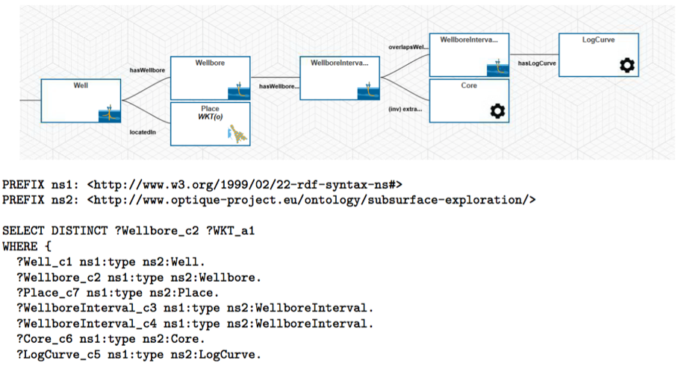
Data Access: Optique Approach

Slide 32
Data Access: Optique Approach

Slide 33
OWL Profiles
OWL 2 (2009) defines language subsets, aka profiles that can be “more simply and/or efficiently implemented”
OWL 2 QL
Based on DL-Lite
Efficiently implementable via rewriting into relational queries (OBDA)

Slide 34
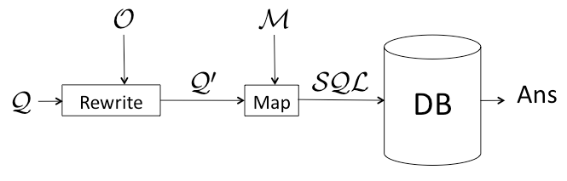
OWL 2 QL and Query Rewriting
Given QL ontology O query Q and mappings M:

Slide 35
OWL 2 QL and Query Rewriting
Given QL ontology O query Q and mappings M:
Use O to rewrite Q → Q⁰ s.t. answering Q⁰ without O is equivalent to answering Q w.r.t. O for any dataset

Slide 36
OWL 2 QL and Query Rewriting
Given QL ontology O query Q and mappings M:
Use O to rewrite Q → Q⁰ s.t. answering Q⁰ without O is equivalent to answering Q w.r.t. O for any dataset
Map ontology queries → DB queries (typically SQL) using mappings M to rewrite Q⁰ into a DB query

Slide 37
OWL 2 QL and Query Rewriting
Given QL ontology O query Q and mappings M:
Use O to rewrite Q → Q⁰ s.t. answering Q⁰ without O is equivalent to answering Q w.r.t. O for any dataset
Map ontology queries → DB queries (typically SQL) using mappings M to rewrite Q⁰ into a DB query
Evaluate (SQL) query against DB

Slide 38
Query Rewriting — Issues
1 Rewriting
May be large (worst case exponential in size of ontology)
Queries may be hard for existing DBMSs

Slide 39
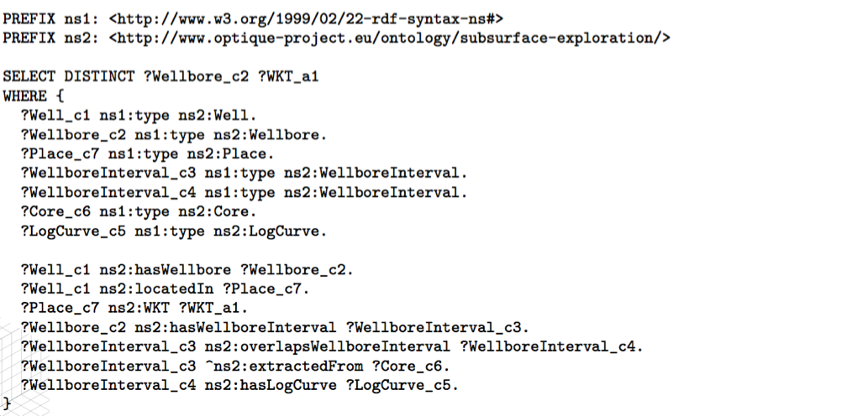
Query: Wellbores with cores that overlap log curves

Slide 40
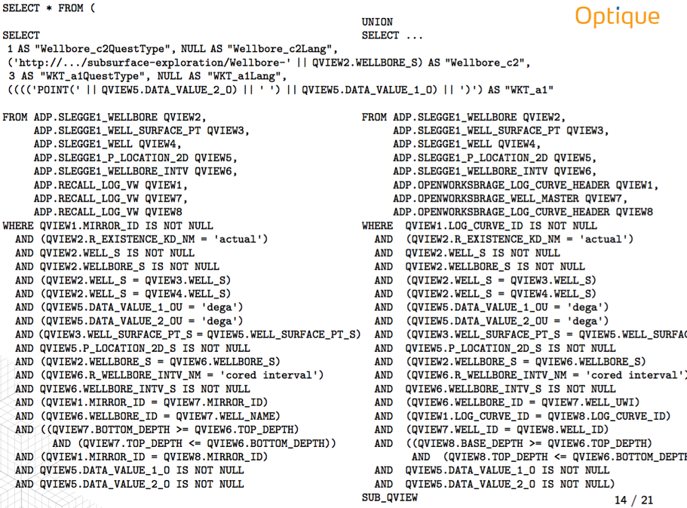
Query: Wellbores with cores that overlap log curves

Slide 41
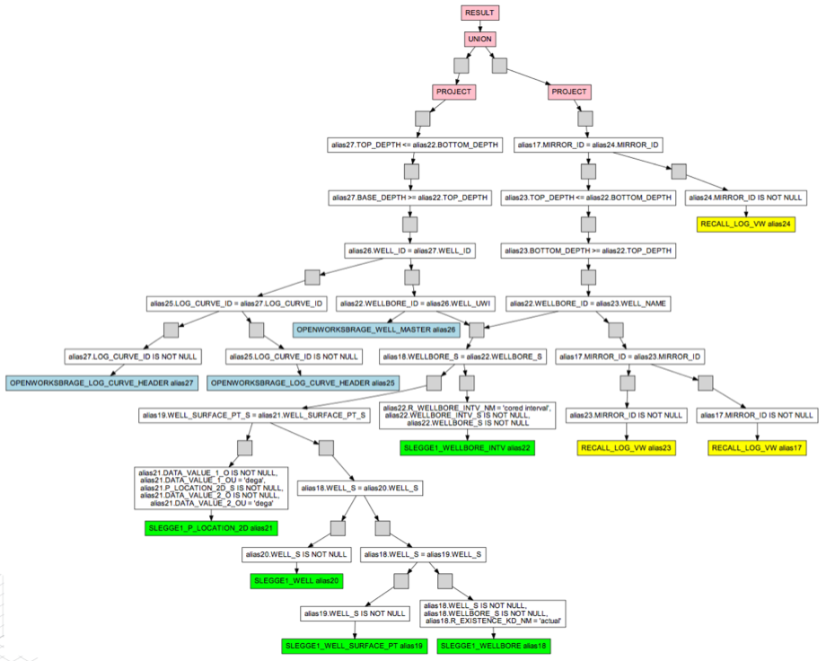
Query: Wellbores with cores that overlap log curves

Slide 42
Query Rewriting — Issues
1 Rewriting
May be large (worst case exponential in size of ontology)
Queries may be hard for existing DBMSs
2 Mappings
May be difficult to develop and maintain

Slide 43
Data Access: Optique Approach

Slide 44
Query Rewriting — Issues
1 Rewriting
May be large (worst case exponential in size of ontology)
Queries may be hard for existing DBMSs
2 Mappings
May be difficult to develop and maintain
3 Expressivity
OWL 2 QL (necessarily) has (very) restricted expressive power, e.g.:
No functional or transitive properties
No universal (for-all) restrictions
…

Slide 45

OWL Profiles – Beyond QL?
OWL 2 (2009) defines language subsets, aka profiles that can be “more simply and/or efficiently implemented”
OWL 2 QL
Based on DL-Lite
Efficiently implementable via rewriting into relational queries (OBDA)
OWL 2 RL
Based on “Description Logic Programs” ( )
Implementable via Datalog query answering
OWL 2 EL
Based on EL⁺⁺
Implementable via Datalog query answering plus “filtration”

Slide 46
RL/Datalog Query Ans. via Materialisation
Given (RDF) data DB, RL/Datalog ontology O and query Q:

Slide 47
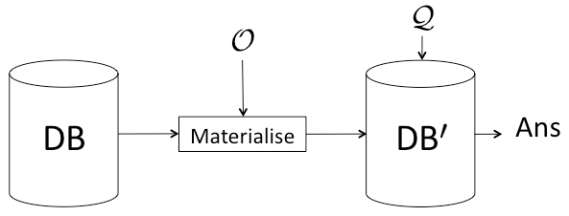
RL/Datalog Query Ans. via Materialisation
Given (RDF) data DB, RL/Datalog ontology O and query Q:
Materialise (RDF) data DB → DB⁰ s.t. evaluating Q w.r.t. DB⁰ equivalent to answering Q w.r.t. DB and O
nb: Closely related to chase procedure used with DB dependencies

Slide 48
RL/Datalog Query Ans. via Materialisation
Given (RDF) data DB, RL/Datalog ontology O and query Q:
Materialise (RDF) data DB → DB⁰ s.t. evaluating Q w.r.t. DB⁰ equivalent to answering Q w.r.t. DB and O
nb: Closely related to chase procedure used with DB dependencies
Evaluate Q against DB⁰

Slide 49

Materialisation — Issues
1 Scalability
Ptime complete
Efficiently implementable in practice?
2 Updates
Additions relatively easy (continue materialisation)
But what about retraction?
3 Migrating data to RDF
Materialisation assumes data in “special” (RDF triple) store
How can legacy data be migrated?
4 Expressivity
; in particular, no RHS existentials

Slide 50
Materialisation: Scalability
Efficient Datalog/RL engine is critical
Existing approaches mainly target distributed “shared-nothing” architectures, often via map reduce
High communication overhead
Typically focus on small fragments (e.g., RDFS), so don’t really address expressivity issue
Even then, query answering over (distributed) materialized data is non-trivial and may require considerable communication
Notes:
NOTE: fragments supported may be even less expressive than RL

Slide 51
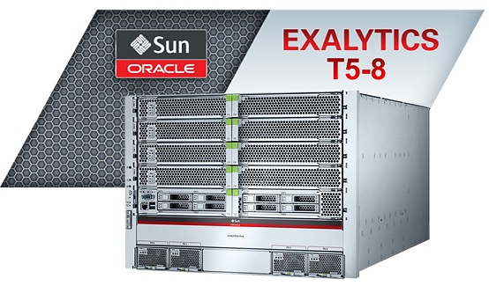
RDFox Datalog Engine
Targets SOTA main-memory, mulit-core architecture
Optimized in-memory storage with ‘mostly’ lock-free parallel inserts
Memory efficient: commodity server with 128 GB can store >10⁹ triples
Exploits multi-core architecture: 10-20 x speedup with 32/16 threads/cores
LUBM 120K (>10¹⁰ triples) in 251s (20M t/s) on T5-8 (4TB/1024 threads)
Notes:
RDFox is a new OWL RL engine with many novel features
LUBM 120K is

Slide 52
RDFox Datalog Engine
Incremental addition and retraction of triples
Retraction via novel FBF “view maintenance” algorithm
Retraction of 5,000 triples from materialised LUBM 50k in less than 1s
Many other novel features
Handles more general (than RL) Dalalog and SWRL rules
SPARQL features such as BIND and FILTER in rule bodies
Native equality handling (owl:sameAs) via rewriting
Stratified negation as failure (NAF)
Notes:
RDFox is a new OWL RL engine with many novel features

Slide 53

Materialisation: Data Migration
Need to specify a suitable migration process
Use R2RML mappings to extract data and transform into RDF
But where do these mappings come from?
Recall query rewriting:
Mappings M are R2RML mappings
Run mappings in reverse to extract and transform data
“Lazy ETL”
Deploy query rewriting (OBDA) system
Extend O and M as needed
Use M to ETL data into RDF store

Slide 54
Materialisation: Expressivity
RL is more powerful than QL, but
In particular, no RHS existentials
Can’t express, e.g.,
Recall OWL 2 EL
Based on EL⁺⁺
Implementable via Datalog query answering plus “filtration”

Slide 55
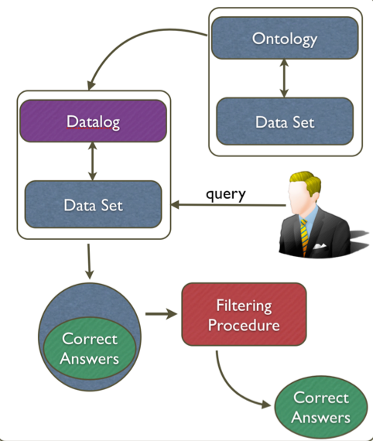
OWL 2 EL via Datalog + Filtration
Given (RDF) Data Set, EL ontology O and query Q:

Slide 56
OWL 2 EL via Datalog + Filtration
Given (RDF) Data Set, EL ontology O and query Q:
Over-approximate O into Datalog program D

Slide 57
OWL 2 EL via Datalog + Filtration
Given (RDF) Data Set, EL ontology O and query Q:
Over-approximate O into Datalog program D
Evaluate Q over D + Data Set (via materialisation)

Slide 58
OWL 2 EL via Datalog + Filtration
Given (RDF) Data Set, EL ontology O and query Q:
Over-approximate O into Datalog program D
Evaluate Q over D + Data Set (via materialisation)
Use (polynomial) Filtering Procedure to eliminate spurious answers

Slide 59
Discussion
QL-Rewriting has many advantages
Data can be left untouched and in legacy storage
Exploits existing DB infrastructure and scalability
…
But what if more expressiveness/flexibility is needed?
Query answering for EL and RL still tractable (polynomial)
Critically depend on Datalog scalability – RDFox to the rescue!
Easy migration path from QL-rewriting via “lazy ETL”

Slide 60
Discussion
QL-Rewriting has many advantages
Data can be left untouched and in legacy storage
Exploits existing DB infrastructure and scalability
…
But what if more expressiveness/flexibility is needed?
Query answering for EL and RL still tractable (polynomial)
Critically depend on Datalog scalability – RDFox to the rescue!
Easy migration path from QL-rewriting via “lazy ETL”

Slide 61
Ongoing/Future Work
Piloting, evaluation and tuning
Notes:
Large-scale architectures: Infiniband (Oracle), numascale, dolphin(?)

Slide 62


Slide 63
Ongoing/Future Work
Piloting, evaluation and tuning
Semantic (data) partitioning and distributed query evaluation
Improved query planning
(Incremental maintenance of) aggregations
Bag semantics for OBDA approach
Expressiveness beyond RL/EL via PAGOdA techniques
Time series data and stream reasoning
Hybrid rewriting/materialisation (on demand) approach
…
Notes:
Large-scale architectures: Infiniband (Oracle), numascale, dolphin(?)

Slide 64

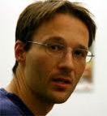








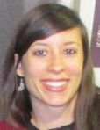

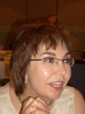

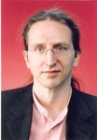
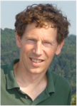
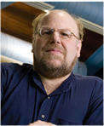
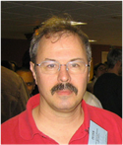
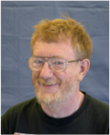







Acknowledgements

Slide 65
Thank you for listening

Slide 66
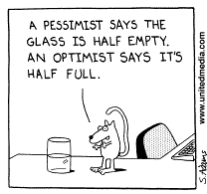
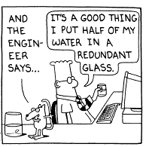
Thank you for listening
YOU MADE THE
GLASS TWICE AS
BIG AS IT
NEEDED
TO BE
A PESSIMIST SAYS THE
GLASS IS HALF EMPTY
AN OPTIMIST SAYS IT’S
HALF FULL
Any questions?

