Slide 1
RAW FP
John Hughes
Mary Sheeran
Notes:
Talk about work we HAVEN’T done…

Slide 2
Notes:
But first, a bit about Sweden

Slide 3
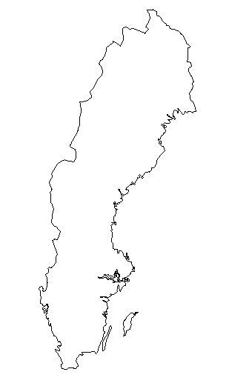
9,000,000
Notes:
900000 people

Slide 4
100,000
Notes:
100000 software developers

Slide 5
50%
Notes:
1% contribute critically to Half of Sweden’s exports depend critically on software.
25-30% of the value of a car is in the software.

Slide 6
Notes:
World’s 5th largest software developer
Software development is of national importance to Sweden

Slide 7
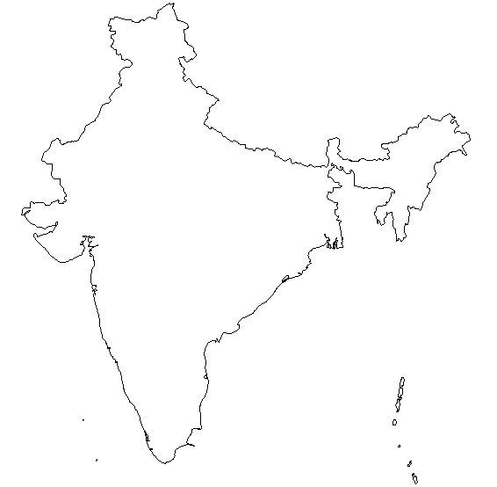
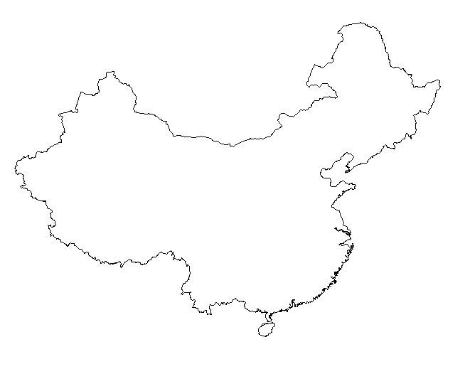
Notes:
But other countries are good at it too—and much cheaper! How can Sweden compete?

Slide 8
Notes:
Exercising captains of industry.
Industrial pressure group, set goal of 10x improved productivity by end of decade!
They’re serious: don’t know how, but they really plan to do it.
This is not business as usual!
This should be music to our ears; isn’t our motto ”Never mind the performance, feel the productivity”?
Inspired by David Turner: FP wll bring an order of magnitude better productivity!

Slide 9
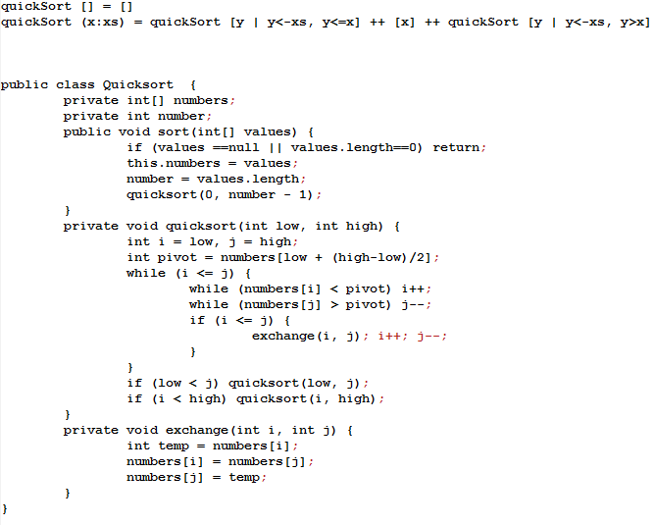
QuickSort
Notes:
In Haskell, in Java, more than 10x as long! A cheap shot…

Slide 10
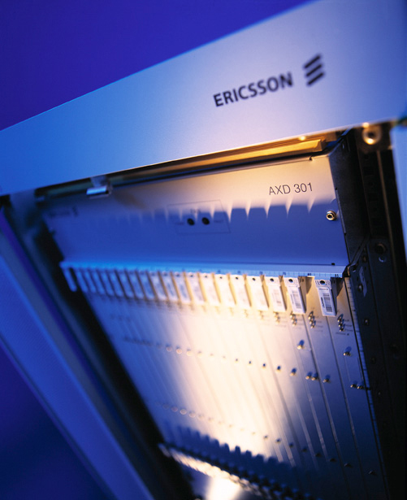
Notes:
First million line Erlang project, 4-10x improved productivity.

Slide 11
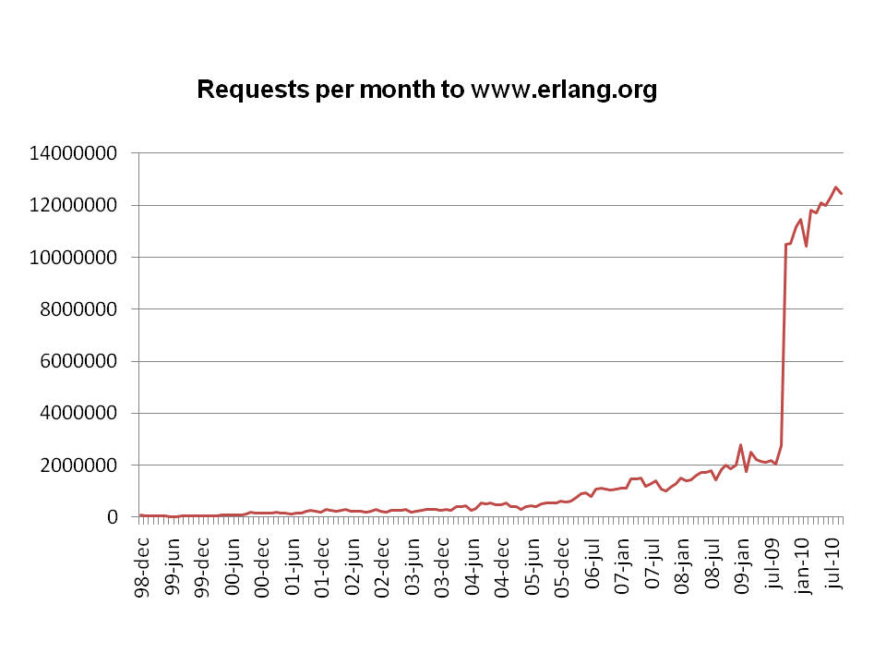
Notes:
Erlang spreading rapidly, Haskell tremendous interest, F# and Scala
Lambda expressions in C#, VB, even Java in 2012?
FP is taking off, a key motivation is productivity!
So: problem solved, the 100K just have to switch to functional languages, right?

Slide 12
Notes:
Wrong!
Even in AXD301, only half the code in Erlang.
”Control plane”, decide which data to route where.
”Data plane”—actually route the data—C/C++, to meet extreme performance demands.

Slide 13
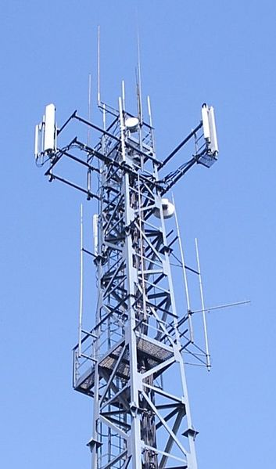
Notes:
Small product—real money made on RBS
Ericsson’s RBS good—squeeze more bandwidth out of the air➔fewer base stations needed
Thanks to DSP code—C code, but not C as we know it!
Tailored exquisitely to hardware—number of multipliers, pragmas…
Performance demands are EXTREME

Slide 14
Notes:
Volvo and Saab: hard-real-time C code running on very cheap processors with very little memory
ABBs robots likewise
Common theme: Haskell isn’t going to run on these things anytime soon.
So: game over?
Maybe not!
Can’t run Haskell on FPGAs, but didn’t stop Satnam using Haskell to program them at Xilinx
Can’r run Haskell on Excel, but didn’t stop Lennart using Haskell to generate financial models for Excel
You know what I’m talking about: DSELs embedded in a FL, that generate low-level code for a different target
Abstraction power of FP, + necessary fine control of resources to attain necessary performance
If we can do it for FPGAs, why not for DSPs? Why not for hard real-time C?

Slide 15
Feldspar
Functional look-and-feel, targetting C for DSP processors
Much more concise, and excellent performance (in some examples, early days)
”Feldspar lets me think big thoughts”
”Feldspar lets me have my cookie and eat it too”
Notes:
We are doing it for DSP!
We’re also doing it for GPU programming.
Not for real-time C—but why shouldn’t we?
DSELs have the potential to combine the productivity of FP with the performance needed by the 100K!

Slide 16
Testing
Testing
Development
QuickCheck
DSELs
DSELs
Notes:
Dvlpment is half the cost—the other half is testing!
Reduce D but not T➔maximum factor of 2 improvement
Luckily a story on testing too: replace test cases by properties, reduce cost and improve quality!
Learned we need domain specific extensions—DS specification languages
Quviq is already developing AutoSAR models for the vehicle industry
Maybe we need to think about requirements too

Slide 17
RAW FP
Notes:
Resource aware fp
DSLs that retain look and feel of FP, but expose control of resources enough to generate high performance code, with DSLs for property-based testing, and hopefully some automated proof
…has the potential to make the 100K an order of magnitude more productive.
An opportunity—perhaps a historic one—when captains of industry are calling for strategic national investment in our strong suit! We need to rise to the challenge.
At Chalmers, we’re working on this, with industrial support, strategic research funding, and a big framework grant of over $1,5 million. We have an even bigger application in to the ”SIS” program—we’ll hear the result in about a month. If we get it, we’ll have a million dollars a year for 5 years—and we have a realistic chance.
Whether we get it not, next target is the EU; for that we need partners.
Now is the time for ambitious proposals; the door we’re pushing on is open. Let’s work together to make it happen.

