Slide 1

Minimising the heat dissipation of information erasure
M. Hamed Mohammady, M. Mohseni, Y. Omar
Physics of Information Group,
Instituto de Telecomunicacoes
Quantum Physics and Logic
Oxford, 15th July 2015

Slide 2
Overview
Landauer’s principle for information erasure
The optimal unitary operator for minimal heat dissipation given maximal probability of information erasure
Trade-off between probability of information erasure and heat dissipation

Slide 3
Landauer’s principle

Slide 4
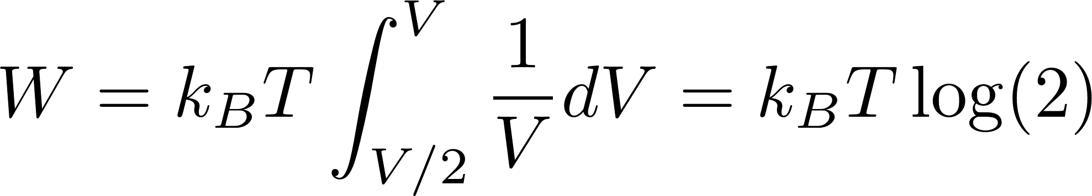
Szilard’s engine

Slide 5
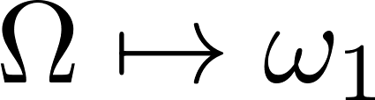
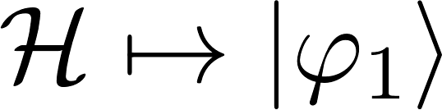
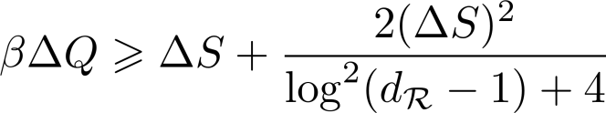

Information erasure as pure state preparation
 | Classical Physics | Quantum Physics
Information erasure | Many-to-one mapping on configuration space | Many-to-one mapping on Hilbert space
Landauer’s limit |  | NJP vol. 16, no. 10, p. 103011, 2014

Slide 6

Landauer’s framework for information erasure

Slide 7
The optimal unitary operator for probabilistic information erasure

Slide 8
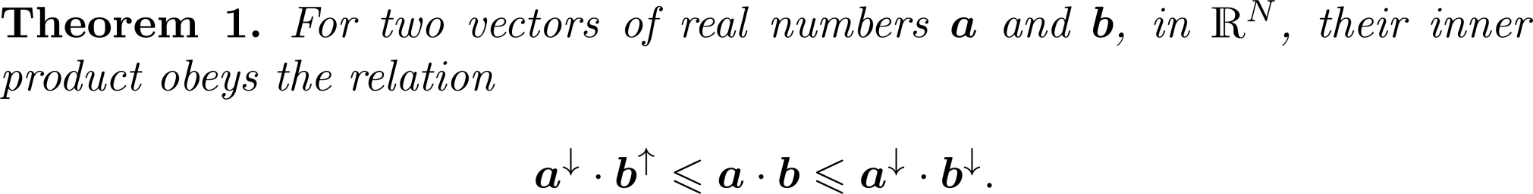
Majorisation theory tools

Slide 9
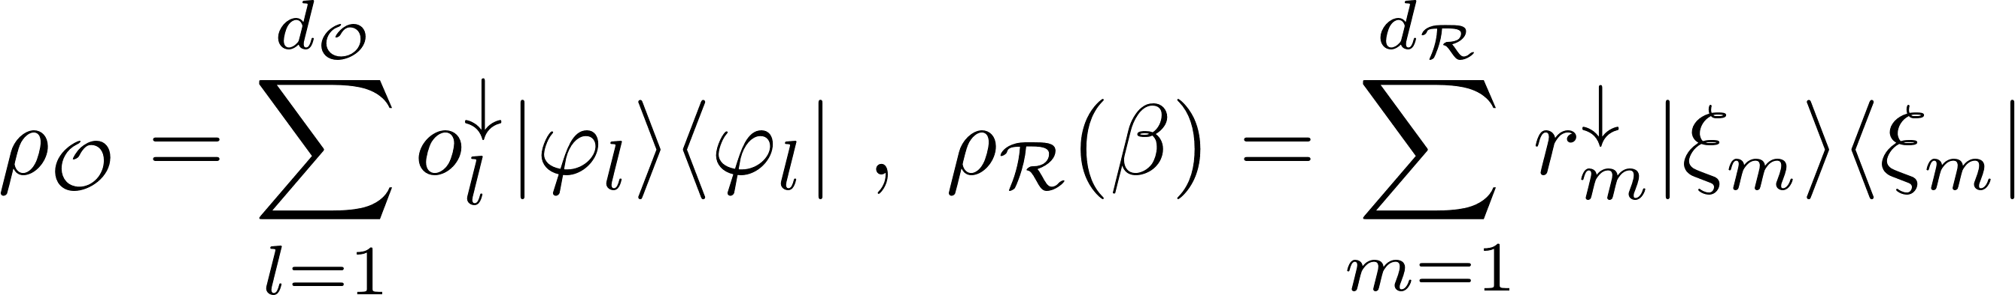
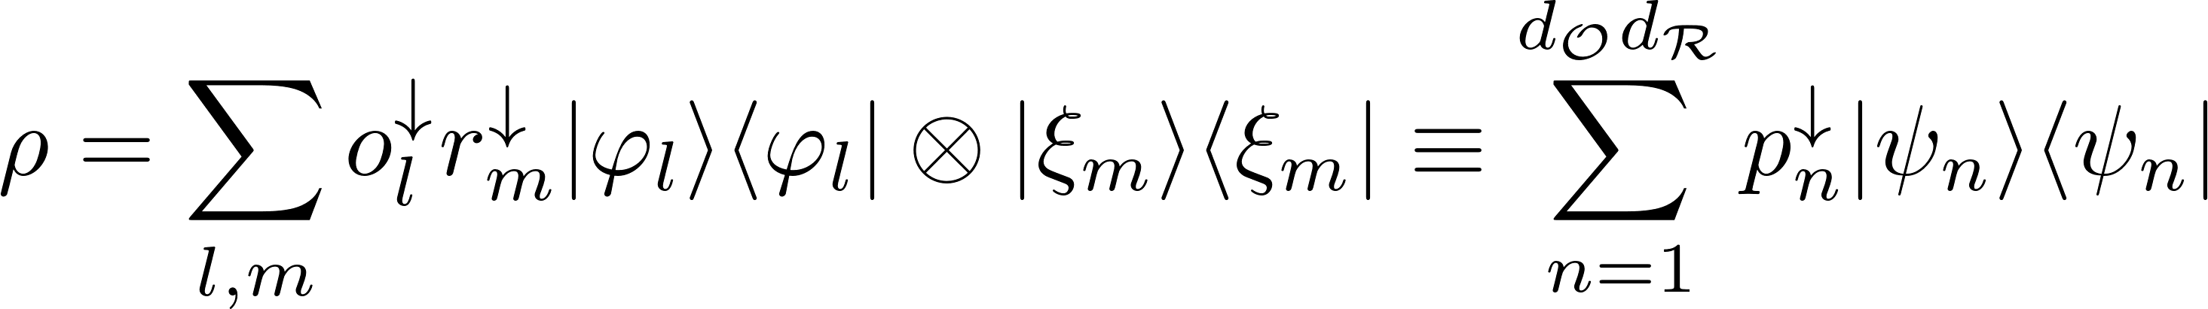
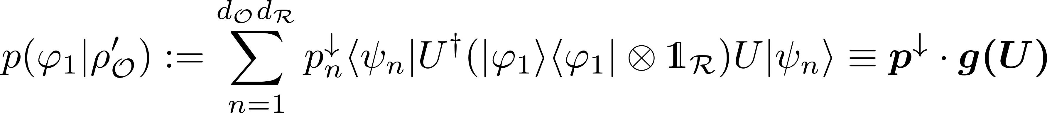
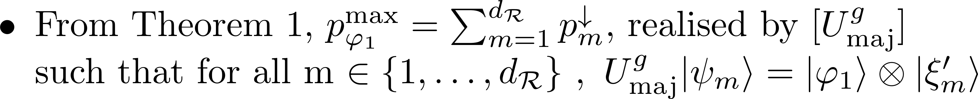
Maximising the probability of information erasure

Slide 10
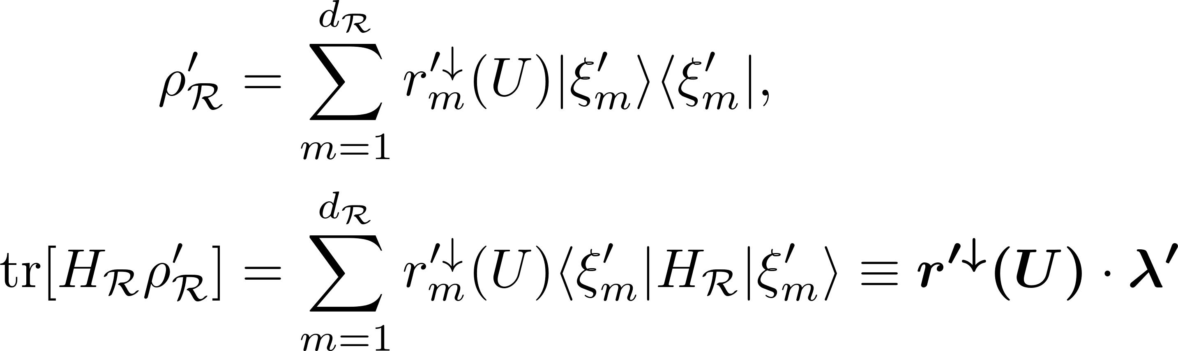
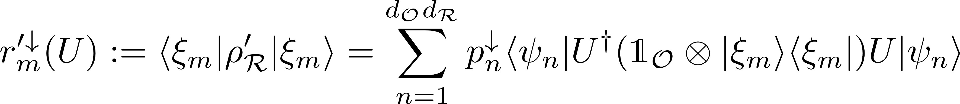
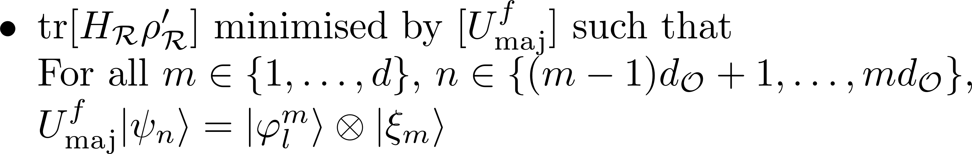
Minimising the heat dissipation

Slide 11
Minimising the heat dissipation for maximal probability ofinformation erasure

Slide 12
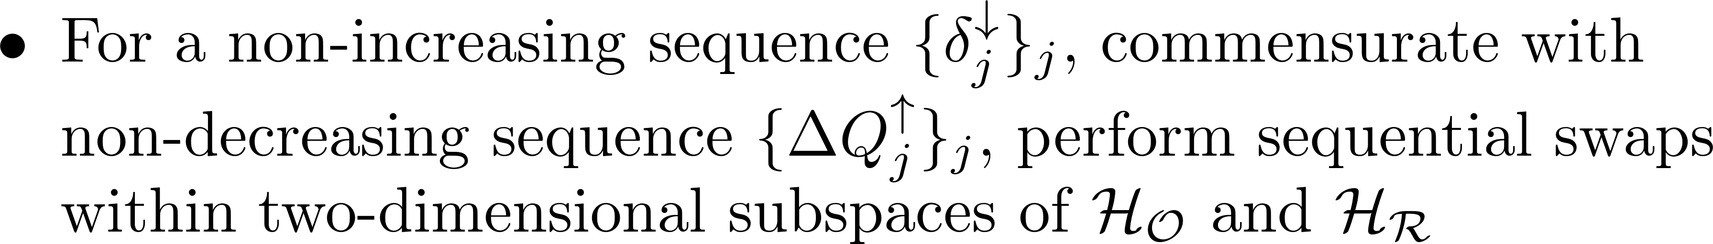
Trade-off between probability of information erasure and heat dissipation

Slide 13
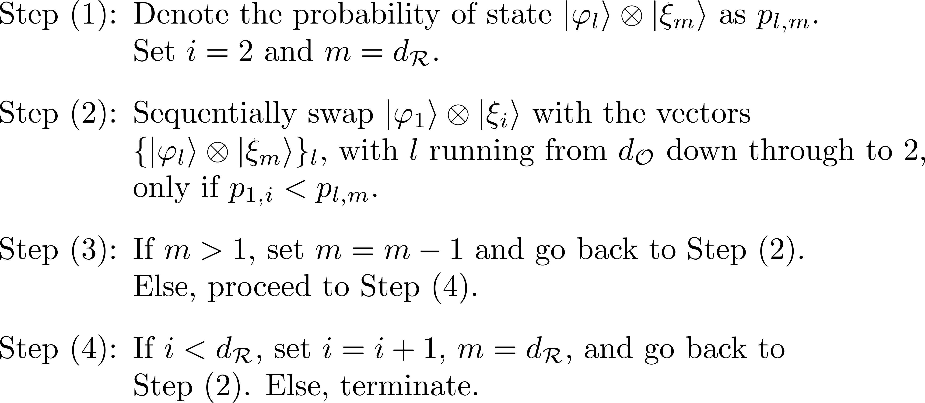
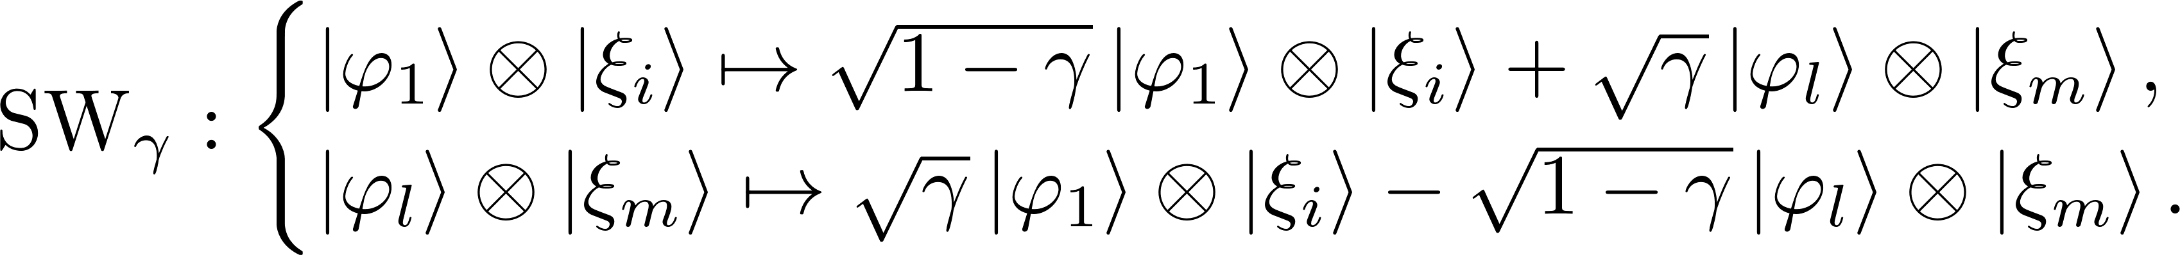
Sequential swap algorithm

Slide 14
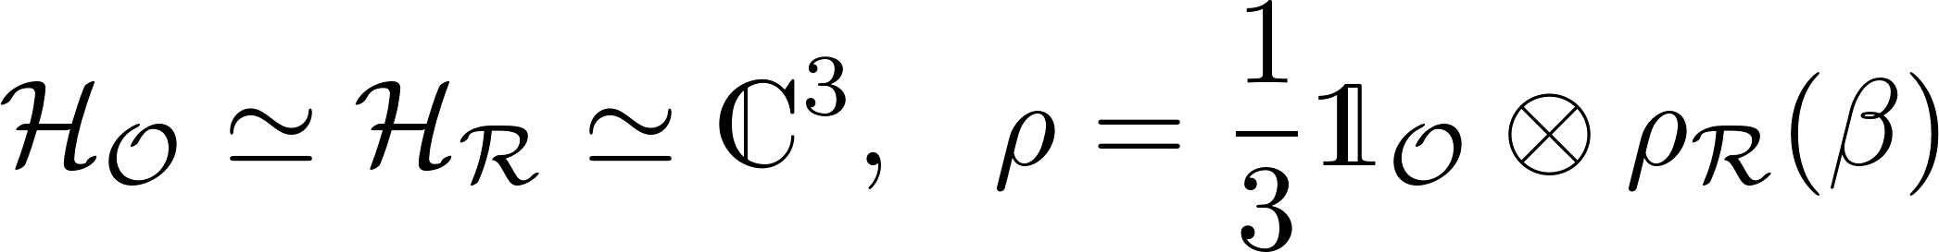

Slide 15
Acknowledgements
M. H. M, and Y. O. thank the support from Fundacao para a Ciencia e a Tecnologia (Portugal), namely through programmes PTDC/POPH and projects PEst-OE/EGE/UI0491/2013, PEst-OE/EEI/LA0008/2013, UID/EEA/50008/2013, IT/QuSim and CRUP-CPU/CQVibes, partially funded by EU FEDER, and from the EU FP7 projects LANDAUER (GA 318287) and PAPETS (GA 323901). Furthermore MHM acknowledges the support from the EU FP7 Marie Curie Fellowship (GA 628912).

