Slide 1
Cyber-Physical Systems
Oxford University – 20Mar2017
Dr. E. R. Griffor, Associate Director
US National Institute of Standards and Technology

Slide 2
National Institute of Standards and Technology (NIST)
About NIST
Part of the U.S. Department of Commerce
NIST’s mission is to develop and promote measurement, standards, and technology to enhance productivity, facilitate trade, and improve the quality of life.
  3,000 employees
  2,700 guest researchers
  1,300 field staff in partner organizations
  Two main locations:
  Gaithersburg, MD
  Boulder, CO
Priority Research Areas
Forensic Science
Disaster Resilience
Advanced Manufacturing
Healthcare
IT and Cybersecurity
Cyber-Physical Systems
Advanced Communications
Notes:
Donna provides NIST overview and NIST cyber overview

Slide 3
NIST Labs and Research Activities
CPS Framework
CPS Testbed UCEF
Trustworthiness

Slide 4
Cyber-Physical Systems
Cyber-Physical Systems (CPS) comprise interacting digital, analog, physical, and human components engineered for function through integrated physics and logic.
Examples include a smart gird, a self-driving car, a smart manufacturing plant, an intelligent transportation system, a smart city, and Internet of Things (IoT) instances connecting new devices for new data streams and new applications.
Common notions of IoT have emphasized networked sensors providing data streams to applications.
CPS concepts complete these IoT notions, providing the means for conceptualizing, realizing and assuring all aspects of the composed systems of which sensors and data streams are components.
The Framework for Cyber-Physical Systems was released by the NIST CPSPWG on May 26, 2016

Slide 5
CPS and IoT
Cyber-Physical Systems (CPS) comprise interacting digital, analog, physical, and human components engineered for function through integrated physics and logic.
Examples of a CPS that are not instances of IoT
Segway Scooter
Smart Spoon enabling Parkinson’s patients to feed themselves (see https://www.liftware.com/)
Autonomous vehicle operating without wired or wireless connections outside the vehicle, e.g.
  a Mars rover operating between messages from Earth
  the original vehicles in the first DARPA Challenge
  cruise missile/smart bomb in flight to target
Generally, any CPS that is fully contained with no outside network connections

Slide 6
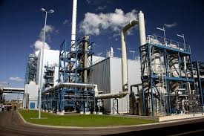



CPS vs. IoT: Motion Activated Light
CPS
IoT Scope of Research
OUTs
INs
Sensors
Communication
Channel
(Network)
Aggregator
(Fusion)
Computation
(e-utility)
Decision
(Software)
Actuators
INs
OUTs
Model of Motion
Physical Interaction
Logical Interaction
Framework Schema: Phys-Log-Log-Log-Log-Phys
Testbed: Experiment, Measurement and Assurance
Challenges: Interoperability, Composition and Composition Types, Trustworthiness, etc.

Slide 7
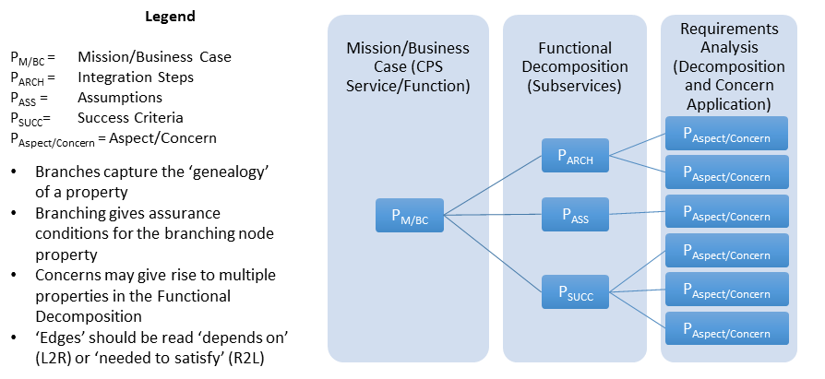
Type Theoretic Assurance of CPS
property-Tree of a CPS
semantics of CPS Framework
… defines composition of concerns
formal methods for assurance of a CPS

Slide 8
Applying CPS Framework to Decomposition
CPS/Function Types
Safety “Properties” of a Function: AEB
Business Case
AEB – vehicle provides automated collision safety function
Use Case
‘feature’
AEB – vehicle provides/maintains safe stopping
CPS (Therm, HVAC, Sensor)
AEB –braking function reacts as required
Functional Decomposition/Allocation
Physical
AEB – friction function provides appropriate friction
Influence
AEB – stopping algorithm provided safe stopping
Energy
Logical
AEB – messaging function receives distance to obstacles and speed from propulsion function
Msg
Info
AEB – distance and speed info is understood by braking
function
Apply Aspects/Concerns
Generate System
Properties

Slide 9
Applying Concerns to Functions
Severity
Frequency
Redundant Torque Request for ASIL>QM
Functional Safety
Hazard
Safety
Controllability
CPS Function
Concern1
Concern2
Confidentiality
Encryption
AES
Reliability
Integrity
Concern 1
Availability
Concern 2
Cyber Security
Trustworthiness
Security
SME Taxonomies
Physical Security
Resilience
Controls
Authorization
OAuth
Predictability
Transparency
Concern 1
Manageability
Innovation
Concern 2
Function/Feature
Privacy
Apply Aspects/Concerns
Dissociability
Generate
‘Properties’
A secure, privacy protected CAN BUS Message may consist of these properties:
{Trustworthiness.Security.Cybersecurity.Confidentiality.Encryption.AES, Trustworthiness.Privacy.Predictability.Controls.Authorization.OAuth}

Slide 10
(NIST-SAE) Applying CPS Framework to Autonomous Vehicles
NIST/SAE/OEM
NIST/SAE/OEM
SAE/OEM
SAE/OEM
(Optional)
SAE/OEM
Automotive Trustworthiness Framework
Enumerate, define, document Automotive System Trustworthiness Concerns
Enumerate, define, document Automotive System Properties
Define Mapping of System Properties to Assurance Processes (standards, etc.)
Update Automotive System Development Process
DRAFT System Trustworthiness Report and integrate into J3061
NIST/SAE/OEM
SAE/OEM
NIST/SAE/OEM
SAE/OEM
Models and Simulations
Experiment Design
Run and Publish
Automotive Trustworthiness Testbed Pilot
Specify Automotive UCEF Testbed with SIM-Wrappers and Configuration
Select targeted Use Cases (Automotive Systems) and Test Cases
Annotate System Trustworthiness Report
Go/No-Go: Evaluate potential for Pilot
NIST/SAE/OEM
Extend Automotive CPS Framework Model
Evaluate potential for additional CPS Aspects beyond Trustworthiness
Repeat above for selected Aspects
Go/No-Go

Slide 11
CPS Framework: Concern-Property Interactions
Concern Tree
Properties/Requirements
Interactions
Controls
Authentication
OAuth
Privacy.Predictability(Ctrls, …, C_{t})
i₁
i₂
.
.
.
i_{k}
[+/-]f
Interactions
[+/-]g
Security.Cybersecurity(C,I,A)
Confidentiality
Encryption
AES
Legend
‘meets’
Integrity
‘addresses’
Availability
Example Impact of one concern on another:
Calculated using pathways through the up- or down-regulation relationships between the Properties of the CPS
These correspond to derivatives (an incremental change in one results in a negative or positive impact on the other)
Impact is the ‘integral’ over all interaction pathways; T₀ topological definition of integral/differential calculus

Slide 12
IT- vs CPS-Based Risk Mitigation
Primary Impact of Failure
Digital | Physical
Mitigation Mechanisms
Digital | Analog | Physical
IT System
IoT/CPS
“Better cybersecurity through physics!”

Slide 13
NIST Activities: CPS Framework
Dimensional Analysis of the Model of a CPS, e.g. Safety and HARA
  Concern-specific abstractions and methodology
  Concern Tree: Decomposition and Composition of Concerns
CPS Framework Open Source Project
  UML/XML Composite Model: Framework + Use Case
  XSLT Presentation of XML Model to make (should be ‘two-way’, compare LaTeX vs. typeset text

Slide 14
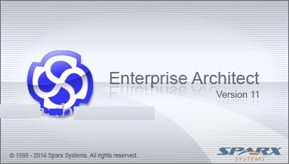



Tools
Enterprise Architect: UML Editor
XMLSpy: XML/XMLSchema Editor
TortoiseGit: Windows GitTool
Notepadd++: Programmers Editor

Slide 15
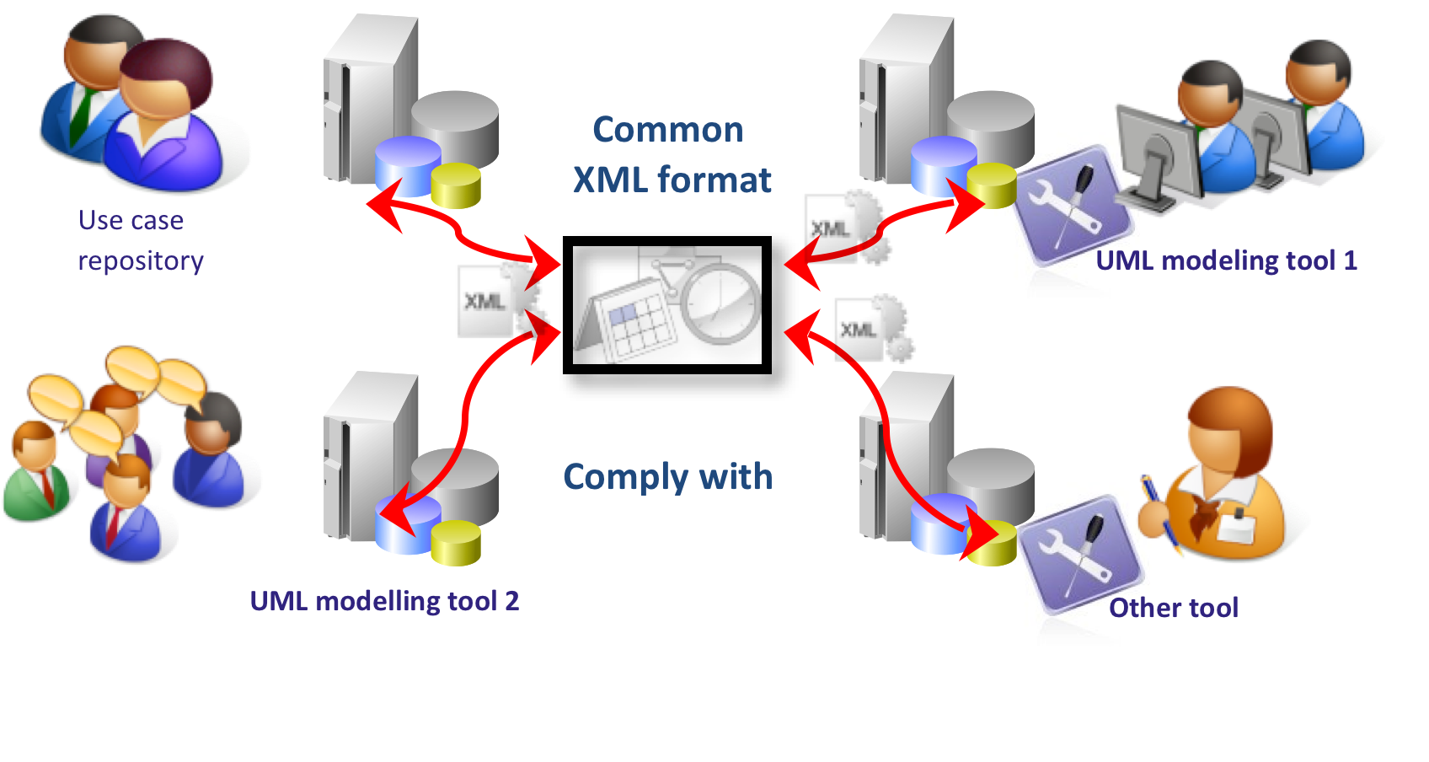
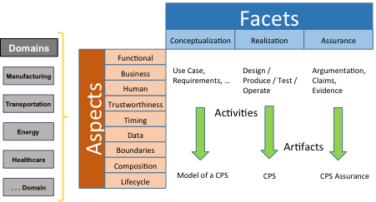
Derivation of a Union of Technologies
IEC 62559 Methodology
NIST CPS Framework Methodology
Standardized XML Schema
Use Case
Requirements
Design
Assurance
Business Case
Conceptualization
Realization
Traceability to Requirements
Algorithmically Prove Design Meets Requirements

Slide 16
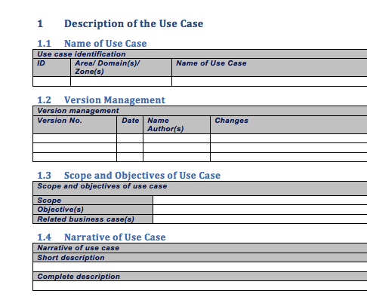
Word Use Case Template

Slide 17
CPS Framework
Facets
Conceptualization
Realization
Assurance
Domains
Functional
Manufacturing
Business
Use Case,
Requirements, …
Design / Produce / Test / Operate
Argumentation,
Claims, Evidence
Human
Transportation
Trustworthiness
Activities
Aspects
Timing
Energy
Data
Boundaries
Artifacts
Healthcare
Composition
Lifecycle
Model of a CPS
CPS
CPS Assurance
. . . Domain

Slide 18








Framework OpenSource Project
Common
XML format –
Model of CPS
CPS
Assurance of CPS
CPS Framework Use Case/Aspects/Concerns Analysis
Requirements modeling tool
Design Verification and Validation and Assurance Tools
Design Exploration / Model Driven Development / Continuous Integration Tools

Slide 19
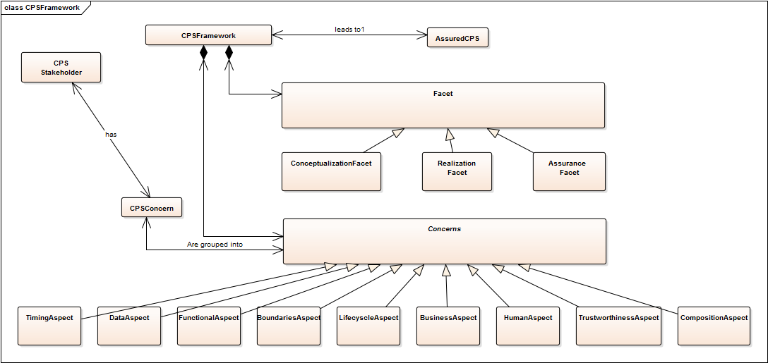
UML Model of Framework

Slide 20
Aspects and Concerns

Slide 21
Facets

Slide 22
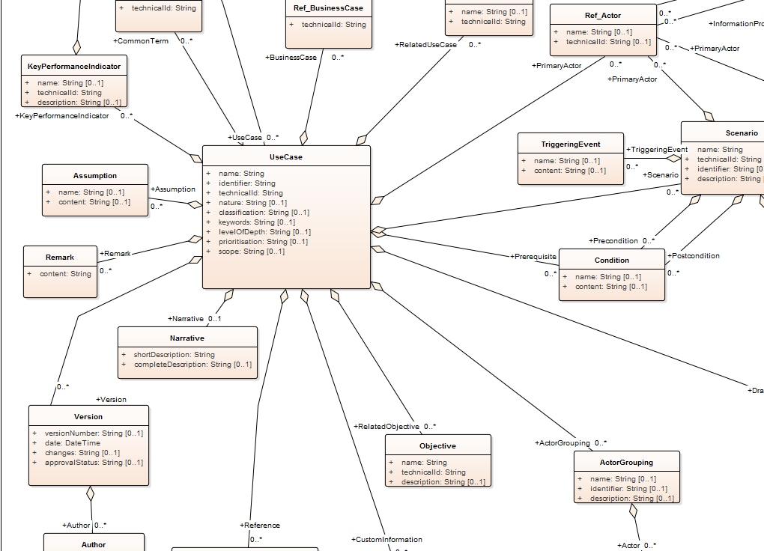
IEC 62559 Model of a Use Case

Slide 23
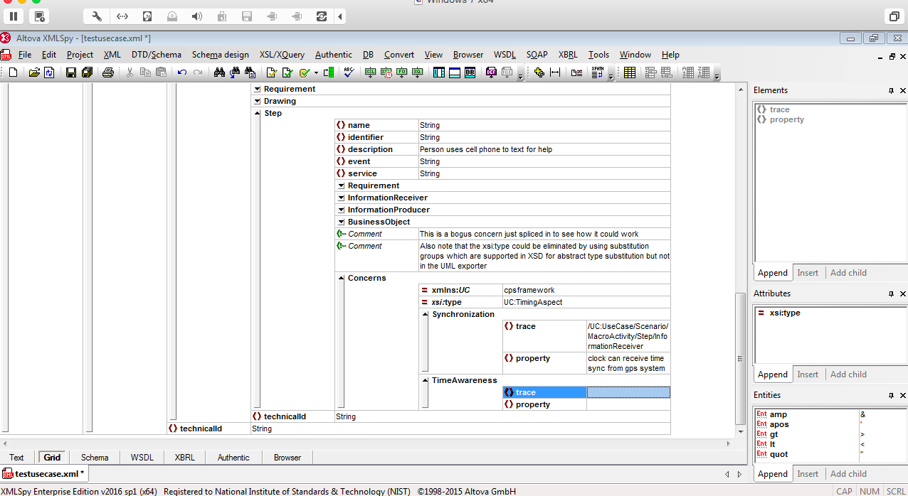
XML Editor of a Use Case

Slide 24
NIST Activities: CPS Testbed
CPS Testbed (Architecture and instance of HW and SW Tools)
  UCEF
  Control Room + Visualization
  Open Source Project 16May2017 at NIST
CPS Testbed Science
  Testbed composition and its semantics (wrappers)
Testing the concerns of the CPS Framework in the testbed
  Setup and Testing as in the case of requirements driven by the Timing concerns

Slide 25
NIST Activities: Trustworthiness
Trustworthiness Concerns (Architecture and instance of HW and SW Tools)
  Decomposition
  Specific science and methodology
Logical and Physical ‘Security
  Using physics to enhance cybersecurity (and other cyber concerns)
Dependencies between concerns (holistics approach to the specifics of individual concerns)
  Merging the physical concept of dependency with a logical concept of dependency

Slide 26
The Category CyPhy
The cyber-physical category CyPhy has as objects:
  Action/Actuation
  Sense
  Phys_State
  Decision
The morphisms of CyPhy are given by:
  Mor(Act,Physical_State) = {phy_act-phys}
  Mor(Decision,Act) = {log_dec-act}
  Mor(Sense,Decision) = {log_sen-dec}
  Mor(Sense,Act) = {phys_sen-act}
  Mor(Phys_State,Sense) = {phy_Phys_State-Sense}.

Slide 27
Symmetric Monoidal Categories
For purposes here systems will be viewed as processes and interactions between them (process algebra in the sense of Milnor for example)
We distinguish two sorts of interactions between processes:
  Logical interactions (exchanges of information)
  Physical interactions (exchanges of energy)
Math model of physical interactions is algebraic systems of ODEs
Math model of logical interactions are formalizations of agent-based models such as complex adaptive systems (J. Holland)
We choose symmetric monoidal categories (SMC) as an example of a model of systems in category

Slide 28
CPS as Functors
A cyber-physical system, in the sense of process algebra, can be represented as a functor from a symmetric monoidal category to the category CyPhy.
Such a functor represents:
Processes as instances of Sensing, Decision, Action or Physical
Interactions as exchanges of information or exchanges of energy
Benefit of this representation can be derived from:
Structural representation of one CPS ‘in another’ (isomorphic with a sub-CPS)

Slide 29
The category CPS
Given two representations of CPS as functors F and G, let SM(F)/SM(G) denote the symmetric monoidal categories that F and G map into CyPhy
Mor(F,G) is the functors T from SM(F) to SM(G) such that the following diagram commutes:
T
SM(F)
SM(G)
F
G
CyPhy

