Slide 1
Context Aware Augmented Reality for Cognitive Assistance in Emergency Medical Services
PIs: Homa Alemzadeh (ECE), John Stankovic (CS), Ronald Williams (ECE)
Presented by: M Arif Rahman

Slide 2
Outline
Motivation
Problem Overview
Contribution
Brief review of the past work
Ongoing work
Details of ongoing work

Slide 3
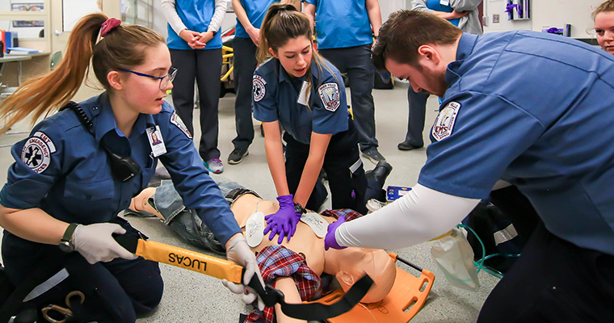
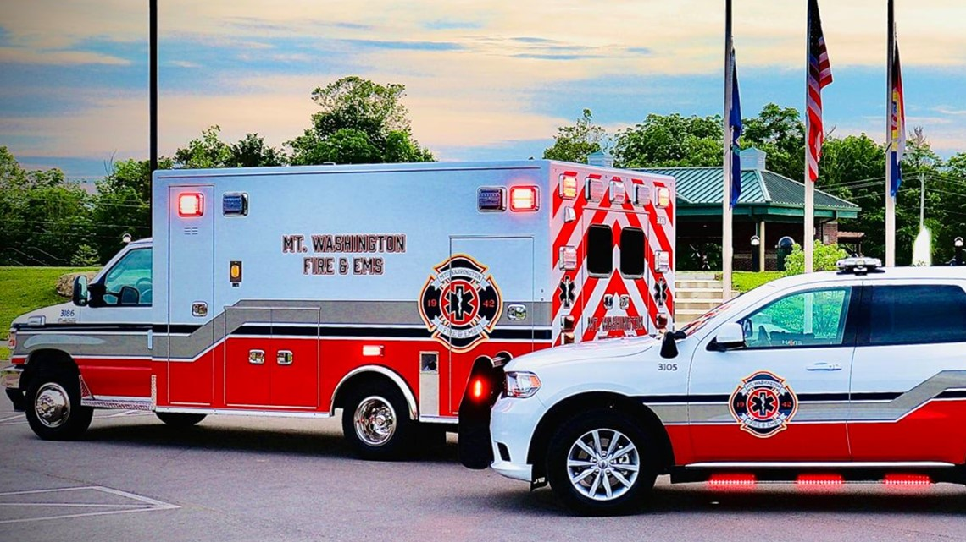
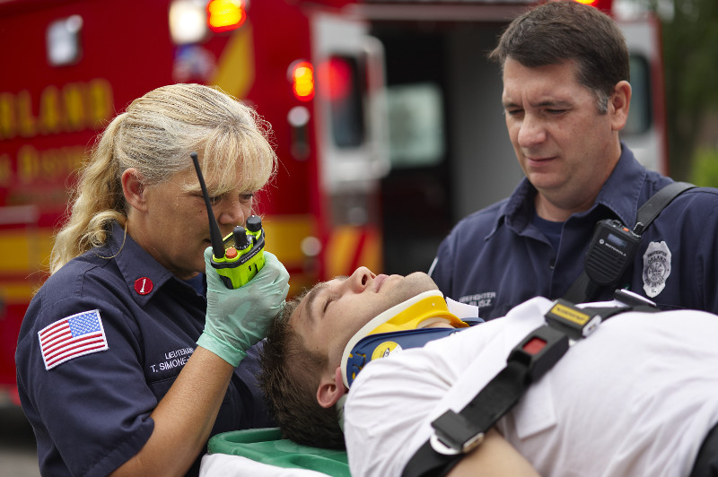
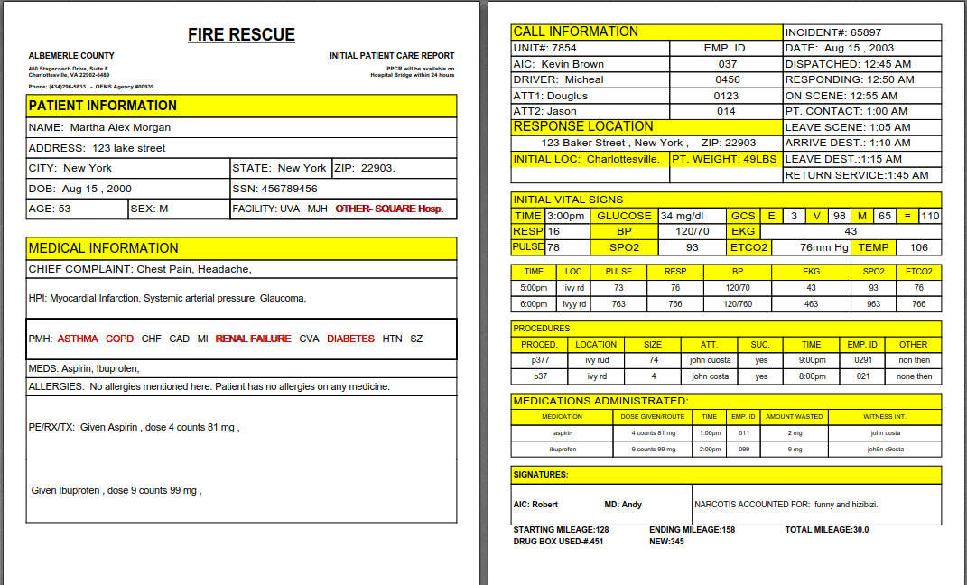
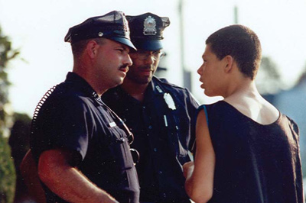
Motivation
EMS
Protocols
Historical EMS Data
Medical history
(EHR)
911 Call record
EMS intervention
EMS radio call
How does an EMS unit arrive and operate
EMS Report
Conversations with bystanders and victims

Slide 4
Motivation
EMS
Protocols
Historical EMS Data
Medical history
(EHR)
911 Call record
EMS intervention
EMS radio call
How does an EMS unit arrive and operate
Information Overload !!
EMS Report
Conversations with bystanders and victims
Collecting, analyzing, prioritizing
Summarizing information
Decision making and execution
*Slide Idea courtesy- Towards Cognitive Assistants in Emergency Medical response (PSCR 2020)

Slide 5
Motivation
Work under tremendous pressure and stressed situation
Perform time sensitive, safety-critical interventions
Some interventions are life-critical
Documentation process is human-memory dependent
Previous research*suggests an automated decision support and training platform in EMS will be very helpful.
Is it possible to develop an automated assistant for EMS providers to better prepare them for the scene and provide help during the scene?
* Bonnie F Daily, James W Bishop, Robert Steiner, et al.2007. The mediating role of EMS teamwork as it pertains to HR factors and perceived environmental performance. Journal of Applied Business Research (JABR)23, 1 (2007).
* Charles N Pozner, Richard Zane, Stephen J Nelson, and Michael Levine. 2004. International EMS systems: the United States: past, present, and future.Resuscitation60, 3 (2004), 239–244.

Slide 6
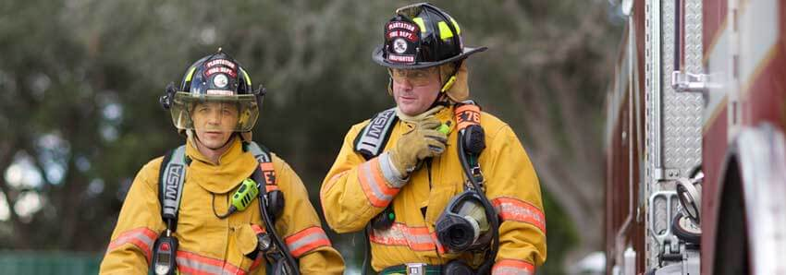
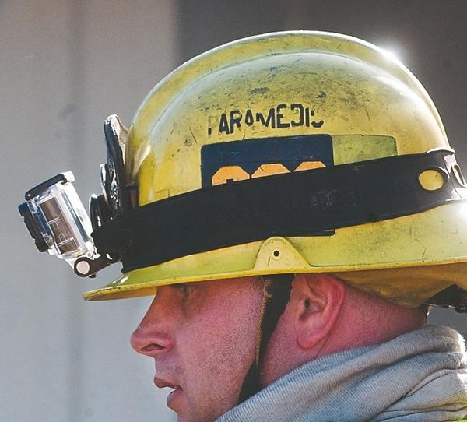
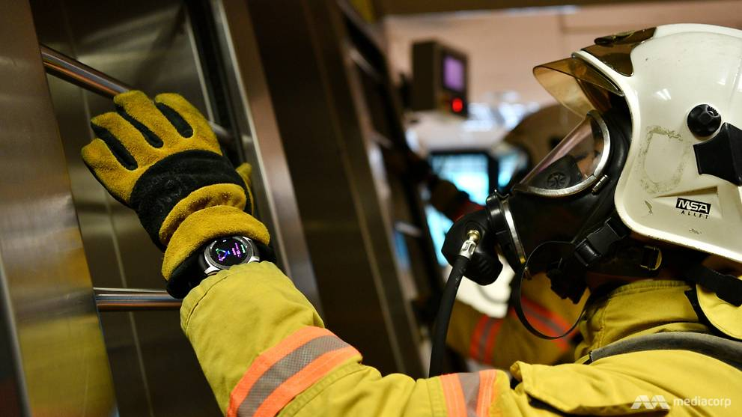
Problem Overview
How can we gather information to provide cognitive assistance to EMS providers?
what kind of equipment may be used
additional cost of data collection
no interruption in regular activity for the providers

Slide 7
Brief Review of the Past Work
First cognitive assistant for providing real-time interactive feedback to multiple EMS providers, and automate post-scene documentation
developed protocol and data-driven, responder-specific approach to provide feedback [IMACS]
an NLP based system to address formal documentation or reporting of critical information for patients in multi-responder EMS scene [GRACE]

Slide 8
Ongoing Work
First multimodal cognitive assistant for hand activity monitoring and automated post-scene documentation for EMS
post-scene analysis on quality of CPR using conversational audio data and a hybrid deep neural network on smartwatch-based sensor data

Slide 9
Ongoing Work
A multimodal cognitive assistant for providing real-time visual assistance
protocol and data-driven, responder-specific approach to provide feedback
augmented context sensing by combining EMS concept based visual image and conversational audio data

Slide 10
Ongoing Work
A transformer based domain-specific language model for EMS that extracts EMS concepts and detects missing information from EMS corpora
real-time concept detection from live EMS transcripts combining ontology based lexicon expansion approach with semantic heuristics and inferences

Slide 11
CPR quality monitoring using audio and sensor data
Cardiopulmonary resuscitation (CPR)- one of the most frequently performed life saving intervention in EMS - CPR is safety-critical, time-sensitive
CPR by chest compressions
Performing CPR properly requires adequate training and practice
Automated post-scene feedback on quality of CPR will be immensely helpful for the providers
EMS training
mock-real scenes
11

Slide 12
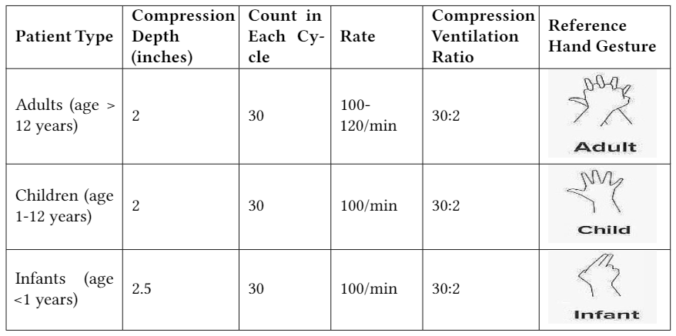
How can we improve the quality of CPR?
real-time feedback
post-scene feedback
Standard gestures and parameters of CPR
12

Slide 13
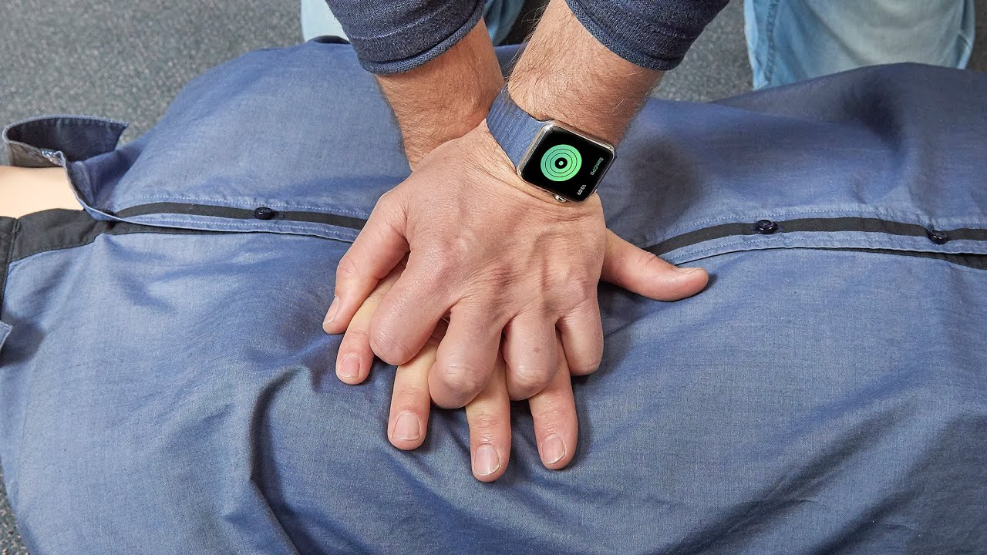
EMS providers always use a watch
smartwatch on dominant wrist to collect sensor data
Develop a classifier for different types of CPR
Provide post-scene feedback on quality of CPR
enhanced learning experience for the providers in training sessions
Gesture Inference
Post-hoc Analysis and Quality Report for CPR
13

Slide 14
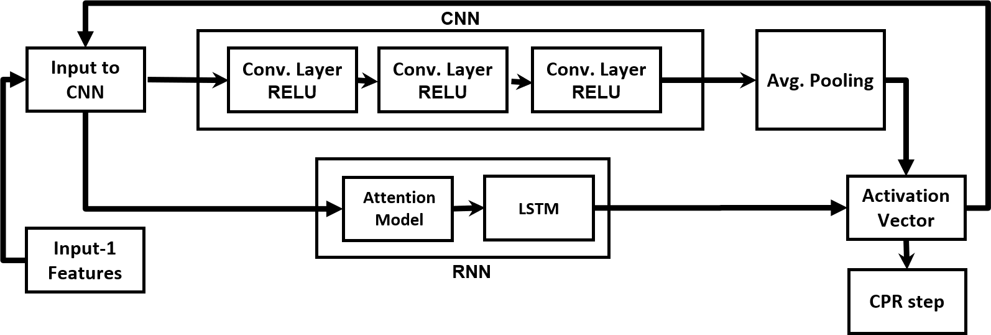
Post-scene qualitative analysis using audio and sensor data
audio data
sensor data
An application** on ASUS Zenwatch2 for data collection
A hybrid attention model with deep neural network* for CPR classification
14

Slide 15
Scene and context sensing using audio and image data
Visually process the scene context ahead of time
On-scene audio data may not always be helpful for situation assessment
out of human sight hazardous and protocol-specific elements
Visual aid is not guaranteed to work in many conditions
deployed as an assistive component to speech based cognitive assistant
15

Slide 16
Context sensing and situational awareness from fusion of real-time EMS speech data with image based visual data
detect target objects by related EMS concepts and ground them at the scene
16

Slide 17
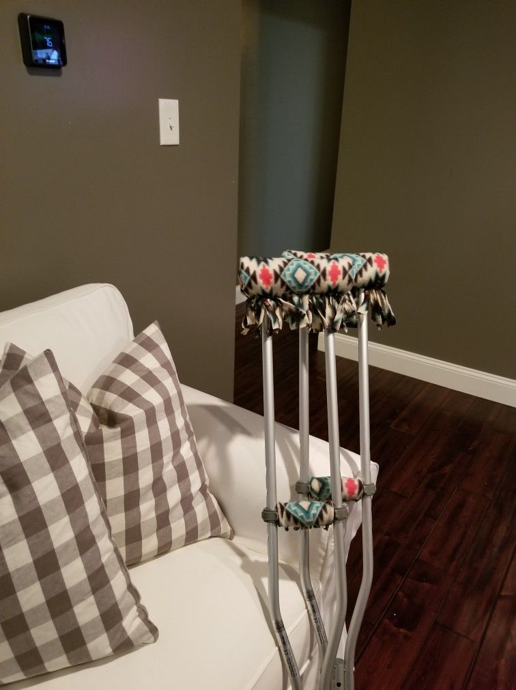
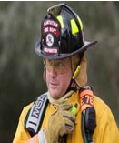
Speech Data: Conversations at scene
Enhanced Scene Awareness and Context Understanding
Speech Data: “we are entering the house, patient is reported as a female in her mid seventies”
Speech Data: EMS Concepts
Image Data: Contextual Objects
Image Data: EMS Scene
Vision
Algorithm
EMS concept
based
object grounding
EMS Responder
Information Alert
Hazardous Context
Protocol-specific Context
Overview for proposed image and audio assisted context sensing system
17

Slide 18
Challenges
Develop an ontology for visually detectable EMS protocols/concepts and objects related to them
EMS Concepts | Related Objects
Broken Bone, Fracture, Disability | Wheelchair, Crutch
Gas leak, Spill | Fire
Unconscious | Wound/Blood
Wound | Gun
18

Slide 19
A BERT model for concept detection from live EMS transcripts
Why do we need a separate concept detection tool for EMS?
EMS concept are unique
live EMS transcripts are unstructured
average F1 score of 73% for the three state-of-the-art tools

Slide 20
Why transformer based language model?
limitations of seq-2-seq models
Why not the original version of BERT or other models?
trained and tested dataset
improper word distributions

Slide 21
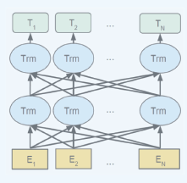
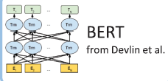
Tasks for fine-tuning
EMS entity detection
Relation extraction
Pre-training for emsBERT
Fine-tuning for emsBERT
EMS, Biomedical, General
EMS Entity
Detection
No chest rise found in compressions
X √ X X X √
Corpora Domain
Relation Extraction
Starting @IV$ in @LEFT$ hand
→ TRUE
Weight Initialization
Pre-trained model
Task Example

Slide 22
pre-train emsBERT in a different method
simultaneous pre-training of two types of corpora
combine them later
Conventional Pre-training
Pre-training for small corpus
General
Corpora
Domain adapted
BERT
Small corpus (EMS)
Simultaneous
Localized emsBERT
Large corpus (Med.)
Domain
Corpora
Domain-specific BERT
Live transcripts
Enhanced emsBERT
Small corpus (EMS)
Simultaneous
22

Slide 23
Any Questions?
Arif Rahman
mir6zw@virginia.edu
Is it possible to develop an automated assistant for EMS providers to better prepare them for the scene and provide help during the scene?

