Slide 1
Use of Augmented Reality (Smart Glasses) to aid first responders
PIs: Homa Alemzadeh (ECE), John Stankovic (CS), Ronald Williams (ECE)
Presented by: Lahiru Nuwan
Notes:
Hi everyone, My name is Arif, I am am PhD Student at University of Virginia. I will be presenting some ongoing developments and ideas of my research for the project Context Aware Augmented Reality for Cognitive Assistance in Emergency Medical Services.

Slide 2
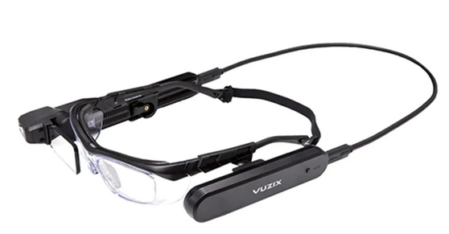
Data streaming from glasses to computer
Android Debugging Bridge
TCP
computer
Vuzix M4000

Slide 3
Data streaming from glasses to computer
Vuzix M4000
Sensor data from accelerometers + gyroscopes
Video from camera
Audio from Mic
Save as files
Live stream

Slide 4
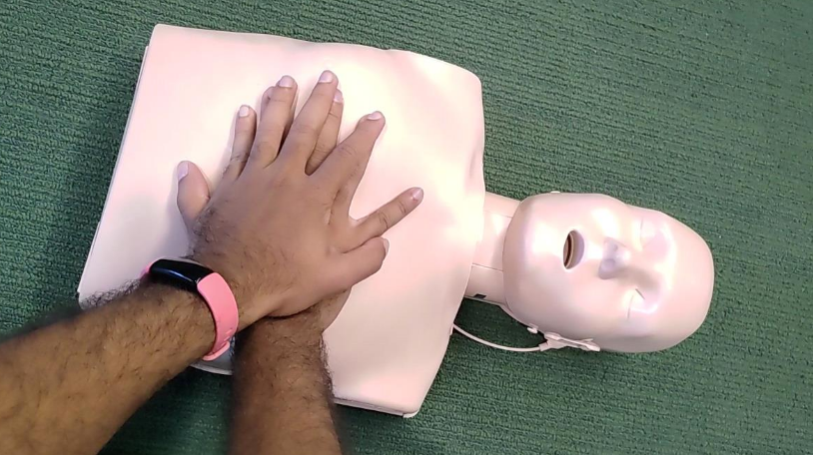
Visual range of the smart glasses
Can cover the hands and the patient chest area when the wearer is looking at their hands

Slide 5
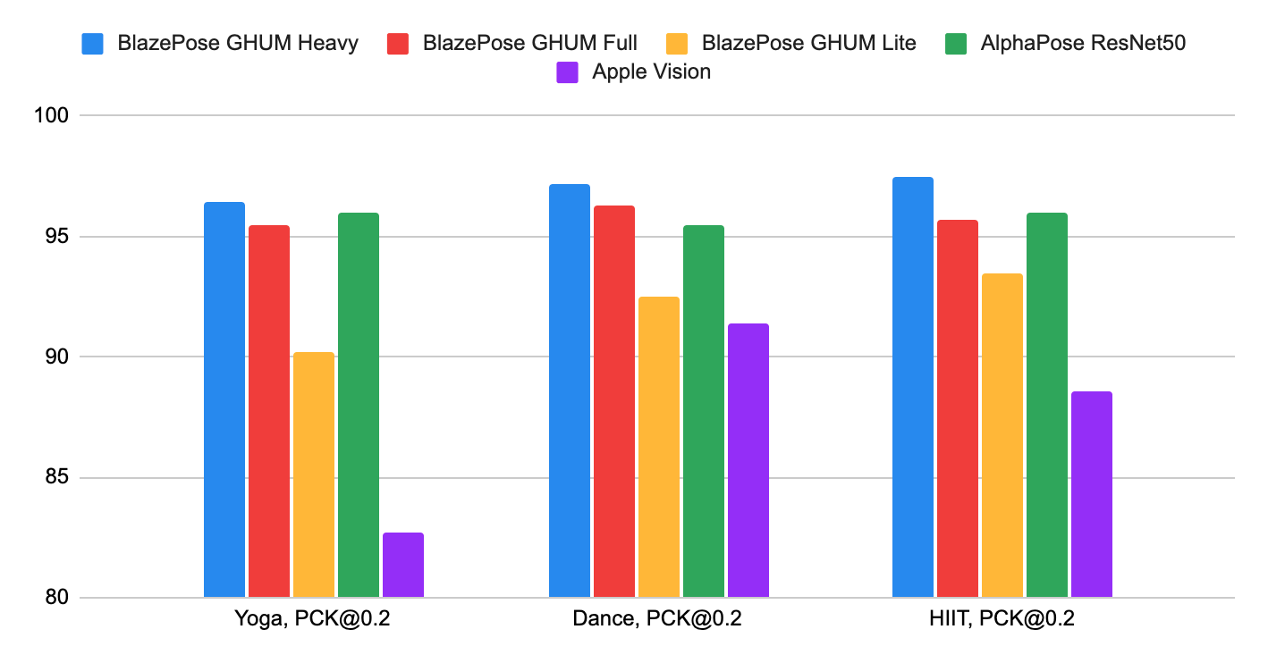
Body pose recognition
Google Media Pipe
BlazePose models are used in Media Pipe
Alpha pose - can recognize multiple people at the same frame
Media Pipe - just one person
Comparison with other models designed for real time performance

Slide 6
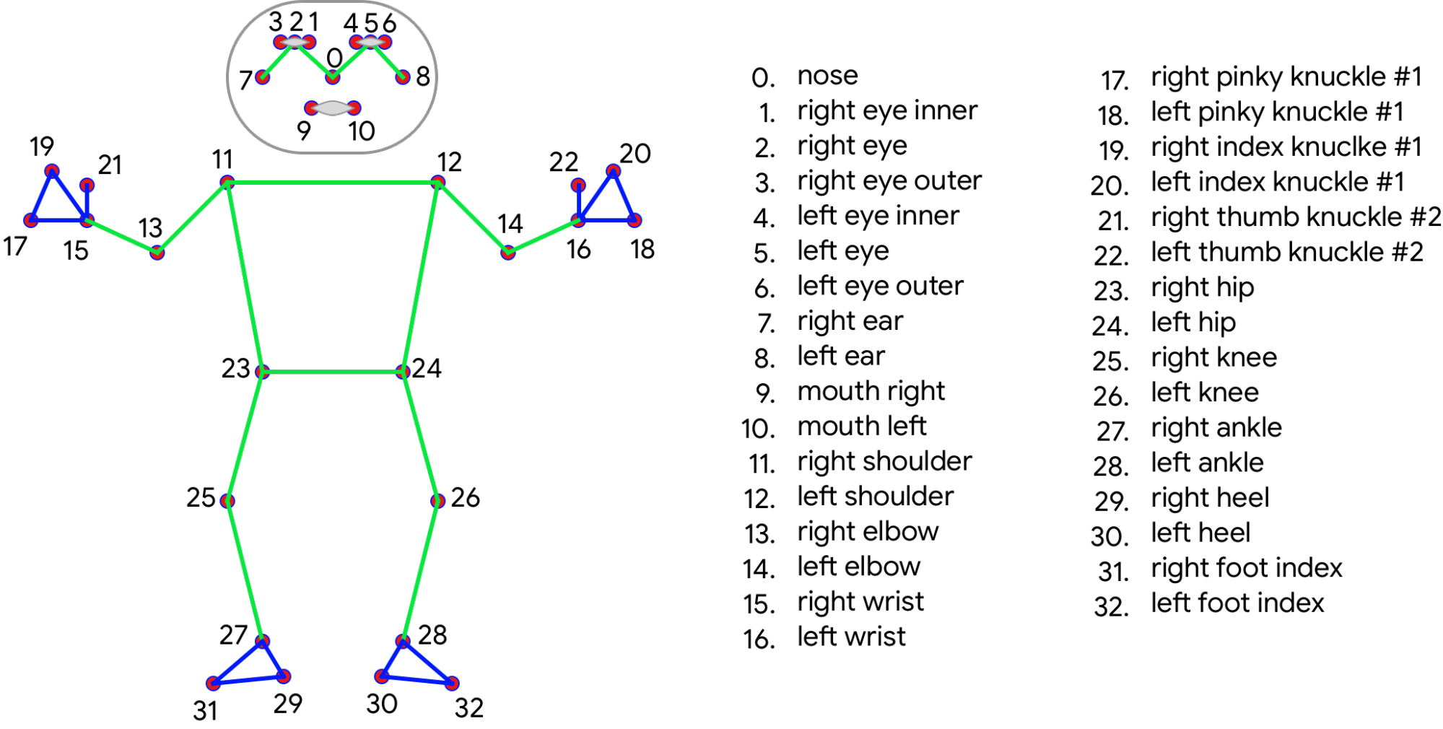
Detected body keypoints

Slide 7
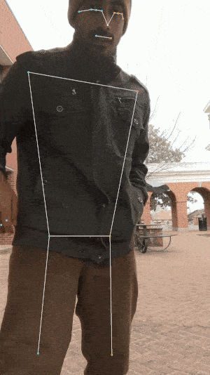
Body pose recognition
Works in real time
No GPU needed
Estimates some of the occluded parts
Gives 3D coordinates of detected keypoints

Slide 8
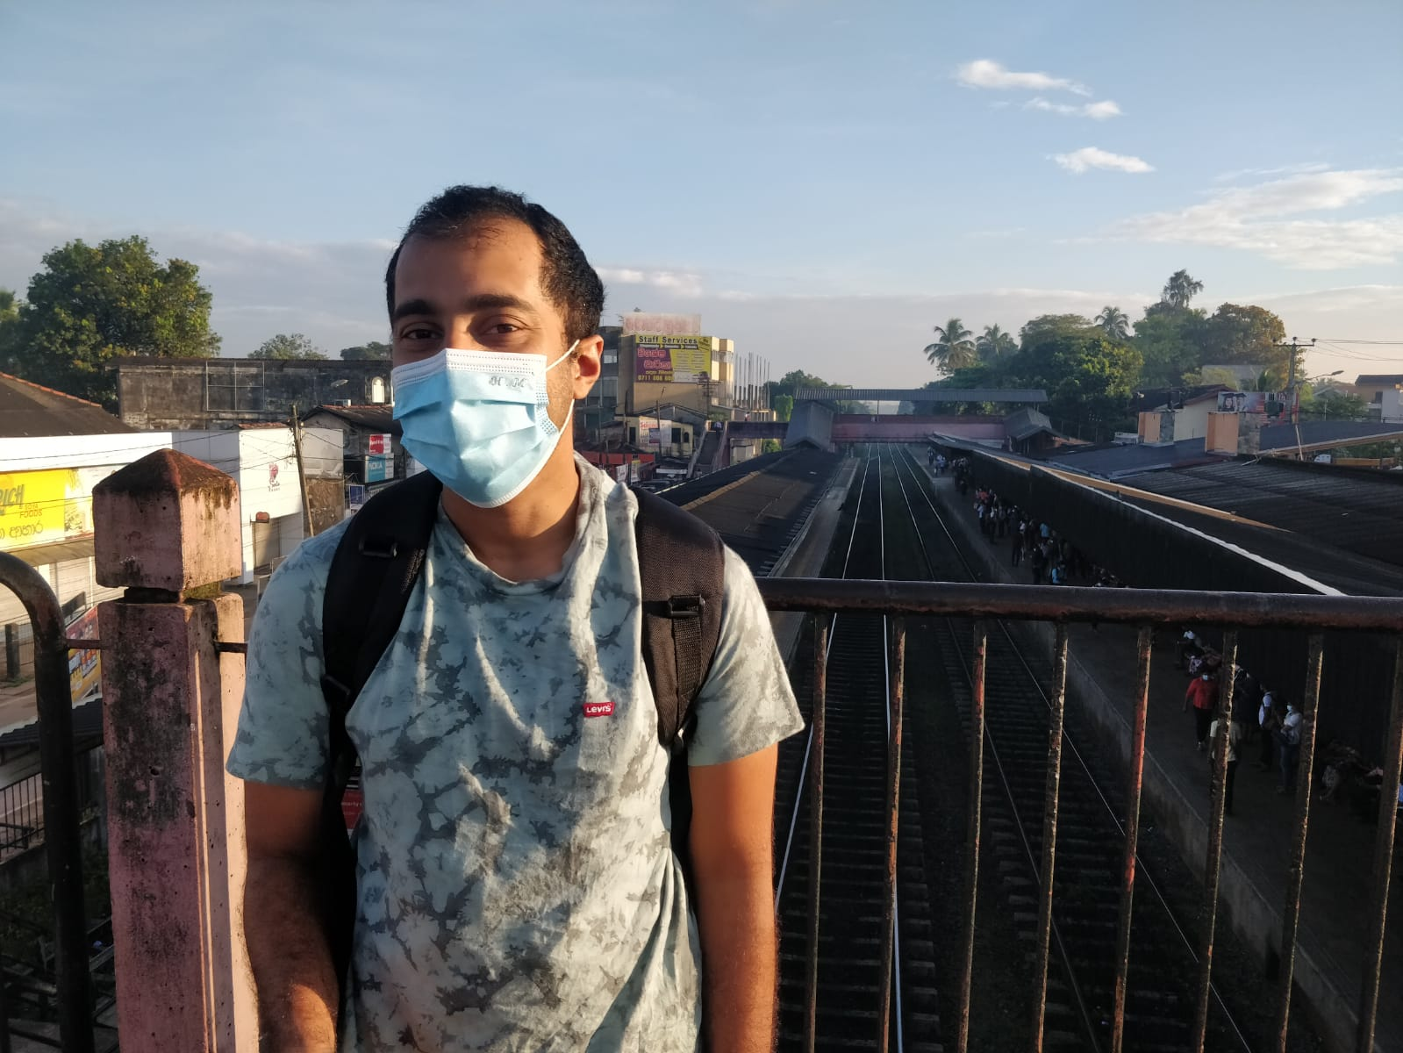
Works when only a part of the body is visible

Slide 9
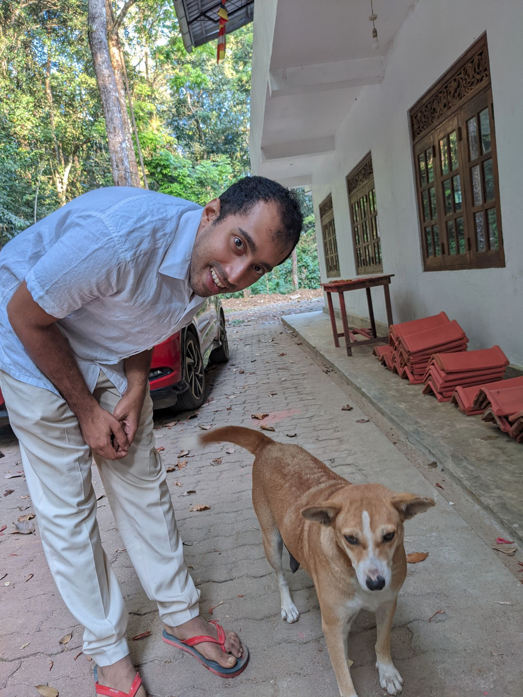
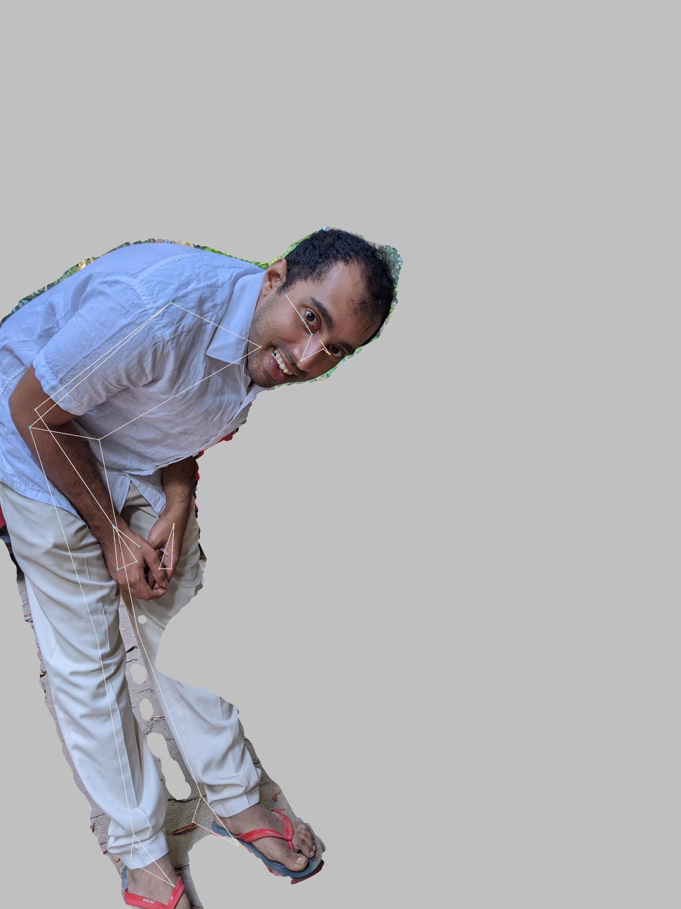
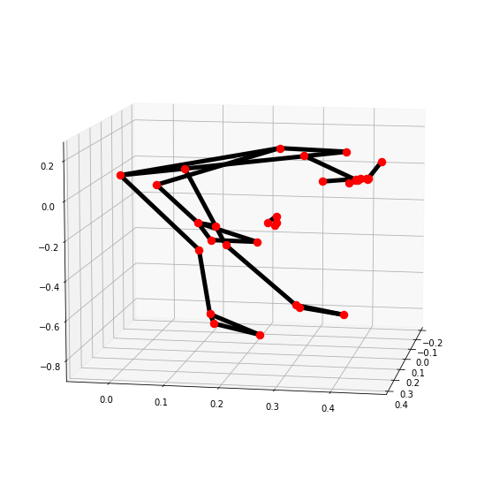
Provides 3D coordinates of identified keypoints

Slide 10
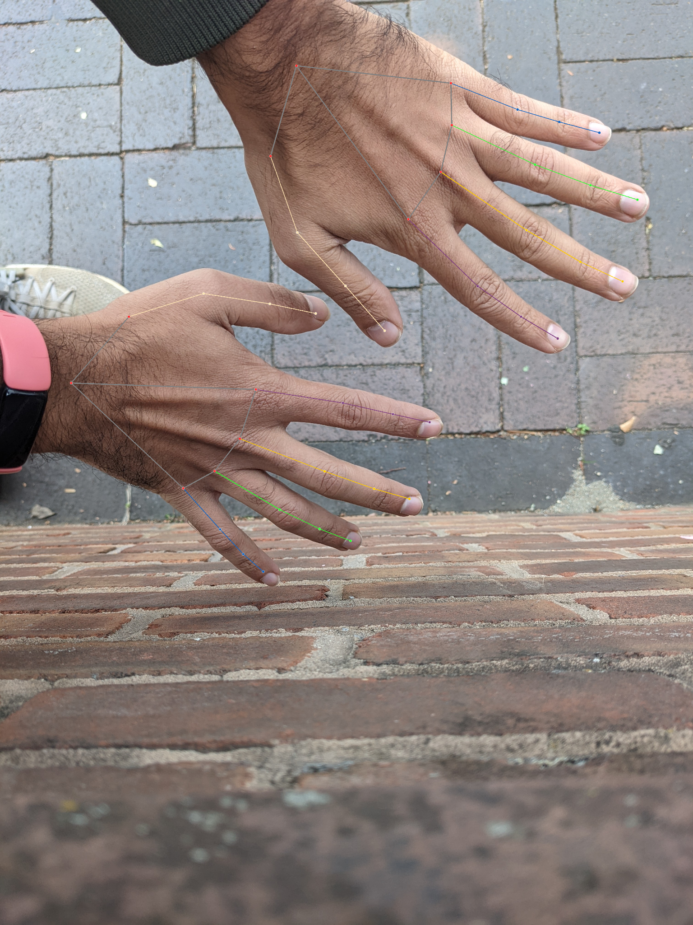
Hand pose recognition
Google Media Pipe
Works in real time
No GPU needed
Gives 3D coordinates of detected keypoints
Can detect 2 hands at the same time

Slide 11
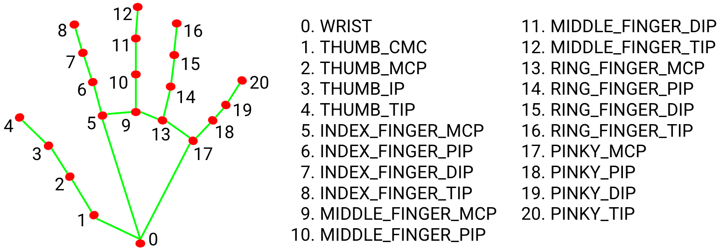
Detected hand keypoints

Slide 12
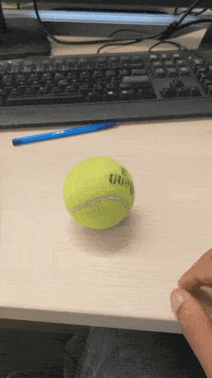

Slide 13
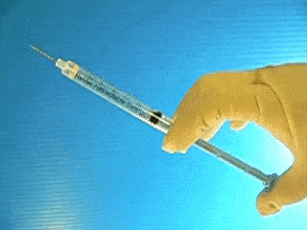
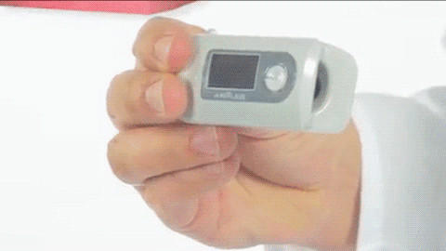
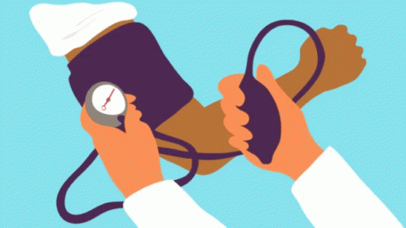
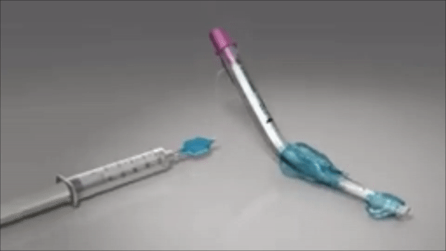
Modelling deformation of objects
Notes:
King LTS-D - used for oral intubation

Slide 14
Objectives of the deformation model
Know when and how much the plunger of the syringe is retracted/advanced
Check if the balloon of the King LTS-D is inflated
Deformation of pressure cuff
Learn to quantify these deformations from watching videos in an unsupervised manner
Notes:
Syringe - barrel, plunger

Slide 15
Thank you

