Slide 1
Two-sided Data-driven UWB Error Mitigation for Indoor Localization

Slide 2
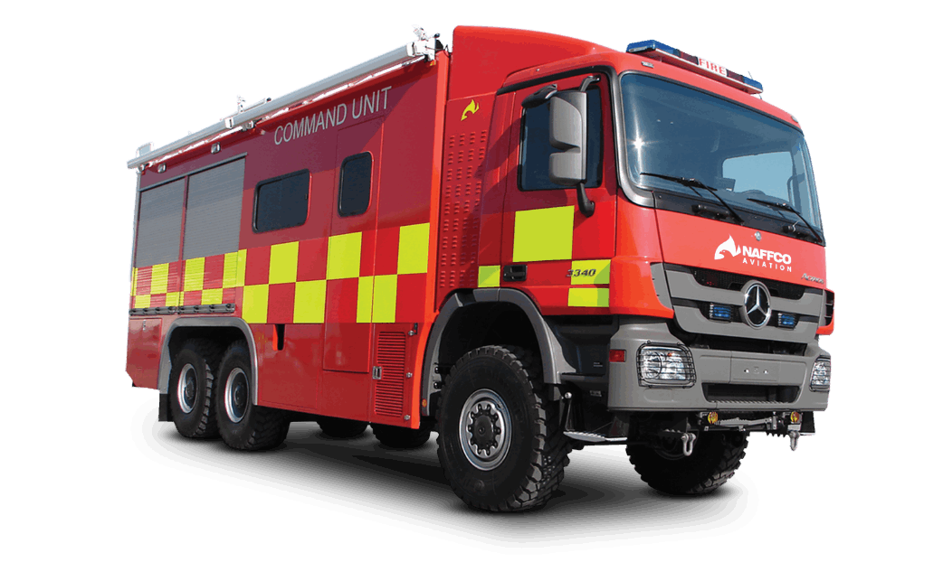
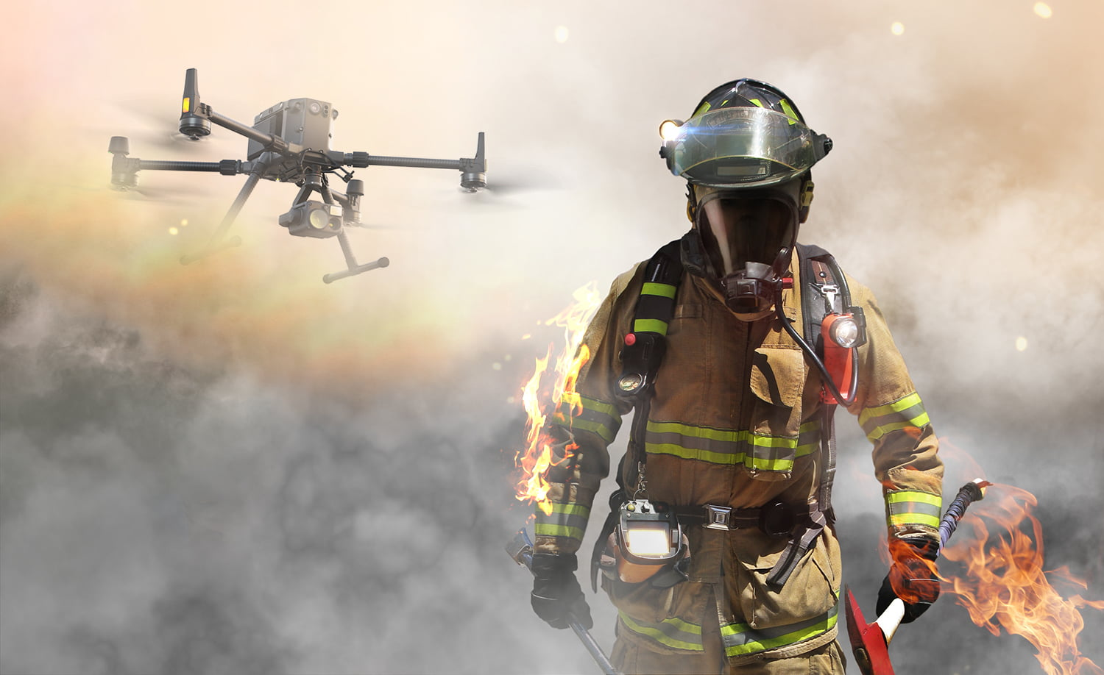
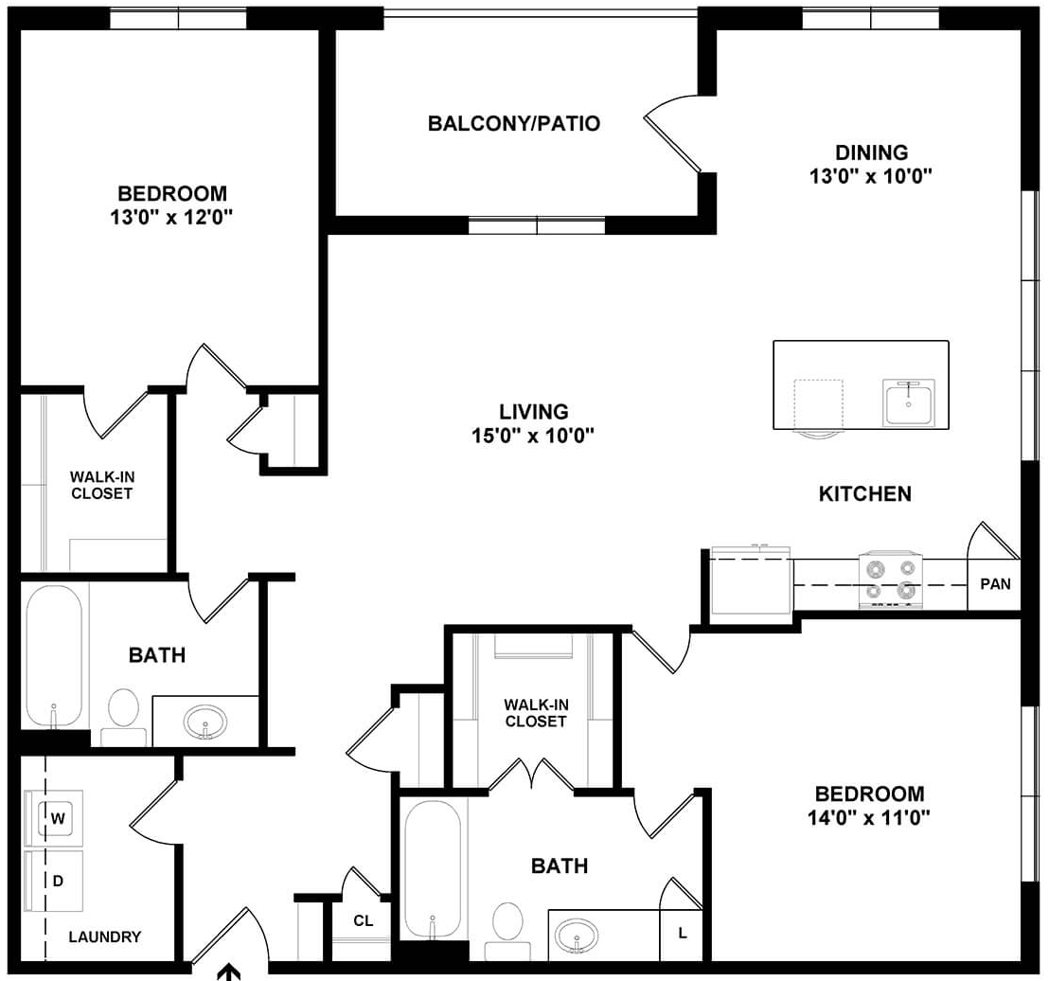
Use case: First responders
Indoor localization can enhance spatial awareness for
First responders
Wheeled-Robots, drones, …
Sensors used for localization should be:
Robust against adverse environments (e.g., smoke, haze)
Robust against body parts (e.g., hand/head) motion artifacts

Slide 3
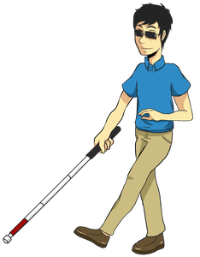



Use case: Assisting visual-impaired people
Find a seat in a hall/theatre
Navigate in building
Cross a road
Accurate (decimeter) spatial knowledge is crucial

Slide 4

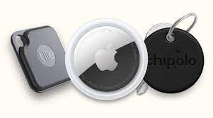
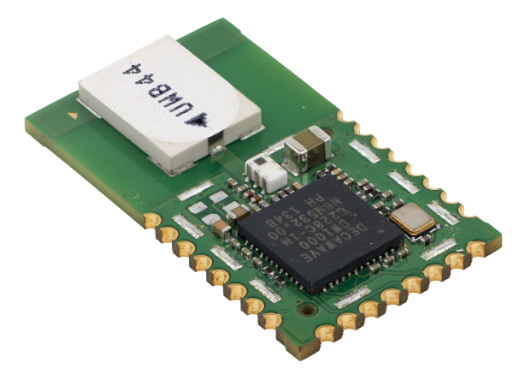
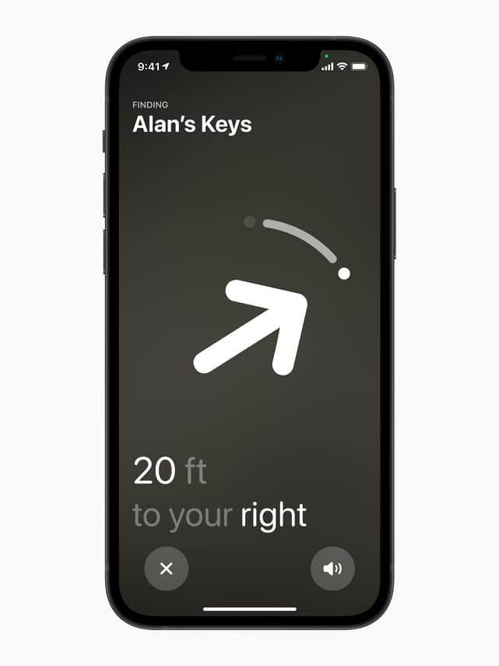

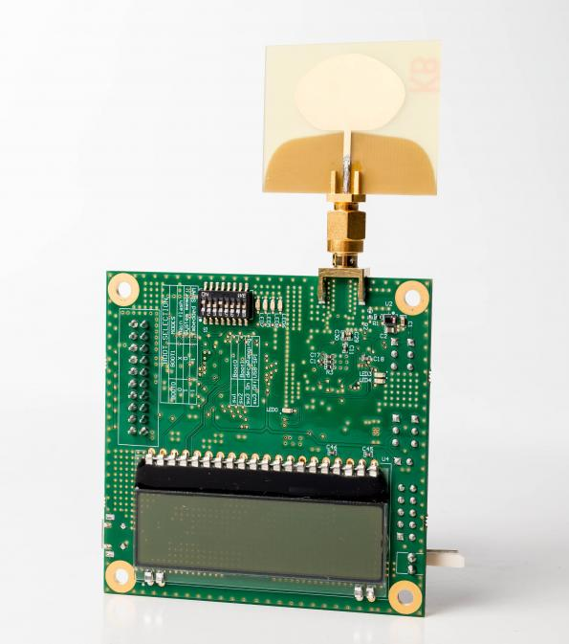
Ultra-wideband (UWB) sensors
Range measurements
Radio pulses
Research platforms
Measure range/distance between 2 sensors
Fine-grained (decimeter accuracy) ranges
Robust to smoke, darkness, …
Commercial devices

Slide 5
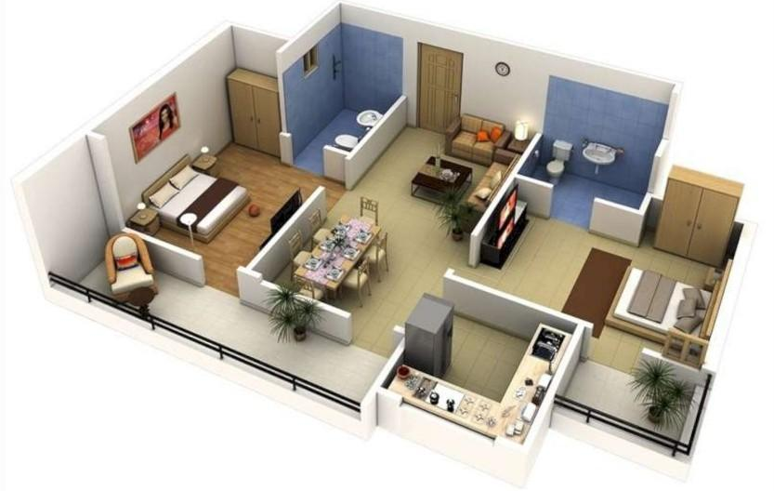
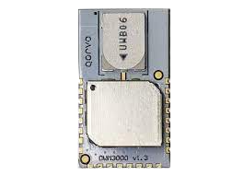
Challenging wireless conditions
Indoor environments:
Expect more None-Line-Of-Sight (NLOS) links
Multiple objects reflects UWB signals
Inaccurate range measurements
How to mitigate ranging errors?

Slide 6

UWB background
Reflector
Reflector
Reflections
Multi-pathed environment
Direct path
Extremely short pulses
(even sub-nanosesond)
UWB can differentiate the direct path among multiple travelling paths
Measure Time-of-Flight accurately

Slide 7
UWB fail under challenging conditions
Reflector
Reflector
Multi-pathed environment
Obstacle
(e.g., thick wall)
Too weak to be detected
FPI: First Path Index
The direct path seems to sink in the noise floor due to an obstacle
Error = 2.8m
Classical thresholding approaches may not work
Channel Impulse Response (CIR)

Slide 8
Previous data-driven approaches are not insightful
Neural net
A typical Double-Sided Two-Way Ranging transaction
CIR
Initiator
POLL
FINAL
Error
Responder
RESPONSE
time
Corrected Range = Raw_Range – Estimated_Error
Which CIR (of poll/response/final packets) should be used?
Can combinations of CIRs perform better?

Slide 9
Example 3 CIRs
Sensor estimated FPIs: error = 2.8m
Hypothetical FPIs: error = 0.0m
Using a single CIR may be sub-optimal
FPI: First Path Index

Slide 10
Proposed approaches
Combine multiple CIRs in a transaction for error mitigation
Weighted sum
FMCIR (2 or 3 CIR)
WMCIR (3-CIR)
Wi is obtained from the prior knowledge of protocol
Assumption:
UWB nodes can execute the neural network, or it can transmit the CIR to a processing node
The UWB nodes use the widely used double-sided two-way ranging scheme
FMCIR: Fused Multi CIR WMCIR: Weighted Multi CIR

Slide 11
Dataset
Range errors in train-set
Red dots: Anchor positions in train-set
Blue dots: Anchor positions in test-set
Shaded area: Tag’s free movements
A sample: {poll_CIR, response_CIR, final_CIR}
Range errors in test-set

Slide 12
Compare different approaches
◀︎
◀︎
◀︎
Using 2 CIRs from both side (◀︎) significantly improves the performance
Using all 3 CIRs (◀︎) further reduces up to 45% range error vs. SOTA (◀︎)
SOTA: State of the art

Slide 13
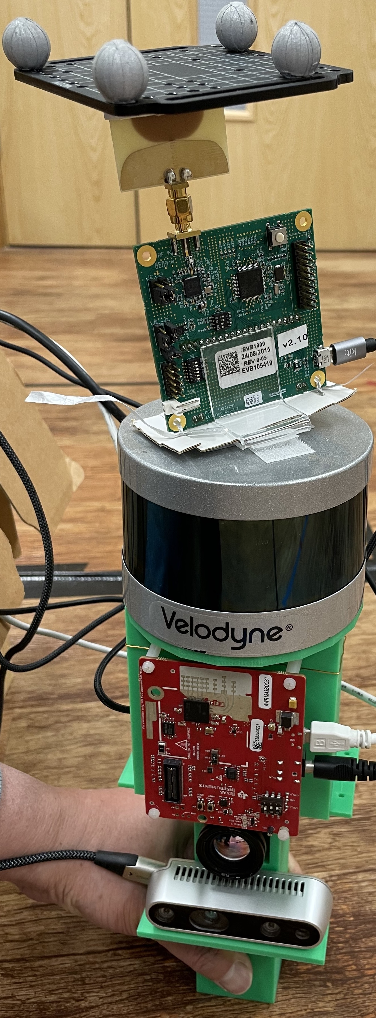
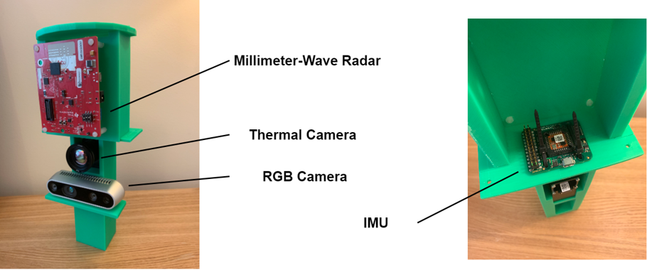
Drift mitigation for mmWave-IMU odometer
Base odometer (MilliEgo): mmWave radar and IMU for trajectory estimation
UWB Tag
Lidar
mmWave Radar
IMU
WMCIR significantly reduces drift effect
Outperforming SOTA

Slide 14
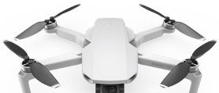
Summary
Systematic studies of efficient uses of CIRs for UWB error mitigation
Proposed two multi-CIR data-driven approaches that outperform SOTA
Created a transaction-level synchronized CIR dataset
Future direction:
Drones used as anchors
Drone formation as an input

