Slide 1
Egocentric Image Captioning
Contents
Introduction
Objectives
EgoCap Image Captioning Dataset
EgoCap Labelling User Interface
Transformer-based Ego-Captioning Model

Slide 2
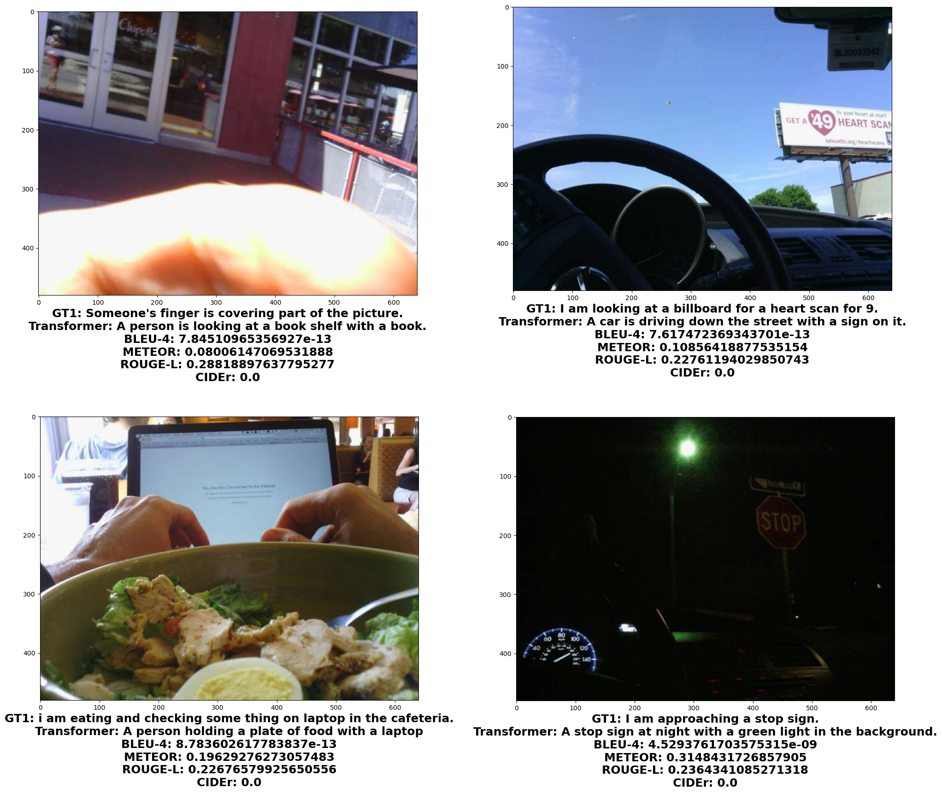
Introduction
To describe visual data in natural language is importance for event summary, activity recognition, and prediction.
Ego-image captioning is under-explored in 1st-person narrative:
(1) Motion blurs & camera angles
(2) Ego-caption has to infer cameraman’s status which is implicit
(3) Lack of dataset

Slide 3
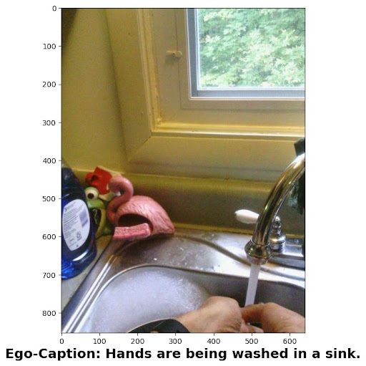
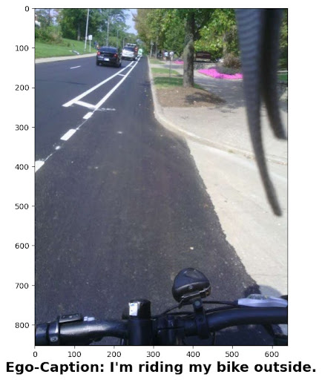
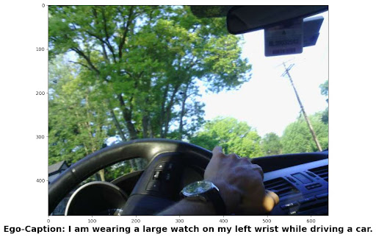
Objectives
1. Lifelog, event summary, and activity prediction via a body-worn camera
2. An ego-image captioning dataset with (5) ground-truth ego-captions
3. A data-driven ego-visual captioning baseline model

Slide 4
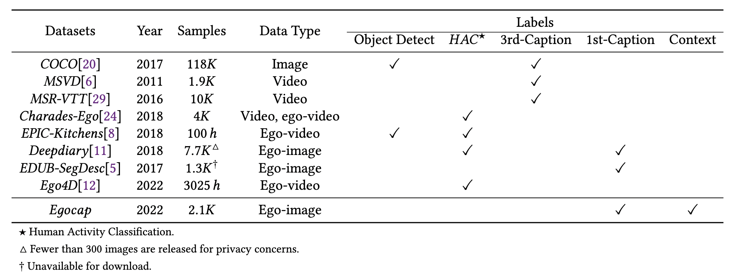
Existing Visual-Semantics Datasets

Slide 5
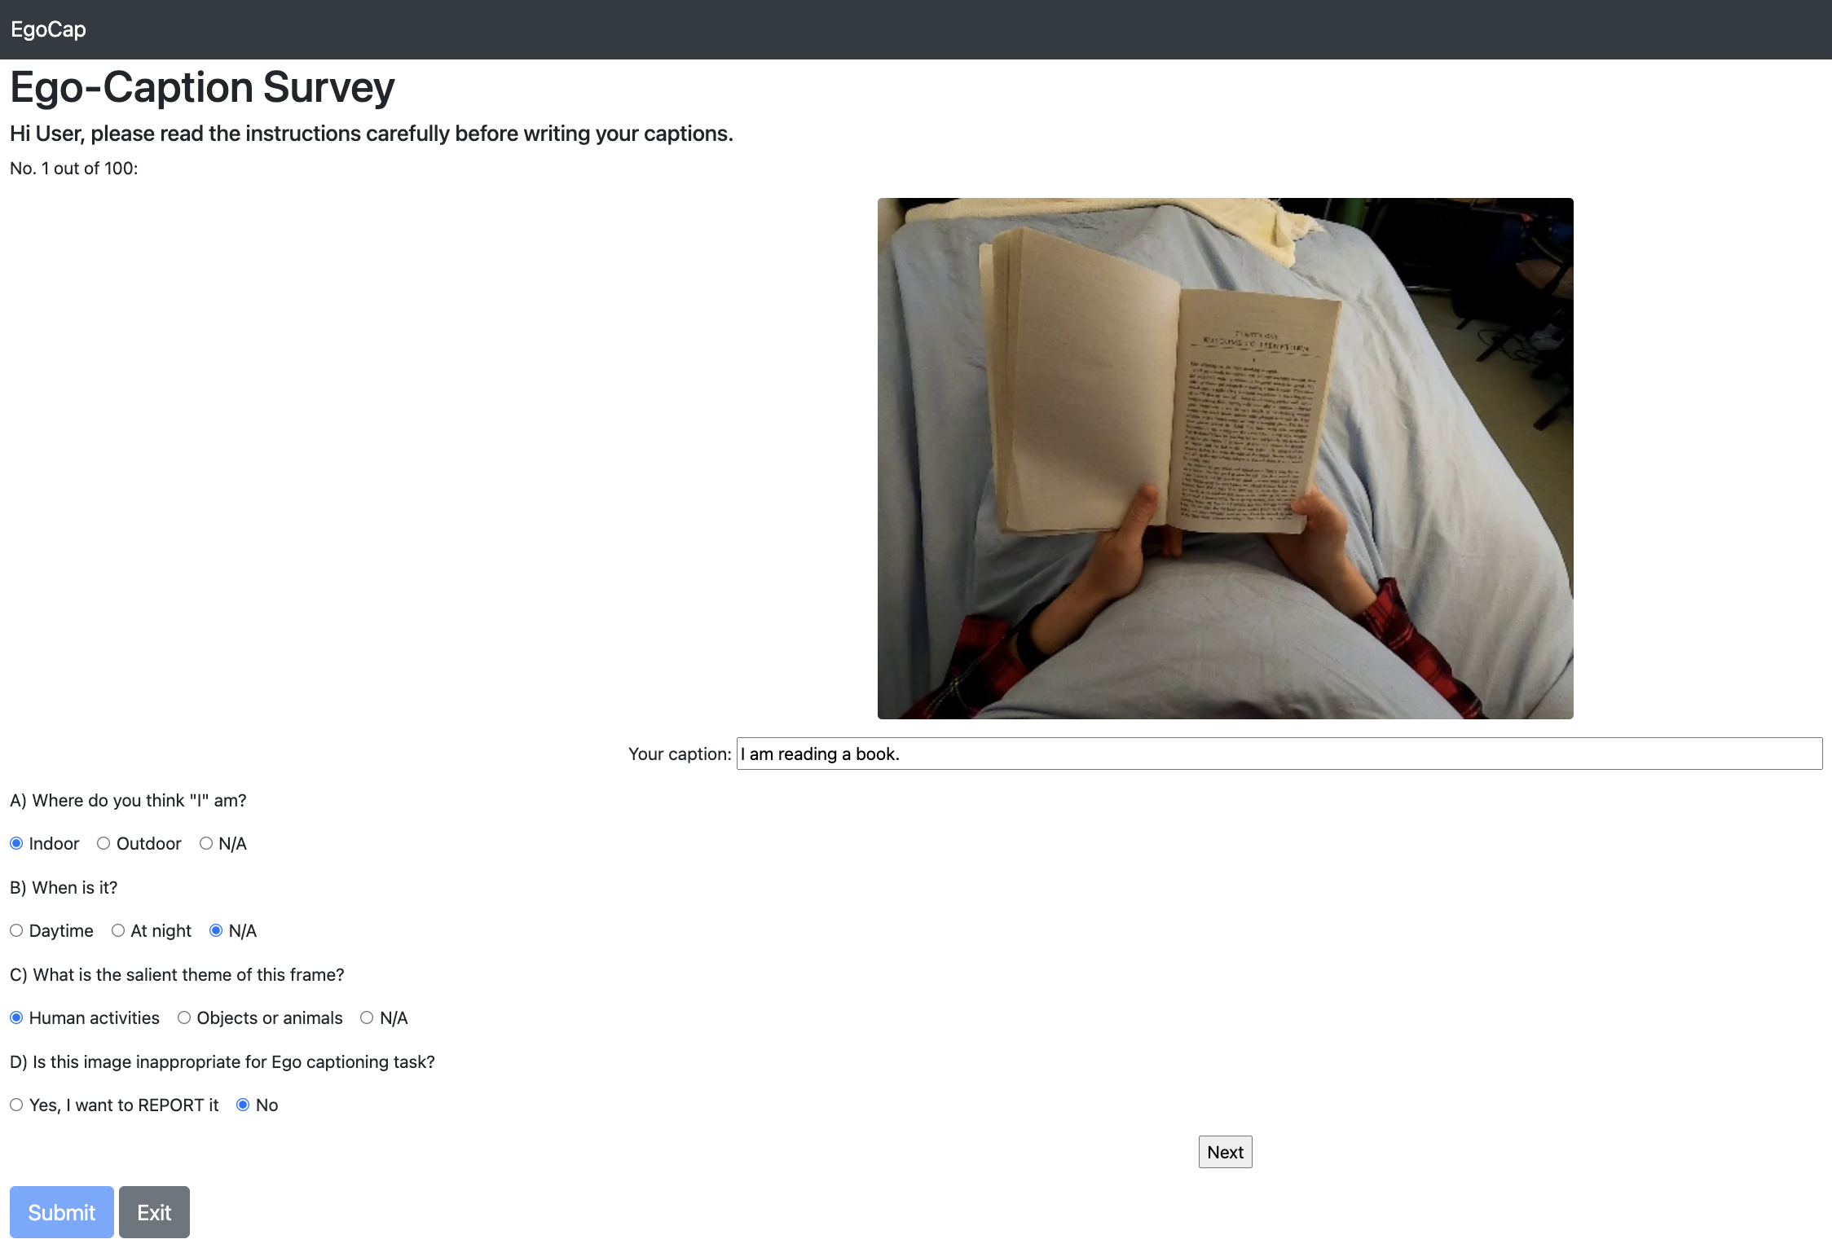
EgoCap Labelling

Slide 6
Ego-Image selection criteria and
Caption Instructions
Daily scenes from angle of a wearable camera; No cinematic, staged, or TV program scenes
No script, no logos
Diversity in object categories and classified human activities
Instructions:
1. Imagine you were the cameraman, use one sentence to describe the scene
2. Focus on your status, activity, environment, and time

Slide 7
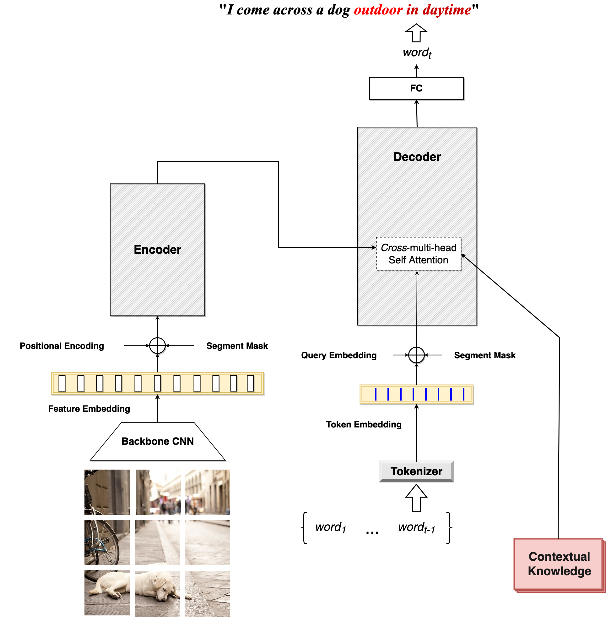
EgoCap Transformer
Backbone CNN for visual feature extraction
Vanilla transformer encoder
Transformer decoder with attention among {visual feature, previous words, contextual knowledge}
Weakly labelled contextual knowledge from image classifier

Slide 8
Summary
Ego-captioning is challenged by
Motion blurs, hand occlusion, and weird camera angles
Making implicit inference of cameraman’s status that is outside FOV
Lack of datasets
Create a new dataset for ego-image captioning and contextual tagging
A transformer-based ego-captioning baseline
Foster ego-scene understanding for emergency responses

