Slide 1

Invariant Set Theory: Violating Measurement Independence without fine-tuning, conspiracy, or constraints on free will
Tim Palmer
Clarendon Laboratory
University of Oxford
Notes:
----- Meeting Notes (28/02/2013 09:52) -----
hello

Slide 2
To explain the experimental violation of Bell Inequalities, a putative theory of quantum physics must violate one (or more) of:
Realism
Local causality
Measurement independence

Slide 3
Fine Tuned?
Conspiratorial?
Denies experimenter free will?
Requires retrocausal physics?
NO!

Slide 5

p-adic Integers and Cantor Sets
Eg
is a bijection between 2-adic integers and points of the Cantor ternary set C₂.
F generalises for arbitrary p.

Slide 6
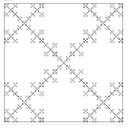
Two points on C_{p}, close together wrt |…|, have |…|_{p}<<1
Two points, one on C_{p}, the other not, close together wrt |…|, have |…|_{p} ≥ p

Slide 7
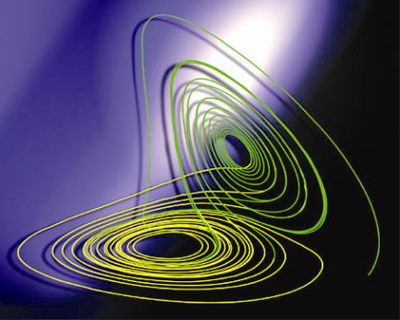
Fractal Invariant Sets are Generic in Nonlinear Dynamical Systems Theory
I_{L}
Global Analysis

Slide 8
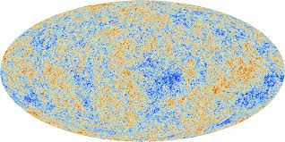
The Cosmological Invariant Set Postulate
States X_{U} of the universe U evolve precisely on a measure-zero fractal subset I_{U} in the state space of U.

Slide 9
The most primitive expressions of the laws of physics are not dynamical laws of evolution but are rather descriptions of the (fractal) geometry of I_{U} .
Below we base I_{U} on a fractal model of the p-adic integers for p>>1.
Like GR, Invariant Set Theory is geometric at heart
Unlike GR, Invariant Set Theory has many direct links to number theory
Invariant Set Theory

Slide 10
References
1. Palmer, T.N., 2009: The invariant set postulate: a new geometric framework for the foundations of quantum theory and the role played by gravity. Proc Roy. Soc., A465, 3165-3185.
2. Palmer, T.N., 2014: Lorenz, Gödel and Penrose: new perspectives on determinism and causality in fundamental physics. Contemporary Physics, 55, 157-178
3. Palmer, T.N., 2015: Bell’s Conspiracy, Schrödinger’s Black Cat and Global Invariant Sets. Phil. Trans. Roy. Soc. A, 373, 20140246; DOI: 10.1098/rsta.2014.0246.
4. Palmer, T.N., 2015: Invariant Set Theory and the Symbolism of Quantum Measurement. Phys Rev D. In review.
5. Palmer, T.N., 2015: Invariant Set Theory: Violating Measurement Independence without fine-tuning, conspiracy, constraints on free will or retrocausality. QPL2015 conference proceedings.
tim.palmer@physics.ox.ac.uk

Slide 11
I_{U} and the Complex Hilbert Space (Ref 4)
Helices are a manifestation of quaternionic structure (Ref 4)
N.B. Histories
above describe e.g.

Slide 12
Interlude: Spherical geometry / number theory
a
φ
c
b

Slide 13
This number-theoretic property of spherical triangles underpins IS theory’s interpretation of all standard quantum phenomena:
Bell (refs 3,5)
CHSH (refs 3,5)
Sequential Stern-Gerlach (Heisenberg Uncertainty Principle) (ref 2)
Mach-Zehnder Interferometry (Wave Particle Duality) (ref 4)
Pusey et al??

Slide 14
Bell’s Theorem

Slide 15
The Key Point

Slide 17
Where Does Quantum Theory Fit?
Quantum theory (e.g. the complex Hilbert Space) arises as the singular limit of IS theory for at p=∞. (The real numbers can be considered a singular limit of p-adic integers at p=∞ - Neukirch Algebraic Number Theory. )
For example, inviscid Euler theory is the singular limit of Navier-Stokes theory for infinite fluid Reynolds Number.
Most of the time Euler theory provides a good description of high Reynolds Number flow. But sometimes it is a catastrophic failure –e.g. it predicts aircraft could never fly!
Similarly quantum theory is an excellent fit to observations most of the time, but could fail catastrophically. Perhaps when describing situations where gravity is important – e.g. vacuum fluctuations and dark energy?

Slide 18
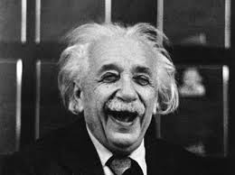
Conclusion
The experimental violation of Bell Inequalities does not preclude a locally causal ontic theory of quantum physics!

Slide 19


