Slide 1
Type-based termination analysis with disjunctive invariants
Dimitrios Vytiniotis, MSR Cambridge
with Byron Cook (MSR Cambridge) and Ranjit Jhala (UCSD)
IFIP WG 2.8, Austin TX, March 2011

Slide 2


… or, what am I doing hanging out with these people?
termination and liveness of imperative programs, shape analysis and heap space bounds, ranking function synthesis
program analysis, model checking and verification for systems code, refinement types, liquid types, decision procedures
And myself?
functional programming, type systems, type inference, dependent types, semantics and parametricity, Coq, Haskell!

Slide 3
The jungle of termination/totality analysis
“Guarded recursion” (my own term)
sized types [Hughes et al, Abel]
modalities for recursion [eg Nakano]
Structural recursion
Conor McBride
offered in Coq and Agda
also Bove & Capretta transformation
Dependent types
programming with well-founded relations (think “ranking functions”)
Coq, Agda, DML [Xi]
Size-change principle
[Jones, Sereni, Bohr]
a control flow analysis essentially
Terminator
termination analysis for imperative programs
“disjunctive invariants” and Ramsey’s theorem
[Cook, Podelski, Rybalchenko]

Slide 4
A dichotomy?
“Guarded recursion”, structural recursion, dependent types
☹ Mostly fully manual
☺ Programmable
☺ Declarative specification
☹ Often tedious to come up with a WF relation or convince type checker (i.e. the techniques don’t make proving totality easier, they just make it possible!)
Terminator and disjunctive
invariants, size-change
☺ Mostly fully automatic
☹ Not programmable
☹ No declarative specs
☺ Often easy for the tool to synthesize the termination argument
Today I will have a go at combining both worlds
WARNING: very fresh (i.e. airplane-fresh) ideas!

Slide 5
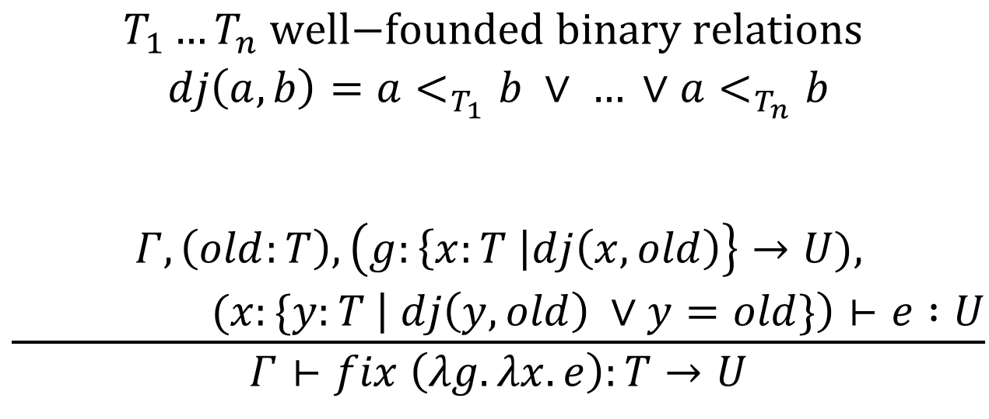
The idea: one new typing rule for totality
$$\frac{\begin{aligned}T_{1}…T_{n} \text{well}\text{−}\text{founded} \text{binary} \text{relations} \\ dj\left(a,b\right)=a<_{T_{1}}b ∨ … ∨a<_{T_{n}}b \\ \\ \\ Γ,\left(old:T\right),\left(g:\left\{x:T \right|dj\left(x,old\right)\right\}→U), \\ (x:\{y:T \left| dj\left(y,old\right) ∨y=old\}\right)⊢e :U\end{aligned}}{Γ⊢fix \left(λg. λx. e\right):T→U}$$

Slide 6

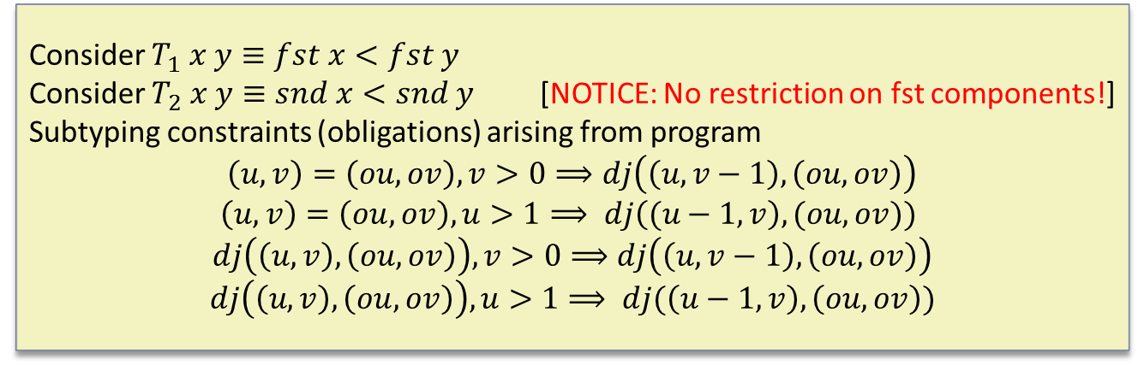
Example
Terminating,
by lexicographic pair order
let rec flop (u,v) =
if v > 0 then flop (u,v-1) else
if u > 1 then flop (u-1,v) else 1
$$\frac{Γ,\left(old:T\right),\left(g:\left\{x:T \right| dj\left(x,old\right)\right\}→U),(x:\{y:T \left| dj\left(y,old\right) ∨y=old\}\right)⊢e:U}{Γ⊢fix \left(λg. λx. e\right):T →U}$$
Consider $T_{1} x y≡fst x<fst y$
Consider $T_{2} x y≡snd x<snd y$ [NOTICE: No restriction on fst components!]
Subtyping constraints (obligations) arising from program
$\left(u,v\right)=\left(ou,ov\right), v>0⟹dj\left(\left(u,v−1\right),\left(ou,ov\right)\right)$
$\left(u,v\right)=\left(ou,ov\right), u>1⟹ dj\left((u−1,v\right),(ou,ov))$
$$dj\left(\left(u,v\right),\left(ou,ov\right)\right),v>0⟹dj\left(\left(u,v−1\right),\left(ou,ov\right)\right)$$
$$dj\left(\left(u,v\right),\left(ou,ov\right)\right), u>1⟹ dj(\left(u−1,v\right),\left(ou,ov\right))$$

Slide 7
Or …
just call Liquid Types and it will do all that for you!
http://pho.ucsd.edu/liquid/demo/index2.php
… after you have applied a transformation to the original program that I will describe later on

Slide 8
Background
Structural and guarded recursion, dependent types and well-founded relations in Coq
We will skip these. You already know

Slide 9
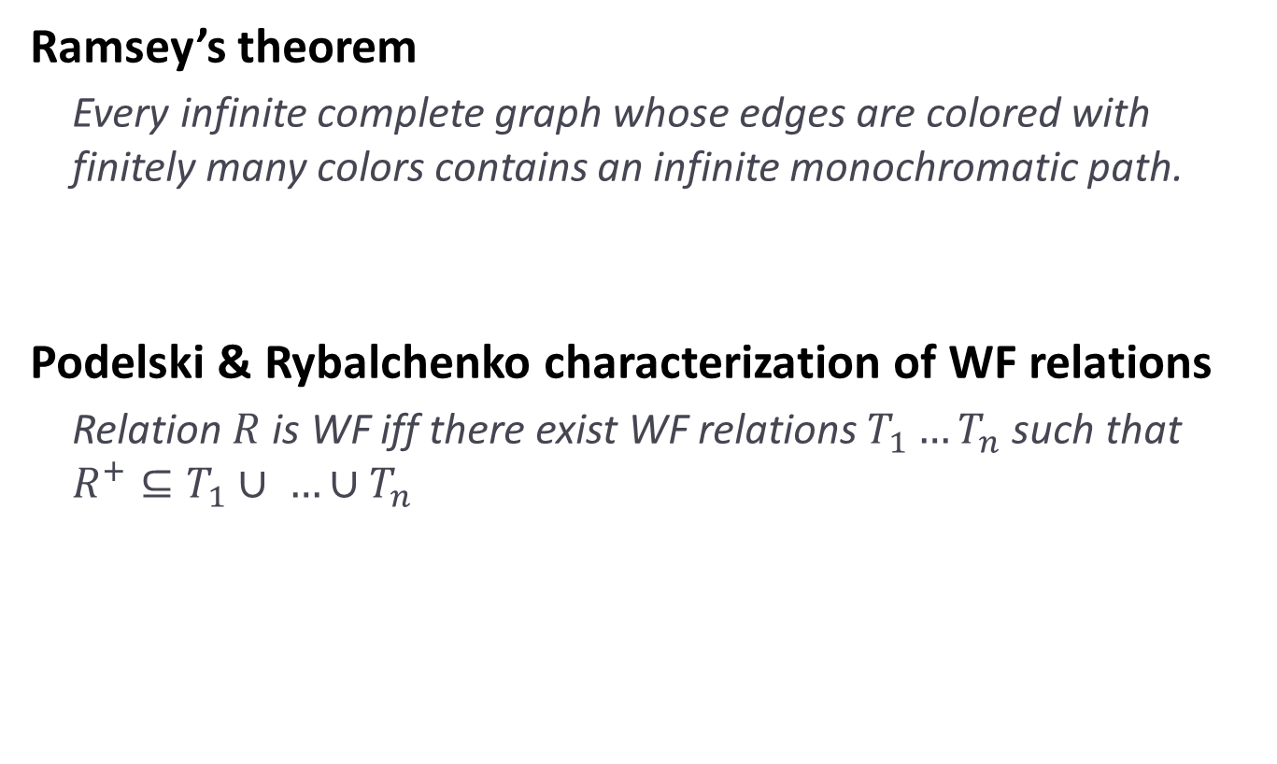
Background: disjunctive invariants
Ramsey’s theorem
  Every infinite complete graph whose edges are colored with finitely many colors contains an infinite monochromatic path.
Podelski & Rybalchenko characterization of WF relations
  Relation $R$ is WF iff there exist WF relations $T_{1}…T_{n}$ such that $R^{+}⊆T_{1}∪ …∪T_{n}$

Slide 10
Background: How Terminator works?
Transform a program, and assert/infer invariants!
Invariant between x and oldx
represents any point of R+!
We need non-deterministic
choice to allow the “start point” to be anywhere
int x = 50;
while (x > 0) do {
…
x = x - 1;
}
bool copied = false;
int oldx;
int x = 50;
while (x > 0) do {
if copied then
assert (x <_{T_i} oldx)
else
if * then {
copied=true; oldx=x;
}
…
x = x - 1;
}

Slide 11
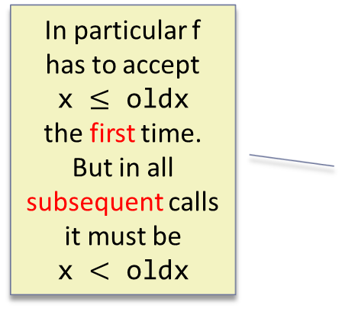

In a functional setting: a first attempt
Let’s consider only divergence from recursion
  Negative recursive types, control $←$ Not well-thought yet
The “state” is the arguments of the recursive function
Hence:
let rec f x =
if x==0 then 41 else f (x-1) + 1
In particular f has to accept
x $≤$ oldx
the first time.
But in all subsequent calls it must be
x $<$ oldx
let rec f x =
if * then
if x==0 then 41 else f (x-1) + 1
else
f’ x x
let rec f’ oldx x =
if x==0 then 41 else f’ oldx (x-1) + 1
But where is the ASSERT?

Slide 12
In a functional setting: a better attempt
Just inline the first call to f’ to expose subsequent calls:
let rec f x =
if x==0 then 41 else f (x-1) + 1
Starts to look like something a refinement type system could express
… but can we dispense with rewriting?
let rec f x =
if * then
if x==0 then 41 else f (x-1) + 1
else
f’ x x if x==0 then 41 else f’ x (x-1) + 1
let rec f’ oldx x =
assert (oldx <_{T_i} x)
if x==0 then 41 else f’ oldx (x-1) + 1

Slide 13
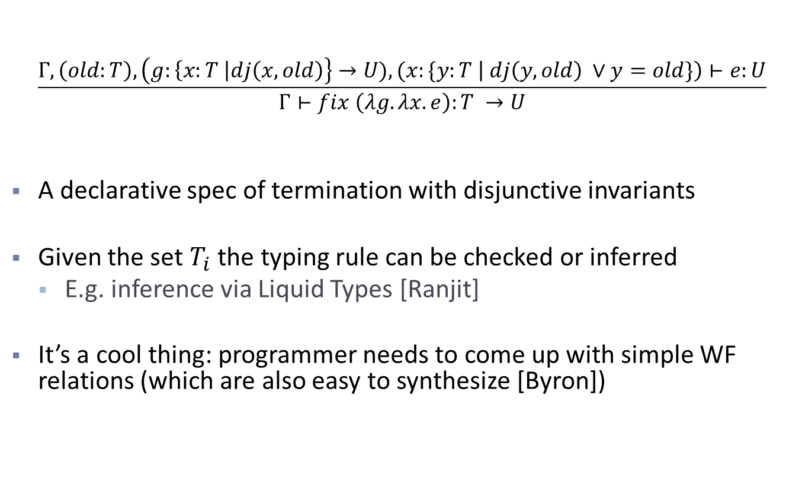
A special typing rule, to avoid rewriting
$$\frac{Γ,\left(old:T\right),\left(g:\left\{x:T \right|dj\left(x,old\right)\right\}→U),(x:\{y:T \left| dj\left(y,old\right) ∨y=old\}\right)⊢e:U}{Γ⊢fix \left(λg. λx. e\right):T →U}$$
A declarative spec of termination with disjunctive invariants
Given the set $T_{i}$ the typing rule can be checked or inferred
  E.g. inference via Liquid Types [Ranjit]
It’s a cool thing: programmer needs to come up with simple WF relations (which are also easy to synthesize [Byron])

Slide 14

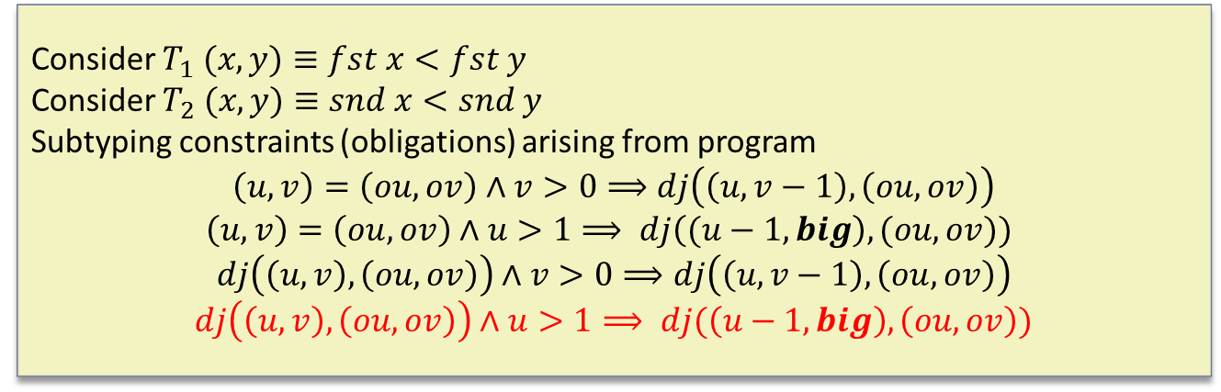
Bumping up the arguments
let rec flop (u,v) =
if v > 0 then flop (u,v-1) else
if u > 1 then flop (u-1,big) else 1
$$\frac{Γ,\left(old:T\right),\left(g:\left\{x:T \right| dj\left(x,old\right)\right\}→U),(x:\{y:T \left| dj\left(y,old\right) ∨y=old\}\right)⊢e:U}{Γ⊢fix \left(λg. λx. e\right):T →U}$$
Consider $T_{1} (x,y)≡fst x<fst y$
Consider $T_{2} (x,y)≡snd x<snd y$
Subtyping constraints (obligations) arising from program
$\left(u,v\right)=\left(ou,ov\right)∧v>0⟹dj\left(\left(u,v−1\right),\left(ou,ov\right)\right)$
$\left(u,v\right)=\left(ou,ov\right)∧u>1⟹ dj\left((u−1,big\right),(ou,ov))$
$$dj\left(\left(u,v\right),\left(ou,ov\right)\right)∧v>0⟹dj\left(\left(u,v−1\right),\left(ou,ov\right)\right)$$
$$dj\left(\left(u,v\right),\left(ou,ov\right)\right)∧u>1⟹ dj(\left(u−1,big\right),\left(ou,ov\right))$$

Slide 15
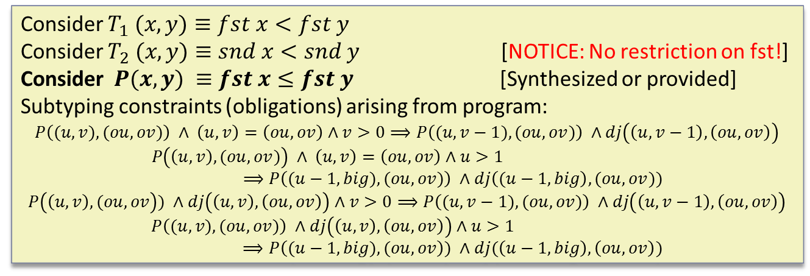
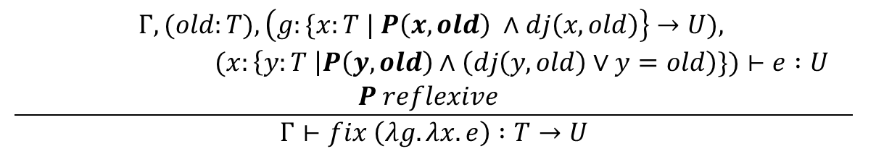
One way to strengthen the rule with invariants
let rec flop (u,v) =
if v > 0 then flop (u,v-1) else
if u > 1 then flop (u-1,big) else 1
$$\frac{\begin{aligned}Γ,(old:T),\left(g:\{x:T | P\left(x,old\right) ∧dj\left(x,old\right)\right\}→U), \\ (x:\left\{y:T \right|P\left(y,old\right)∧\left(dj\left(y,old\right)∨y=old\right)\})⊢e :U \\ P reflexive \end{aligned}}{Γ⊢fix \left(λg. λx. e\right) :T→U}$$
Consider $T_{1} (x,y)≡fst x<fst y$
Consider $T_{2} (x,y)≡snd x<snd y$ [NOTICE: No restriction on fst!]
Consider $P(x,y) ≡fst x≤fst y$ [Synthesized or provided]
Subtyping constraints (obligations) arising from program:
$$P\left((u,v),(ou,ov)\right) ∧ \left(u,v\right)=\left(ou,ov\right)∧v>0⟹P\left((u,v−1),(ou,ov)\right) ∧dj\left(\left(u,v−1\right),\left(ou,ov\right)\right)$$
$$P\left(\left(u,v\right),(ou,ov)\right) ∧ \left(u,v\right)=\left(ou,ov\right)∧u>1⟹P\left((u−1,big),(ou,ov)\right) ∧dj\left((u−1,big\right),(ou,ov))$$
$$P\left(\left(u,v\right),(ou,ov\right)) ∧dj\left(\left(u,v\right),\left(ou,ov\right)\right)∧v>0⟹P\left((u,v−1),(ou,ov)\right) ∧dj\left(\left(u,v−1\right),\left(ou,ov\right)\right)$$
$$P\left((u,v),(ou,ov)\right) ∧dj\left(\left(u,v\right),\left(ou,ov\right)\right)∧u>1⟹P\left((u−1,big),(ou,ov\right)) ∧dj(\left(u−1,big\right),\left(ou,ov\right))$$

Slide 16
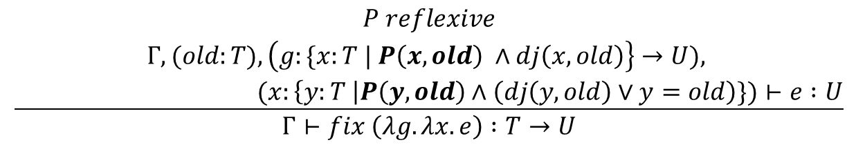
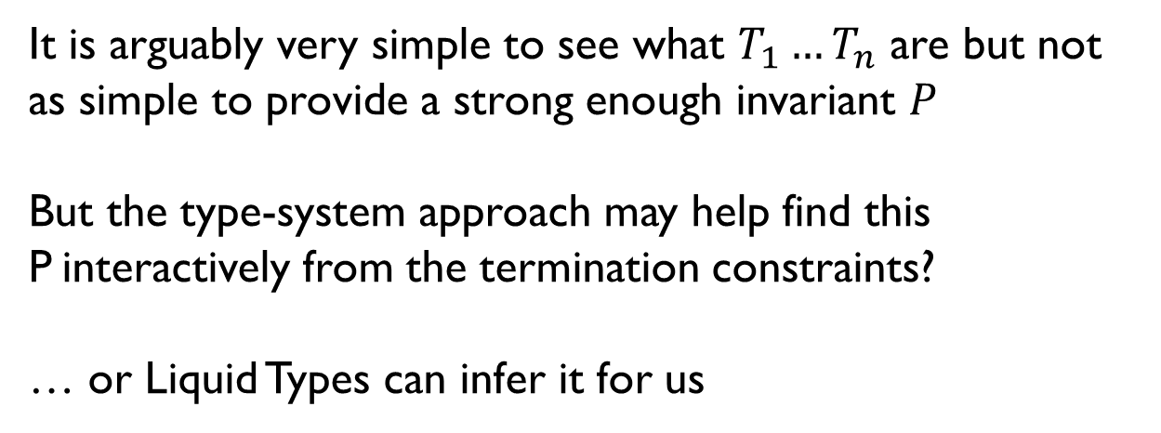
Scrap your lexicographic orders? ...
$$\frac{\begin{aligned}P reflexive \\ Γ,(old:T),\left(g:\{x:T | P\left(x,old\right) ∧dj\left(x,old\right)\right\}→U), \\ (x:\left\{y:T \right|P\left(y,old\right)∧\left(dj\left(y,old\right)∨y=old\right)\})⊢e :U\end{aligned}}{Γ⊢fix \left(λg. λx. e\right) :T→U}$$
It is arguably very simple to see what $T_{1}…T_{n}$ are but not as simple to provide a strong enough invariant $P$
But the type-system approach may help find this P interactively from the termination constraints?
… or Liquid Types can infer it for us

Slide 17
What next?
More examples. Is it easy for the programmer?
Formal soundness proof
  Move from trace-based semantics (Terminator) to denotational?
Integrate in a refinement type system or a dependently typed language
  Tempted by the Program facilities for extraction of obligations in Coq
  Is there a constructive proof of (some restriction of) disjunctive WF theorem? If yes, use it to construct the WF ranking relations in Coq
  Applicable to Agda, Trellys?
  Liquid types. Demo works for many examples via the transformation
Negative recursive datatypes, mutual recursion …

Slide 18
Thanks!
A new typing rule for termination
based on disjunctive invariants
New typing rule serves as:
a declarative specification of that method, or
the basis for a tool that could potentially increase the programmability of totality checking

