Slide 1
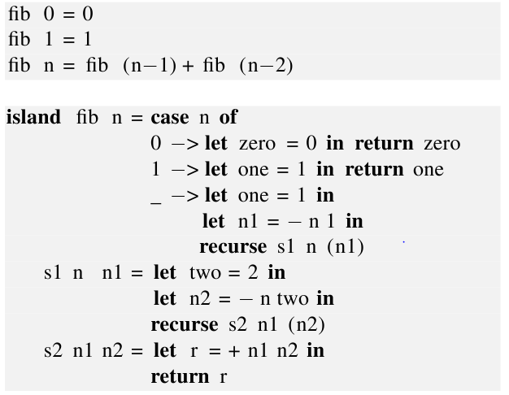
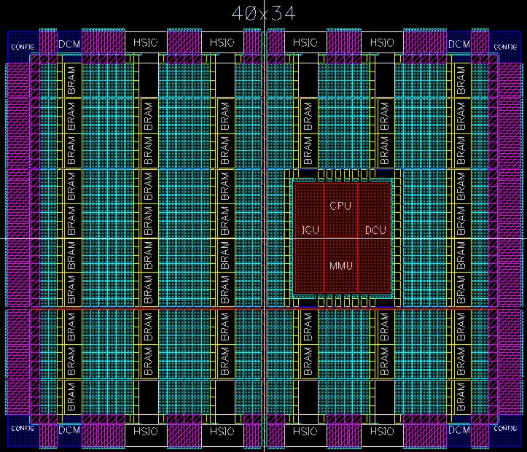
Running Dynamic Algorithms on
Static Hardware
Stephen Edwards (Columbia)
Simon Peyton Jones, MSR Cambridge
Satnam Singh, MSR Cambridge

Slide 2
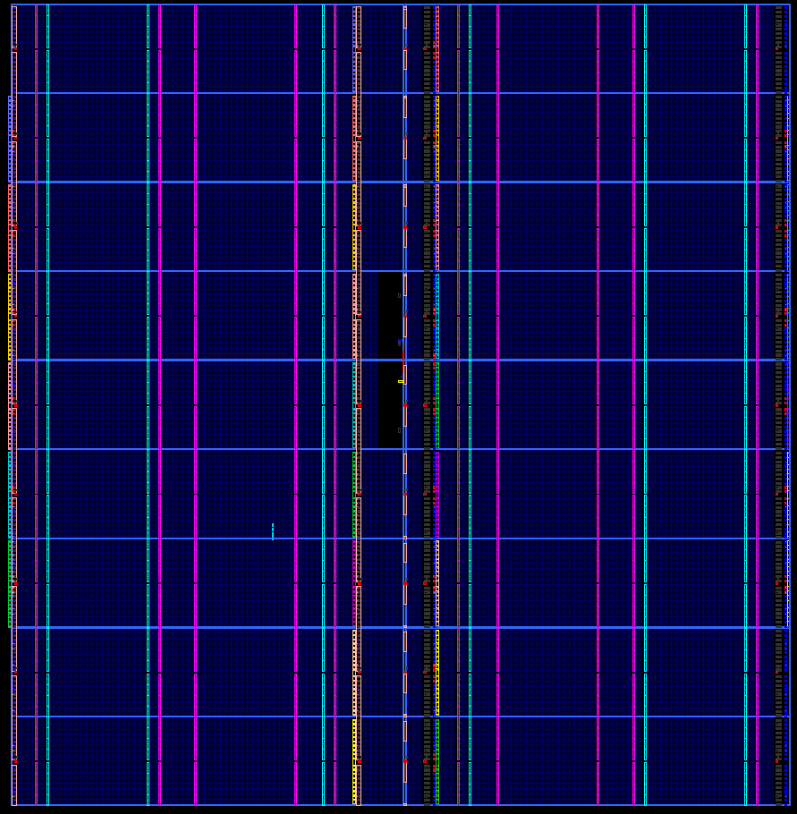
14820 sim-adds
1,037,400,000,000
additions/second
32-bit
integer
Adder
(32/474,240)
>700MHz
332x1440
XC6VLX760 758,784 logic cells, 864 DSP blocks,
1,440 dual ported 18Kb RAMs

Slide 3
The holy grail
The program (software)
Magic
Gates (hardware)
Software is quick to write
Gates are fast and power-efficient to run
FPGAs make it seem tantalisingly close

Slide 4
Reality
Does not work
The program (software)
Magic
Gates (hardware)
Programs are
  Recursive
  Dynamic
  Use the heap
Hardware is
  Iterative
  Static
  No heap
This talk: towards bridging the gap

Slide 5
function addtree (a : int_array) return integer is
variable len, offset : natural ;
variable lhs, rhs : integer ;
begin
len := a'length ;
offset := a'left(1) ;
if len = 1 then
return a(offset) ;
else
lhs := addtree (a(offset to offset+len/2-1)) ;
rhs := addtree (a(offset+len/2 to offset+len-1)) ;
return lhs + rhs ;
end if ;
end function addtree ;

Slide 6
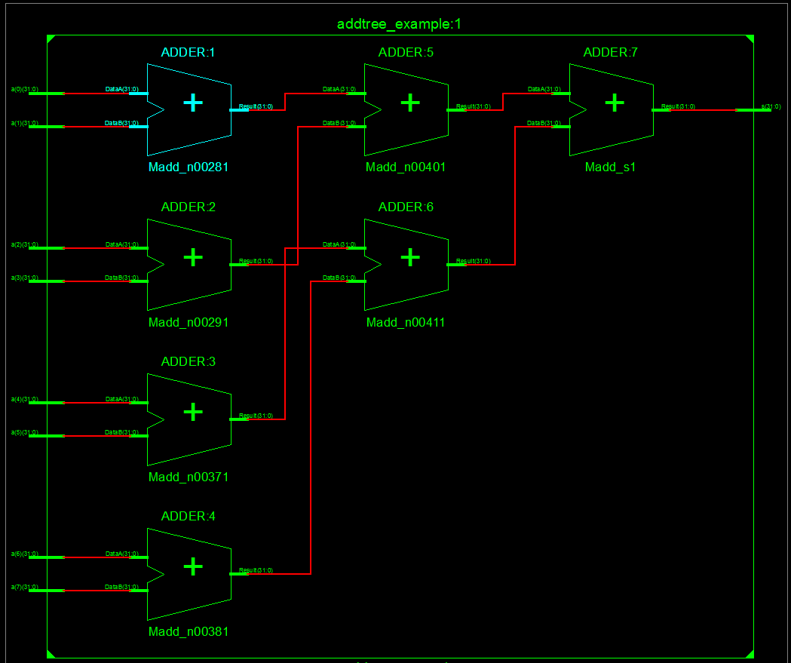

Slide 7
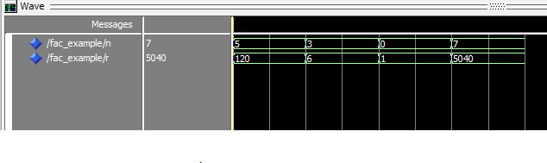
entity fac_example is
port (signal n : in natural ;
signal r : out natural) ;
end entity fac_example ;
architecture behavioural of fac_example is
function fac (n : in natural) return natural is
begin
if n <= 1 then
return 1 ;
else
return n * fac (n-1) ;
end if ;
end function fac ;
begin
r <= fac (n) ;
end architecture behavioural ;

Slide 8
c := a + b ; -- cycle 0
d := 2 * c ; -- cycle 1
e := d – 5; -- cycle 2
process
variable state : integer := 0 ;
variable c, d, e : integer ;
begin
wait until clk’event and clk=‘1’;
case state is
when 0 => c := a + b ; state := 1 ;
when 1 => d := 2 * c ; state := 2 ;
when 2 => e := d – 5 ; state := 3 ;
when others => null ;
end case ;
end process ;

Slide 9
entity fibManual is
port (signal clk, rst : in bit ;
signal n : in natural ;
signal n_en : in bit ;
signal f : out natural ;
signal f_rdy : out bit) ;
end entity fibManual ;
use work.fibManualPackage.all ;
use work.StackPackage.all;
architecture manual of fibManual is
begin
compute_fib : process
variable stack : stack_type := (others => 0) ;
variable stack_index : stack_index_type := 0 ; -- Points to next free elem
variable state : states := ready ;
variable jump_stack : jump_stack_type ;
variable jump_index : stack_index_type := 0 ;
variable top, n1, n2, fibn1, fibn2, fib : natural ;
begin
wait until clk'event and clk='1' ;
if rst = '1' then
stack_index := 0 ;
jump_index := 0 ;
state := ready ;
else
case state is
when ready => if n_en = '1' then -- Ready and got new input
-- Read input signal into top of stack
top := n ;
push (top, stack, stack_index) ;
-- Return to finish
push_jump (finish_point, jump_stack, jump_index) ;
state := recurse ; -- Next state top of recursion
end if ;
when recurse
=> pop (top, stack, stack_index) ;
case top is
when 0 => push (top, stack, stack_index) ;
-- return
pop_jump (state, jump_stack, jump_index) ;
when 1 => push (top, stack, stack_index) ;
-- return
pop_jump (state, jump_stack, jump_index) ;
when others => -- push n onto the stack for use by s1
push (top, stack, stack_index) ;
-- push n-1 onto stack
n1 := top - 1 ;
push (n1, stack, stack_index) ;
-- set s1 as the return point
push_jump (s1, jump_stack, jump_index) ;
-- recurse
state := recurse ;
end case ;

Slide 10
when s1 => -- n and fib n-1 has been computed and is on the stack
-- now compute fib n-2
pop (fibn1, stack, stack_index) ; -- pop fib n-1
pop (top, stack, stack_index) ; -- pop n
push (fibn1, stack, stack_index) ; -- push fib n-1 for s2
n2 := top - 2 ;
push (n2, stack, stack_index) ; -- push n-2
-- set s2 as the jump point
push_jump (s2, jump_stack, jump_index) ;
-- recurse
state := recurse ;
when s2 => pop (fibn2, stack, stack_index) ;
pop (fibn1, stack, stack_index) ;
fib := fibn1 + fibn2 ;
push (fib, stack, stack_index) ;
-- return
pop_jump (state, jump_stack, jump_index) ;
when finish_point => pop (fib, stack, stack_index) ;
f <= fib ;
f_rdy <= '1' ;
state := release_ready ;
stack_index := 0 ;
jump_index := 0 ;
when release_ready => f_rdy <= '0' ;
state := ready ;
end case ;
end if ;
end process compute_fib ;
end architecture manual ;

Slide 11
PLDI 1998
Notes:
Papers based on experimental results made clear the urgent need for a better way to produce embedded software.

Slide 12
PLDI 1999
Notes:
Random abstract graph indicating experimental nature of PLDI papers.

Slide 13
PLDI 2000
Notes:
Random abstract graph indicating experimental nature of PLDI papers.

Slide 14
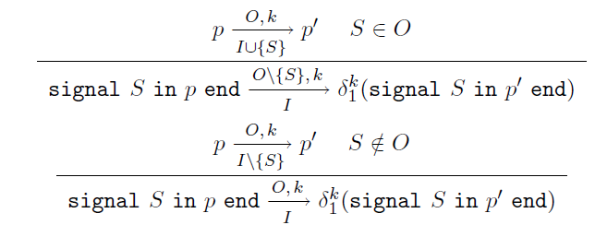
POPL 1998
Notes:
Theoretically based conferences grappled with the theory and semantics of systems suitable for producing embedded systems (slides of random definitions and proofs).

Slide 15
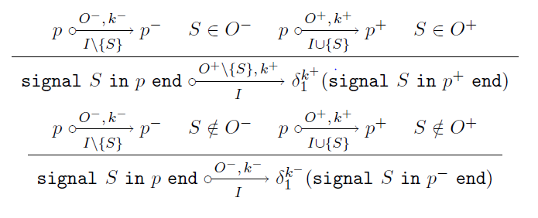
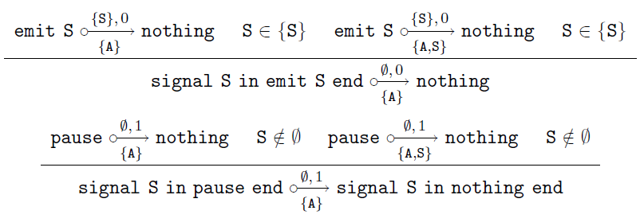
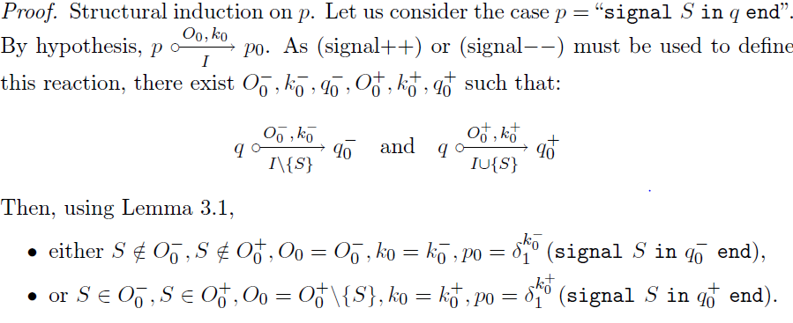
POPL 1999

Slide 16
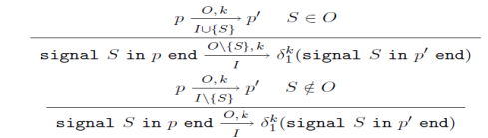
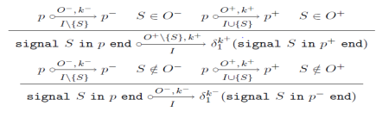
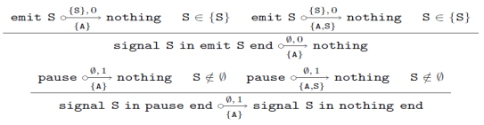
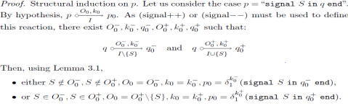
POPL 2000

Slide 17





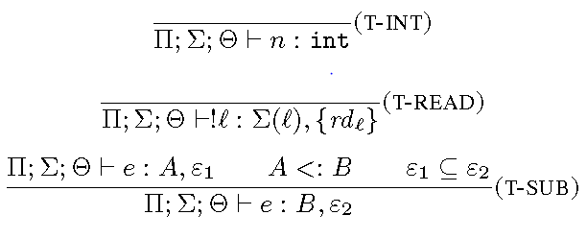

Slide 18
Our goal
Write a functional program, with
  Unrestricted recursion
  Algebraic data types
  Heap allocation
Compile it quickly to FPGA
Main payoff: rapid development, exploration
Non-goal: squeezing the last drops of performance from the hardware
Generally: significantly broaden the range of applications that can be directly compiled into hardware with no fuss

Slide 19
Applications
Searching tree-structured dictionaries
Directly representing recursive algorithms in hardware
Huffman encoding
Recursive definitions of mathematical operations

Slide 20
Compiling programs to hardware
First order functional language
Inline (absolutely) all function calls
Result can be directly interpreted as hardware
Every call instantiates a copy of that function’s RHS
No recursive functions
[Readily extends to unrolling recursive functions with statically known arguments]

Slide 21
Our simple idea
Extend “Every call instantiates a copy of that function’s RHS” to recursive functions
fib :: Int -> Int
fib 0 = 1
fib 1 = 1
fib n = 1 + fib (n-1) + fib (n-2)
main x y = fib x * fib y
x
fib
*
y
fib

Slide 22
Our simple idea
Extend “Every call instantiates a copy of that function’s RHS” to recursive functions
fib :: Int -> Int
fib 0 = 1
fib 1 = 1
fib n = 1 + fib (n-1) + fib (n-2)
main x y = fib x * fib y
Question: what is in these “fib” boxes?
x
fib
*
y
fib

Slide 23
Our simple idea
Extend “Every call instantiates a copy of that function’s RHS” to recursive functions
fib :: Int -> Int
fib 0 = 1
fib 1 = 1
fib n = 1 + fib (n-1) + fib (n-2)
main x y = fib x * fib y
Non-answer: instantiate the body of fib
fib
-1
fib
+
+1
-2
fib

Slide 24
Our “island” intermediate language
Haskell
Island intermediate language
“Straightforward”
VHDL
Easy
FPGA
CPS conversion
The Island Intermediate Language is
  Low level enough that it’s easy to convert to VHDL
  High level enough that it’s (fairly) easy to convert Haskell into it

Slide 25
!

Slide 26
fib in IIL
fib :: Int -> Int
fib 0 = 1
fib 1 = 1
fib n = 1 + fib (n-1) + fib (n-2)
island {
fib n = case n of
0 -> return 1
1 -> return 1
_ -> let n1 = n-1
in recurse n1 [s1 n]
s1 n r1 = let n2 = n-2
in recurse n2 [s2 r1]
s2 r1 r2 = let r = 1+r1+r2
in return r }

Slide 27
fib :: Int -> Int
fib 0 = 1
fib 1 = 1
fib n = 1 + fib (n-1) + fib (n-2)
s1, s2 correspond to return addresses, or continuations.
Converting to IIL is just CPS conversion
But there are choices to make
Entry point
Pop stack; apply saved state to result (i.e. 1)
island {
fib n = case n of
0 -> return 1
1 -> return 1
_ -> let n1 = n-1
in recurse fib n1 [s1 n]
[s1 n] r1 = let n2 = n-2
in recurse fib n2 [s2 r1]
[s2 r1] r2 = let r = 1+r1+r2
in return r }
Start again at entry point, pushing [s1 n] on stack
Resume here when [s1 n] is popped

Slide 28
fib in IIL
fib :: Int -> Int
fib 0 = 1
fib 1 = 1
fib n = 1 + fib (n-1) + fib (n-2)
island {
fib n = case n of
0 -> return 1
1 -> return 1
_ -> let n1 = n-1
in recurse fib n1 [s1 n]
[s1 n] r1 = let n2 = n-2
in recurse fib n2 [s2 r1]
[s2 r1] r2 = let r = 1+r1+r2
in return r }
State | Stack
fib 2 | ε
fib 1 | [s1 2]:ε
[s1 2] 1 | ε
fib 0 | [s2 1]:ε
[s2 1] 1 | ε
return 3
Each step is a combinatorial computation, leading to a new state

Slide 29
fib :: Int -> Int
fib 0 = 1
fib 1 = 1
fib n = 1 + fib (n-1) + fib (n-2)
Registers (state, memory)
State | X1
s1 | 2
s2 | 7
Top
Arg
island {
fib n = case n of
0 -> return 1
1 -> return 1
_ -> let n1 = n-1
in recurse n1 [s1 n]
[s1 n] r1 = let n2 = n-2
in recurse n2 [s2 r1]
[s2 r1] r2 = let r = 1+r1+r2
in return r }
s1
s2
Arg:=1+X1+Arg
Push [s1 Arg];
Arg := Arg-2
Pop
fib
Arg>1; Push [s1 Arg];
Arg:=Arg-1
Arg <= 1; Arg:=1
Pop

Slide 30
data IIR
= ADD IIRExpr IIRExpr IIRExpr
| SUB IIRExpr IIRExpr IIRExpr
| MUL IIRExpr IIRExpr IIRExpr
| GREATER IIRExpr IIRExpr IIRExpr
| EQUAL IIRExpr IIRExpr IIRExpr
…
| ASSIGN IIRExpr IIRExpr
| CASE [IIR] IIRExpr [(IIRExpr, [IIR])]
| CALL String [IIRExpr]
| TAILCALL [IIRExpr]
| RETURN IIRExpr
| RECURSE [IIRExpr] State [IIRExpr]
deriving (Eq, Show)

Slide 31
fib :: Int -> Int
fib 0 = 0
fib 1 = 1
fib n
= n1 + n2
where
n1 = fib (n – 1)
n2 = fib (n - 2)

Slide 32
$ ./haskell2vhdl Fib.hs
Compiling Fib.hs
Writing Fib_fib.vhd ... [done]

Slide 33
STATE 1 FREE
PRECASE
ds1 := ds
CASE ds1
WHEN 1 =>
RETURN 1
WHEN 0 =>
RETURN 0
WHEN others =>
v0 := ds1 - 2
RECURSE [v0] 2 [ds1]
END CASE
STATE 3 FREE n2
n1 := resultInt
v2 := n1 + n2
RETURN v2
STATE 2 FREE ds1
n2 := resultInt
v1 := ds1 - 1
RECURSE [v1] 3 [n2]

Slide 34
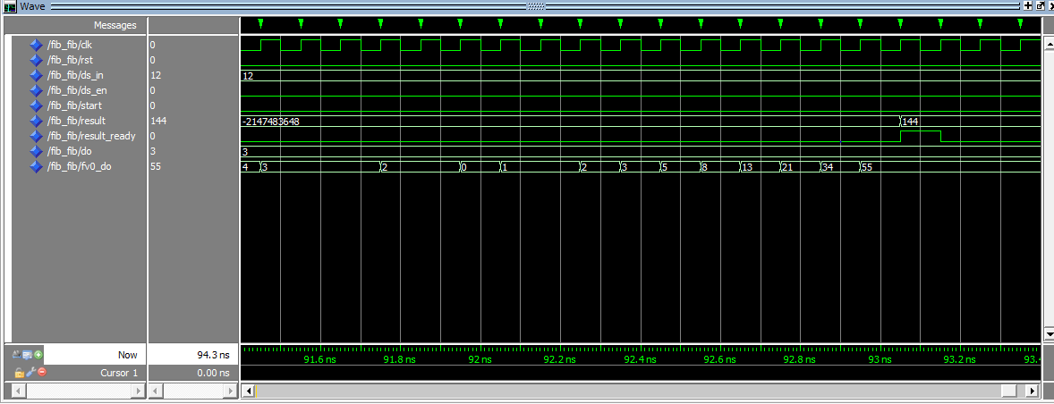

Slide 35
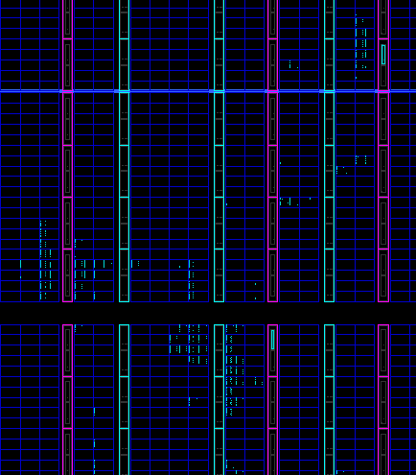

Slide 36
gcd_dijkstra :: Int -> Int -> Int
gcd_dijkstra m n
= if m == n then
m
else
if m > n then
gcd_dijkstra (m - n) n
else
gcd_dijkstra m (n - m)

Slide 37
STATE 1 FREE
PRECASE
v0 := m == n
wild := v0
CASE wild
WHEN true =>
RETURN m
WHEN false =>
PRECASE
v1 := m > n
wild1 := v1
CASE wild1
WHEN true =>
v2 := m - n
TAILCALL [v2, n]
WHEN false =>
v3 := n - m
TAILCALL [m, v3]
END CASE
END CASE

Slide 38
$ make gcdtest
# Time: 1450 ns Iteration: 1 Instance: /gcdtest/fib_circuit
# ** Note: Parameter n = 6
# Time: 1450 ns Iteration: 1 Instance: /gcdtest/fib_circuit
# ** Note: GCD 12 126 = 6
# Time: 1500 ns Iteration: 0 Instance: /gcdtest
# quit

Slide 39
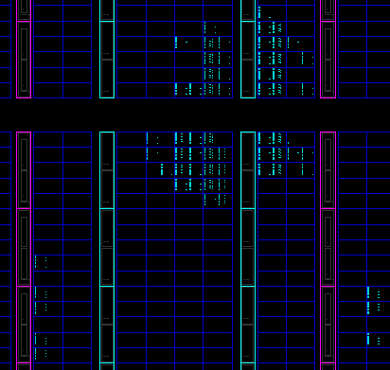

Slide 40
fib :: Int -> Int
fib 0 = 0
fib 1 = 1
fib n
= n1 + n2
where
n1 = fib (n - 1)
n2 = fib (n - 2)

