Slide 1
Putting the thrill back into computing at School
Simon Peyton Jones
Microsoft Research
and
The Computing at School Working Group

Slide 2
What is going on?
An increasing sense of unease about the way we teach our kids about computing. Something here is Not Right

Slide 3
Information and
Communication
Technology

Slide 4
ICT is failing our kids
The most exciting discipline on the planet comes over as dull and de-motivating
“The image of IT-related degrees and careers was that they would be repetitive, boring, and more-of-the-same; for example use of IT office applications such as word processing, spreadsheets, and databases”. The next bullet says “The ICT GCSE had a major part to play in creating their (negative) impressions”. [2008 “IT & Telecoms Insight Report” published by Eskills UK]
“The assessment requirements of some vocational qualifications may actually be limiting students’ achievement. In many of the schools visited, higher-attaining students were insufficiently challenged....much of the work in ICT at Key Stage 4, particularly for the higher attainers, often involved consolidating skills that students had already gained proficiency.” [2009 Ofsted report “The importance of ICT”]

Slide 5
Teachers agree
“It’s the biggest sales environment ever. Always going for figures, always going for 100%. ICT is purely there to boost the results in my school, that’s all it’s there for.”
“I’m afraid I’ve done enough dragging students through qualifications, it’s demoralising and it’s morally wrong, so I’m moving on”
“Half the year group choose ICT because they enjoyed it so much at KS3, but then KS4 just squeezes the creativity out, it sucks the life out of the subject and they hate it”
“The exam is just so easy compared to the silly amount of effort they have to put into doing the coursework in order to get basic grades… my kids do no work for the exams and do really well at them”

Slide 6
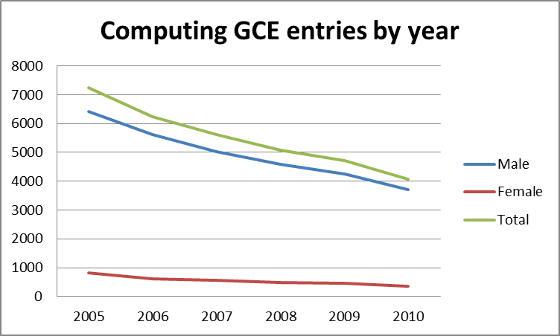
A-level Computing decline

Slide 7
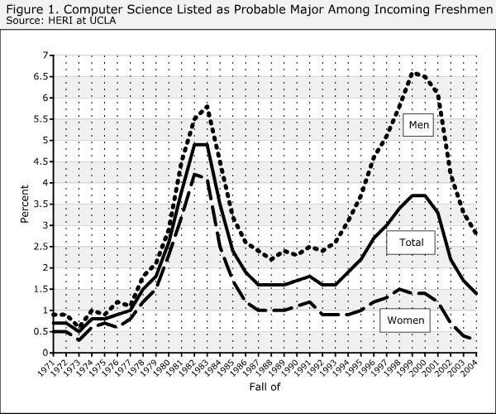
University trends 1970-2005
Source: CRA, May 2005

Slide 8
What is going on?
An increasing sense of unease about the way we teach our kids about computing. Something here is Not Right
2008: let’s fix this. Birth of the Computing at School Working Group.

Slide 9
The Computing At School working group (CAS)
Simply a group of individuals, concerned about the state of computing education at school in the UK
Varied backgrounds, common concerns
Teachers
Industry (eg Google, Microsoft)
University academics (incl CPHC, UKCRC)
Members of exam board (eg AQA)
Members of professional societies (eg BCS)
Parents
Local educational advisers
Teacher trainers
Now fully part of BCS, the Chartered Institute for IT
No staff, no money, no office. All volunteers

Slide 10
Diagnosis
Disciplines
Principles, ideas
Knowledge, laws
Techniques, methods
Broadly applicable
Dates slowly
Skills
Technology, artefacts
Machines
Programs
Products
Organisations
Business processes
Dates quickly
Physics, chemistry, mathematics, English
Budgeting, presentation skills, metalwork, textiles

Slide 11
Diagnosis
Computer Science
(discipline)
Barely taught
ICT
(technology focused)
Dominant
Spreadsheets
Databases
Powerpoint
Using the web
Safety on the internet
Plan communication projects
Analysing and automating processes
Principles
Ideas
Laws
Broadly applicable
But needs application
Dates slowly
No KS4 qualification at all (2009)
Range of 14+ different KS4 qualifications

Slide 12
Headline messages
Computer Science should be recognised in school as a rigorous subject discipline, like physics or history, quite distinct from the (useful) skills of digital literacy.
Just as every student needs to learn a bit of chemistry, even though few will become chemists, so every student should learn a bit of computer science (including some elementary programming) because they live in a digital world.
From primary school onwards (like science).
Re-introduce the thrill and excitement of computational thinking and creation.

Slide 13
Headline messages
Computer Science should be recognised in school as a rigorous subject discipline, like physics or history, quite distinct from the (useful) skills of digital literacy.
Just as every student needs to learn a bit of chemistry, even though few will become chemists, so every student should learn a bit of computer science (including some elementary programming) because they live in a digital world.
From primary school onwards (like science).
Re-introduce the thrill and excitement of computational thinking and creation.
NB Computer Science, not just programming

Slide 14
What is going on?
An increasing sense of unease about the way we teach our kids about computing
2008: let’s fix this. Birth of the Computing at School Working Group.
2008-11: chug chug chug

Slide 16
What is CAS doing?
Influencing national policy
Computing: a curriculum for schools
Directly support teachers
“on the ground”

Slide 17
If we say Computing is a discipline,
we have to say what it is
Need to tell ourselves
Need to tell our head teachers
Need to tell DfE
Need to tell ministers
“Is there a core body of knowledge for Computing that doesn’t change from year to year?” DfE offical, June 2011

Slide 18
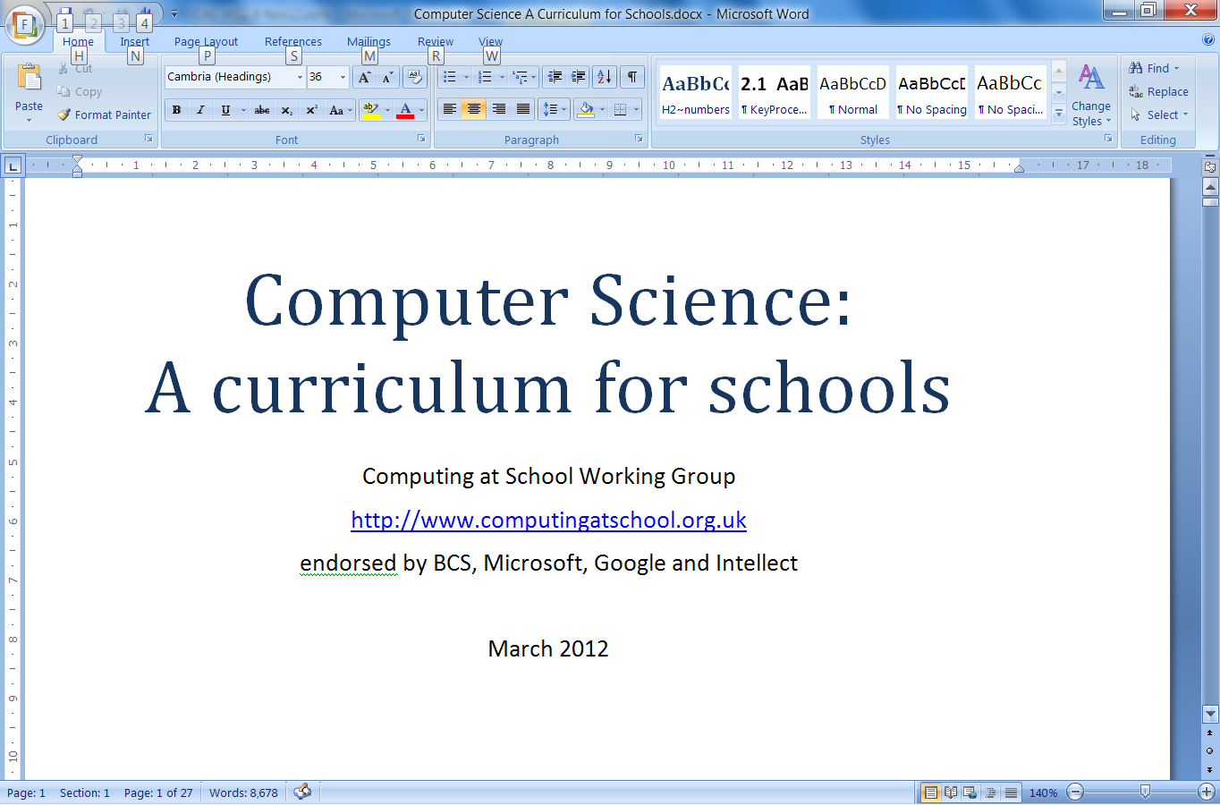

Slide 20
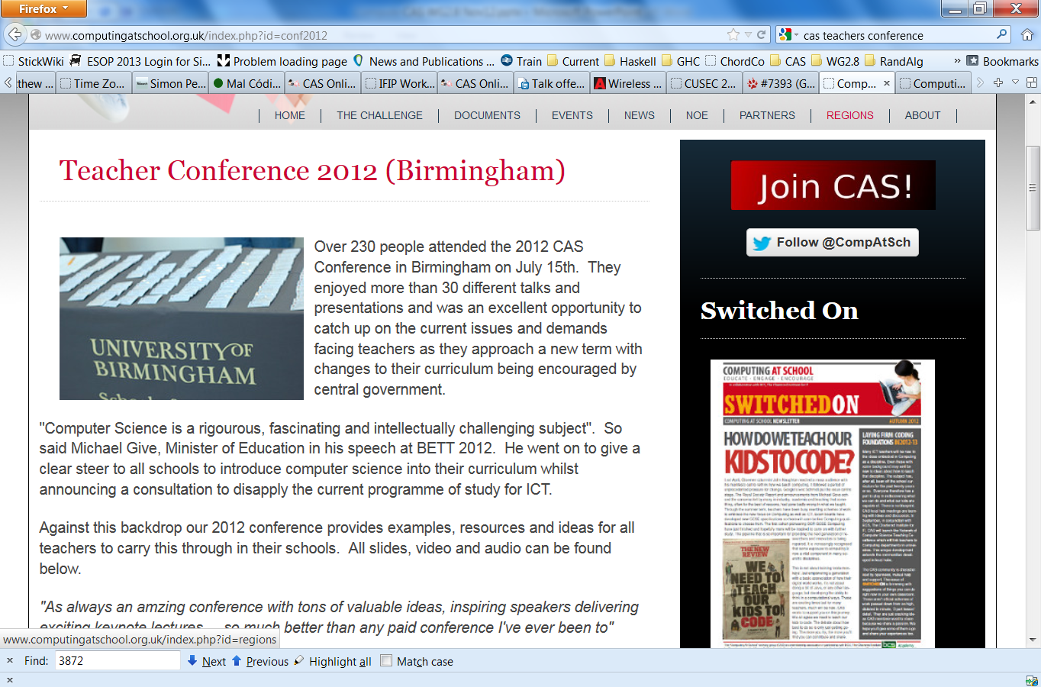

Slide 21
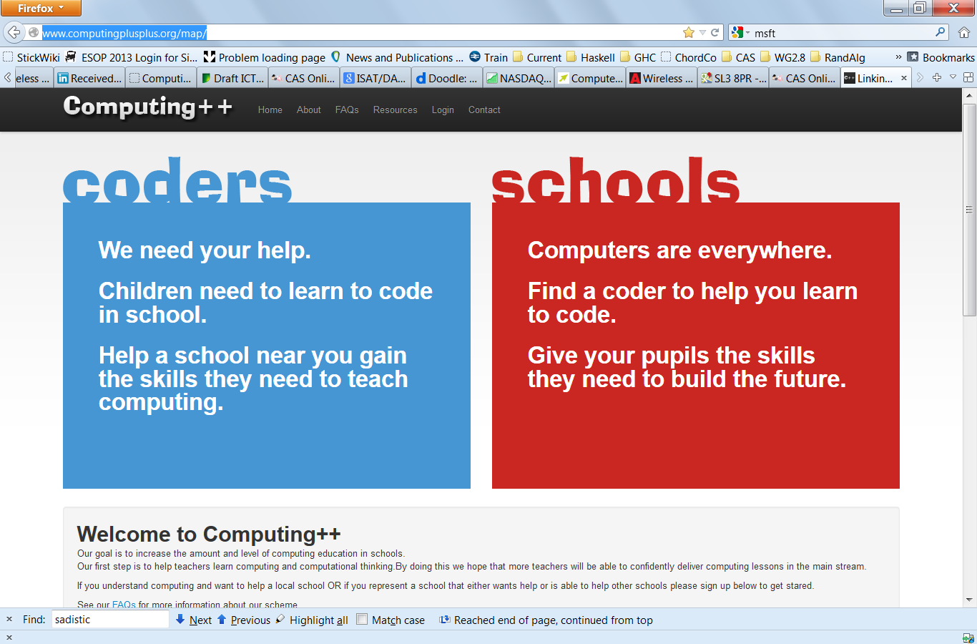

Slide 22
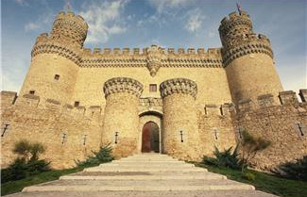

Slide 23
2012: blam!

Slide 24
January 2012: breakthrough
We’re encouraging rigorous Computer Science courses
The new Computer Science courses will reflect what you all know: that Computer Science is a rigorous, fascinating and intellectually challenging subject. Computer Science requires a thorough grounding in logic and set theory, and is merging with other scientific fields into new hybrid research subjects like computational biology.
Although individual technologies change day by day, they are underpinned by foundational concepts and principles that have endured for decades. Long after today’s pupils leave school and enter the workplace – long after the technologies they used at school are obsolete – the principles learnt in Computer Science will still hold true.”
Michael Gove, Jan 2012

Slide 25
High profile reports
Feb 2011: The Livingstone/Hope report
Bring computer science into the National Curriculum as an essential discipline
2011: Ofsted report on ICT
Jan 2012: Royal Society Computing in Schools Report
The current delivery of Computing education in many UK schools is highly unsatisfactory
Computer Science is a rigorous academic discipline and needs to be recognised as such in schools
Every child should have the opportunity to learn Computing at school

Slide 26
Qualifications
 | Awarding bodies | Number of GCSEs in Computer Science
Sept 2009 |  | 0
Sept 2010 | OCR | 1
Sept 2012 | AQA, Edexcel, WJEC | 4
Sept 2013 | CIE | 5

Slide 27
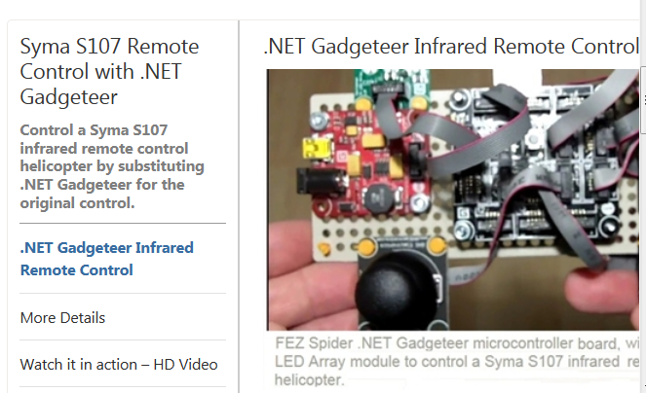
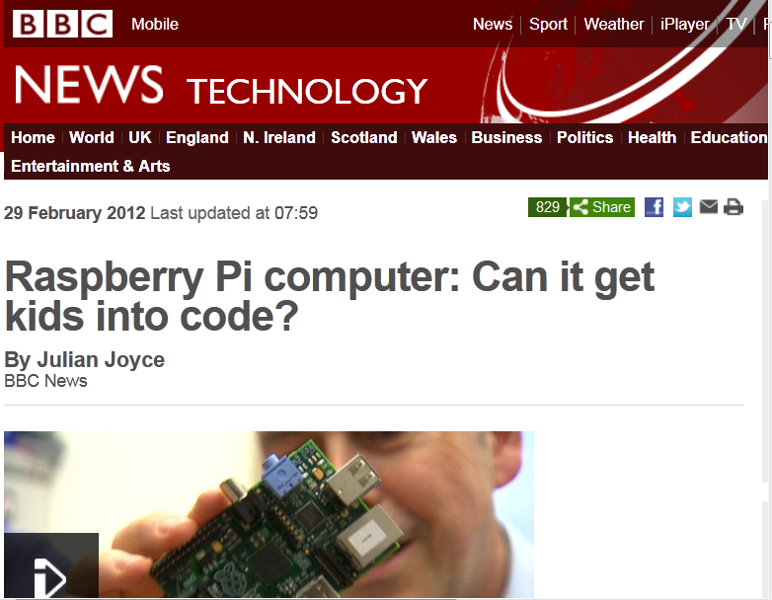
New dirt-cheap hardware platforms

Slide 28
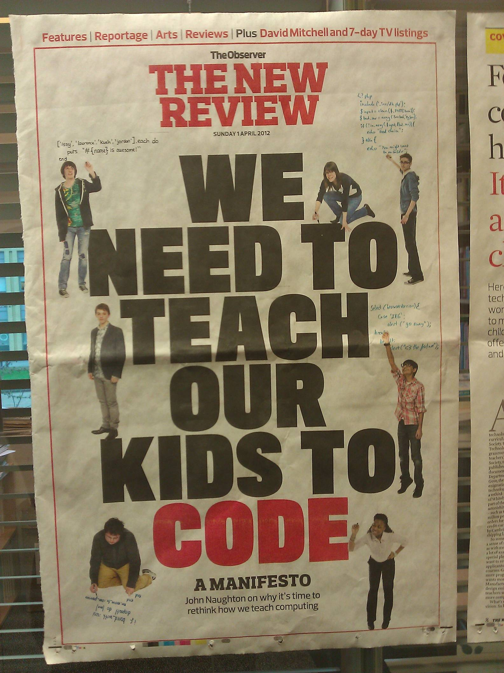
Amazing
media coverage
e.g Observer
1 April 2012

Slide 29
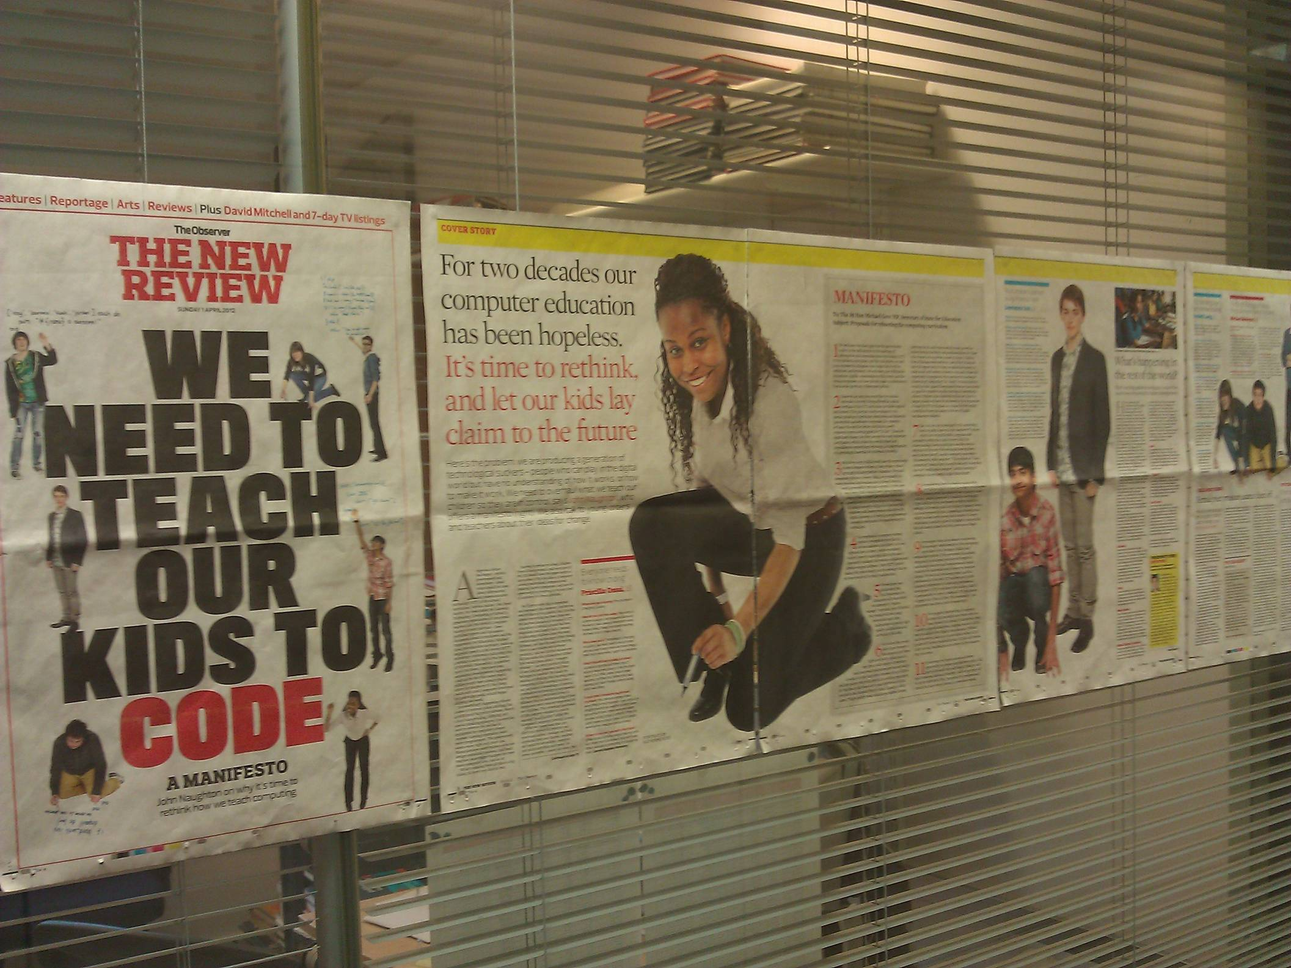

Slide 30
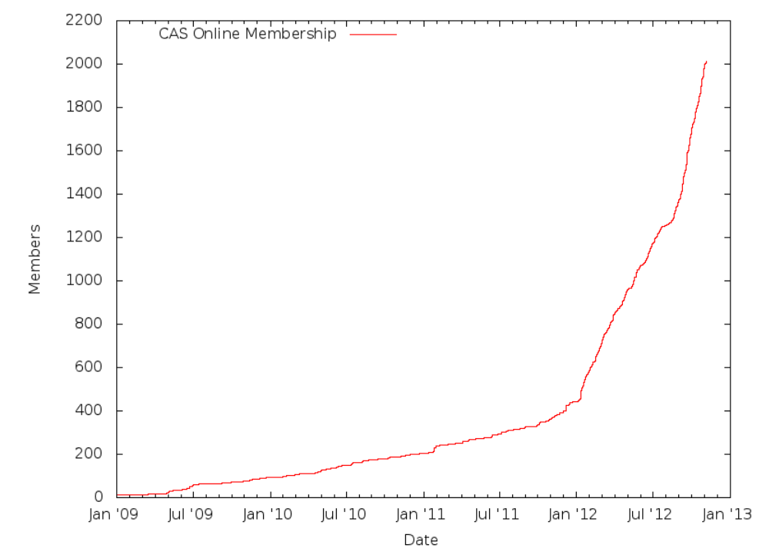

Slide 31
Curriculum
June 2012: Secretary of State Gove withdraws the National Curriculum for ICT (although ICT will remain compulsory). Schools are now free to teach whatever they want under that title.
Sept 2012: SLPJ asked to chair group to write the new National Curriculum for ICT

Slide 32
Bottom line
Situation unrecognisable compared to 12 months ago. The ice has melted. Everything is in flux.
The DfE is treating ICT/CS as a guinea pig. They are consciously “standing back” to allow “the community” to sort it out.
Internally, DfE now takes it as given that CS is a rigorous subject that should be taught at school
Opportunity – and danger.

Slide 33
Battle
War

Slide 34
Challenge: training teachers
Short-medium term: existing ICT teachers are under-qualified; but many are eager to learn. Major CPD programme is required.
Medium-long term: initial teacher training for computer science teachers

Slide 35
Training teachers
2 weeks ago, Gove announced
£20,000 scholarships for would-be Computer Science teachers, just like Physics
£150,000 to CAS to support training courses for current ICT teachers

Slide 36
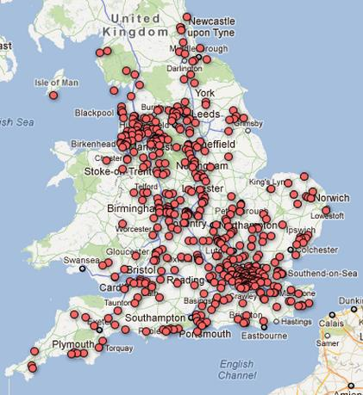
CPD and the Network of Excellence
CAS has launched a national Network of Excellence and CPD programme
500 schools signed up in six weeks
Universities deliver CPD to their local schools (need to work on links to you)
Master teachers seconded 1 afternoon/week to package their SoWs etc for others to use

Slide 37
What have we learned?

Slide 38
Lessons
Broadly based; not just teachers
Simple message, emphasis on CS as a discipline, like science
CAS Curriculum immensely helpful
Realisation that the status quo is undefended
Many, many stakeholders => many meetings
Partnership, not competition with other groups

Slide 39
Our friends... we love you
Apps for Good
Technocamps
cs4fn
Code Clubs
Raspberry Pi
Hack to the future
YouSrc
Codeacademy
Coding for kids
Young Rewired State
NextGen skills campaign
Games Britannia

Slide 40
Lessons
Civil servants, and even politicians, are trying to do the Right Thing
You can turn from a guerrilla group into a group that the government looks to for policy advice, in a blink
Networks matter. One meeting leads to another.
Luck has played a part; notably the change of government.
Centralised nature of UK education has helped

Slide 41
www.computingatschool.org.uk

Slide 42
http://www.computingatschool.org.uk (follow the “Documents” link)
The same structure as NC Programmes of Study (but in more detail)
Importance of the subject
Key concepts
Key processes (what students should be able to do)
Range and content (what students should know)
Level descriptors
Total 22 pages.

Slide 43
General aims
Focus on fundamentals
Not much change year to year
Not much about Facebook, YouTube, mobile phones
Focus on what the subject is, not how it should be taught
You add the “how”
Initial focus on secondary (KS3, KS4). We are now adding primary (KS1, KS2) in the next few months.
Ambitious but do-able

Slide 44
What is CAS doing?
Influencing national policy
Computing: a curriculum for schools
Directly support teachers
“on the ground”

Slide 45
Teachers: the myth
ICT teachers are not very good
They are happy with the status quo
They couldn’t teach computer science even if we wanted them to
So: we are stuck at Square 1

Slide 46
Teachers: the reality
Most teachers live and die for their students: they work nights
Few are happy with the status quo
It’s the biggest sales environment ever. Always going for figures, always going for gold, always going for 100%. ICT is purely there to boost the results in my school, that’s all it’s there for.
I’m afraid I’ve done enough dragging students through qualifications, it’s demoralising and it’s morally wrong, so I’m moving on
Half the year group choose ICT because they enjoyed it so much at KS3, but then KS4 just squeezes the creativity out, it sucks the life out of the subject and they hate it
The exam is just so easy compared to the silly amount of effort they have to put into doing the coursework in order to get basic grades… my kids do no work for the exams and do really well at them

Slide 47
Teachers: the reality
Many teachers are longing to introduce computing, but they feel
isolated (seldom more than one ICT specialist in a school)
under-qualified (even specialist ICT teachers seldom have a computer science degree)
under the gun for results (a Computing GCSE will be demanding)
But they are keen. Very keen. Very very keen.

Slide 48
There is a lot we can do to help
Annual CAS Teachers Conference (June)
Teaching material, classroom resources
Local hubs
Training courses (residential, distance, teachshares)
Sixth form conferences
Newsletter (once a term)
STEM ambassadors (embryonic)
Teacher-practitioner exchange

Slide 49
What is CAS doing?
Influencing national policy
Computing: a curriculum for schools
Directly support teachers
“on the ground”

Slide 50
In short…
The cat is among the pigeons. Everything is in motion: it is a time of opportunity
The Government is explicitly stepping back and saying “you fix it”
So much to do:
Schools and teachers are beset by FUD
Danger that they’ll simply drop ICT altogether
Crying need for teacher training
And advocacy by parents, governors..
Huge opportunity

Slide 51
What people here might do
Join CAS – lurk on the mailing list
Give a talk at your local hub – or help to organise one
Help with Technocamps or after school clubs
Talk to school governors about whether computing is on their curriculum radar
Contribute to infrastructure: Raspberry Pi, Gadgeteer, web presence
Help fix the School Infrastructure Problem (can’t teach programming because the network is mission-critical)

